Slide 1

Emergency Relief Vent
+91 9156463116/5/4
sales@vcplin.com
www.vcplin.com

Slide 2
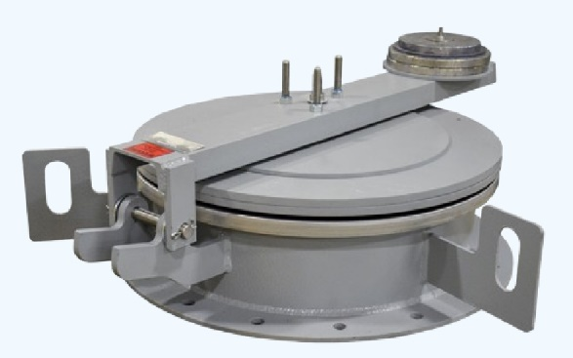
Reliable Emergency Vent Solutions by Ventil
Your Trusted Pressure Relief Device Manufacturer in India
Ventil offers high-performance emergency vents that ensure safety in pressure-sensitive systems. As a leading emergency vent manufacturer in India, we specialize in designing and manufacturing emergency relief valves, also called storage tank emergency vents, to prevent equipment damage during abnormal pressure surges.
+91 9156463116/5/4
sales@vcplin.com
www.vcplin.com

Slide 3
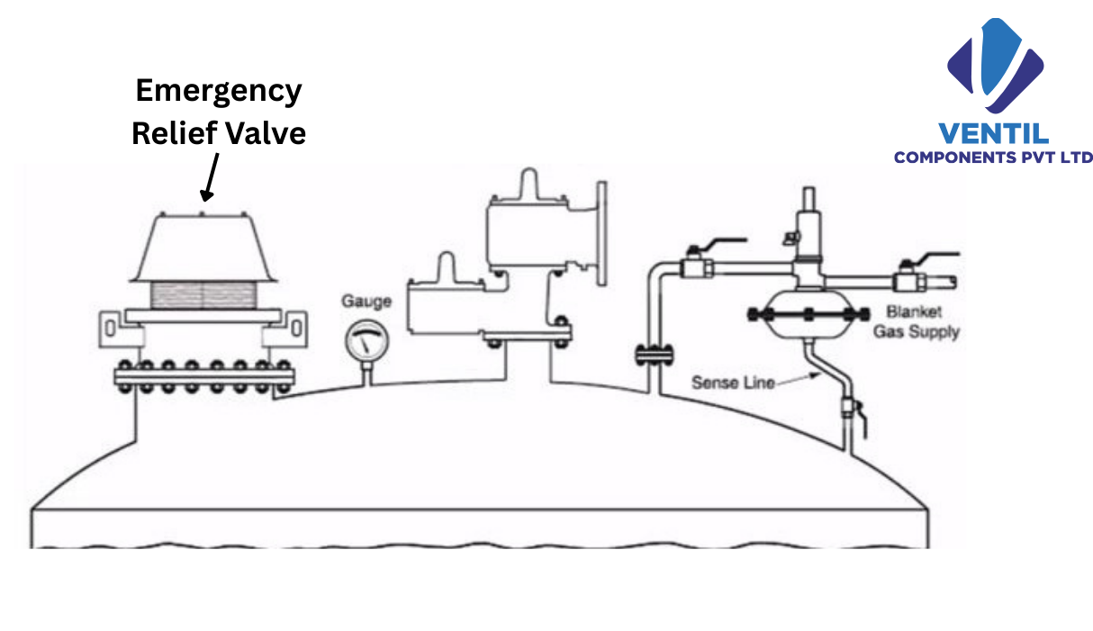
What is an Emergency Vent?
An emergency vent (also referred to as an emergency relief vent or emergency valve) is a critical
safety device designed to relieve excess internal pressure in storage tanks during emergency
scenarios such as fire exposure or rapid pressure build-up. These devices act as pressure release
valves, allowing gas or vapor to escape safely, thereby preventing structural failure
+91 9156463116/5/4
sales@vcplin.com
www.vcplin.com

Slide 4
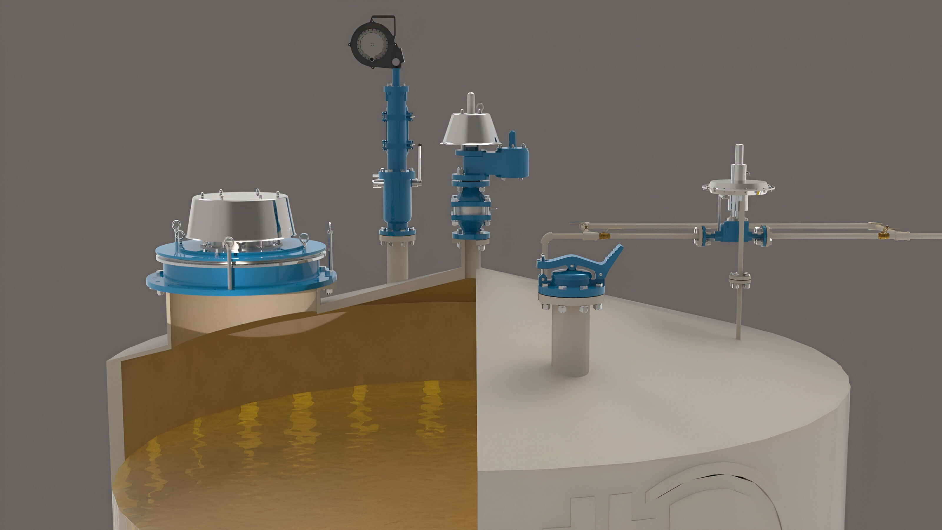
Features of Ventil Emergency Relief Vents
Size: 6" to 24" - End Connection: Flanged to ANSI B 16.5 #150 RF
Body Material: CS, SS304, SS316 - Type: Hinged/ Spring Load
+91 9156463116/5/4
sales@vcplin.com
www.vcplin.com

Slide 5
Features of Ventil Emergency Relief Vents
Body Material: CS, SS304, SS316
Type: Hinged/ Spring Load
Pressure and vacuum relief valve integration
High-capacity vent pressure control
Fast-acting emergency venting mechanism
Suitable for emergency vent for storage tanks
Designed as both pressure relief valves and vacuum relief solutions
Available in spring-loaded and weight-loaded variants
+91 9156463116/5/4
sales@vcplin.com
www.vcplin.com

Slide 6
Why Choose Ventil Emergency Vents?
Made in India with global standards
Compatible with fuel tank emergency vent and storage tank emergency vent systems.
Robust build and corrosion-resistant materials.
Reliable performance under extreme conditions
+91 9156463116/5/4
sales@vcplin.com
www.vcplin.com

Slide 7
Trusted Across Industries
Made in India with global standards
Compatible with fuel tank emergency vent and storage tank emergency vent systems.
Robust build and corrosion-resistant materials.
Reliable performance under extreme conditions
+91 9156463116/5/4
sales@vcplin.com
www.vcplin.com

Slide 8
Get in Touch
Looking for a trusted emergency vent manufacturer in India? Connect with Ventil for customized emergency venting and pressure relief device solutions. Contact us today to request a quote or consultation
Get the Best Emergency Vent for Your Industry from Ventil!
+91 9156463116/5/4
sales@vcplin.com
www.vcplin.com

Slide 9
Conclusion
Ventil provides a complete range of high-performance pressure safety solutions, including rupture discs, bursting discs, flame arrestors, explosion vent, flameless venting and other essential pressure relief components. Designed for reliability and efficiency, our products ensure maximum protection across industries such as, pharmaceuticals, oil & gas, and manufacturing, reinforcing our commitment to safety, innovation, and quality.
+91 9156463116/5/4
sales@vcplin.com
www.vcplin.com

Slide 10




Speak with Our Expert:
Ventil Components Pvt Ltd. 246/9, Maan Hinjawadi, Phase1, Tal- Mulshi, Pune
411057, Maharastra
+91 9156463116/5/4
sales@vcplin.com
www.vcplin.com
+91 9156463116/5/4
sales@vcplin.com
www.vcplin.com

