Slide 1
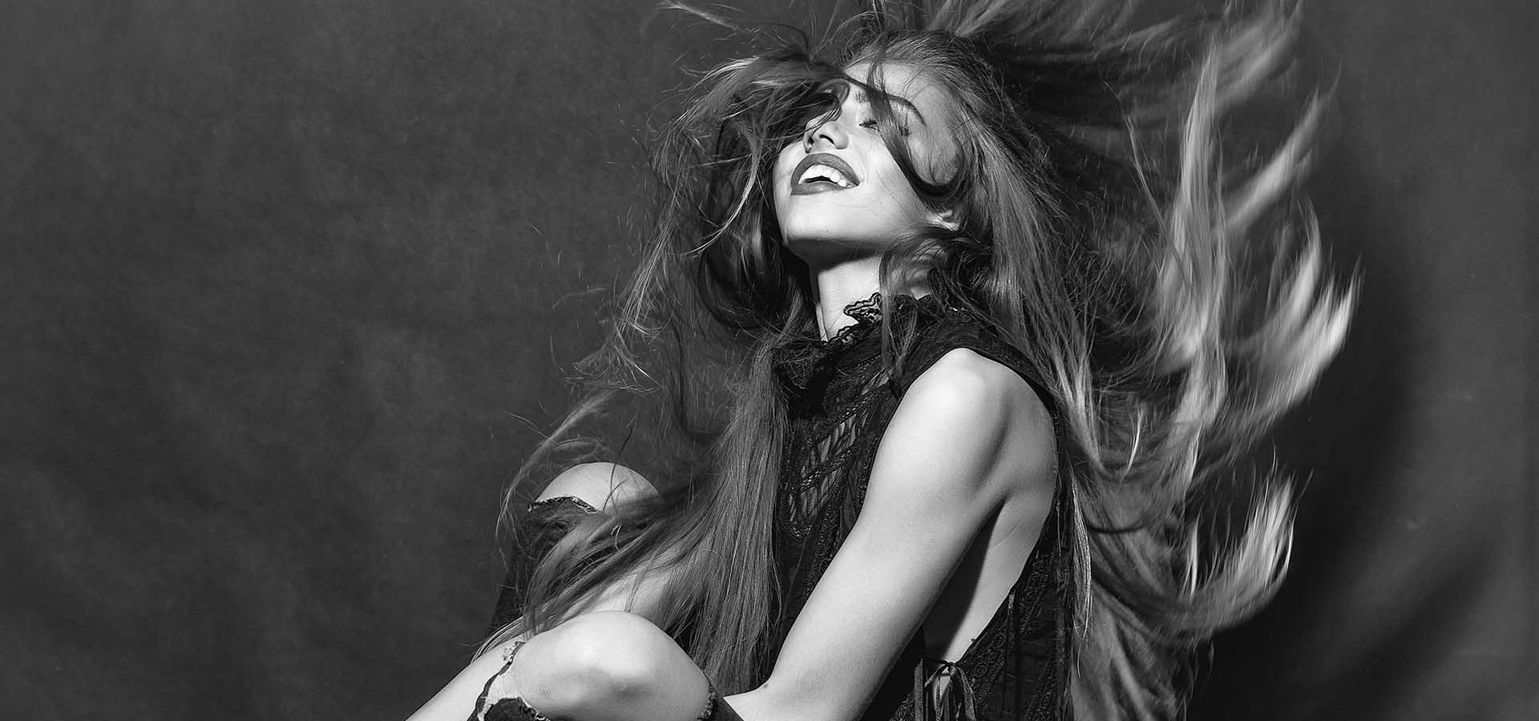



Revolutionizing Laser Treatments
At LaserOne, we are transforming the way hair restoration is approached, offering a pain-free alternative to traditional hair transplants. Our goal is to help you achieve natural, healthy hair regrowth without the discomfort or high costs of surgery.
https://laser-one.co.uk
Notes:
1

Slide 2
About us
Here at LaserOne we are all about you, understanding your situation, your needs and what your desired outcome is. We understand the implications hair loss can have on your mental health and confidence. So why not come and discuss over a nice coffee how we can help restore your confidence and get you on the path to regrow your hair.
https://laser-one.co.uk
Notes:
2

Slide 3
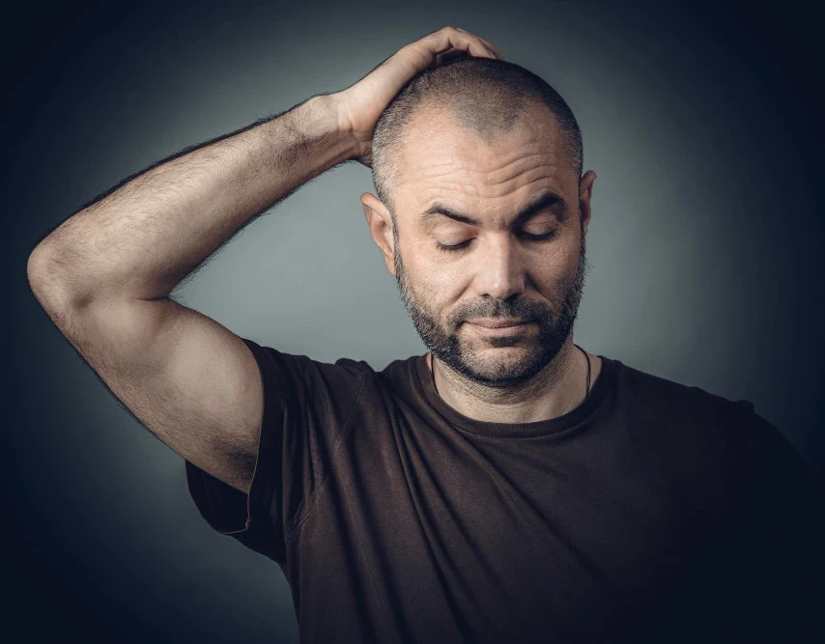
OUR STORY
Hair loss is something I’ve gone through myself, so I get how tough and emotional it can be. For a long time, I thought a hair transplant was the only real option—until I tried laser hair regrowth. The results honestly blew me away. It worked so well for me that I felt compelled to bring this amazing technology to North Essex. At LaserOne, we’re here to help others feel confident again, with treatments that are effective, pain-free, and backed by real experience.
George Barron,
Director
https://laser-one.co.uk
Notes:
3

Slide 4
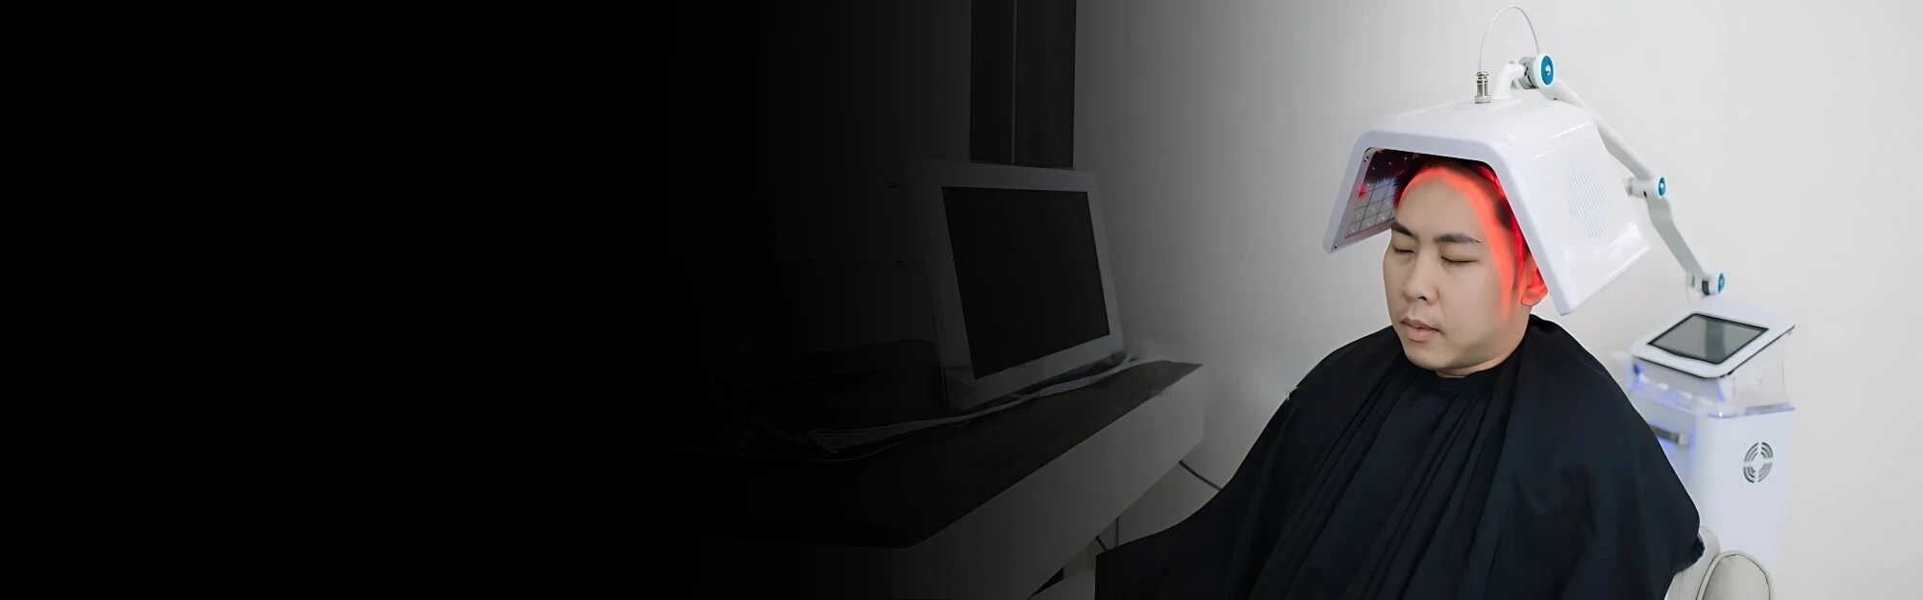
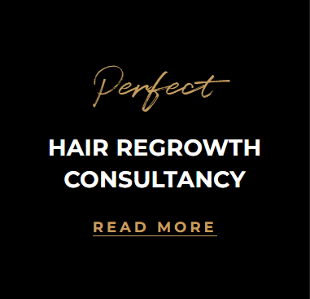
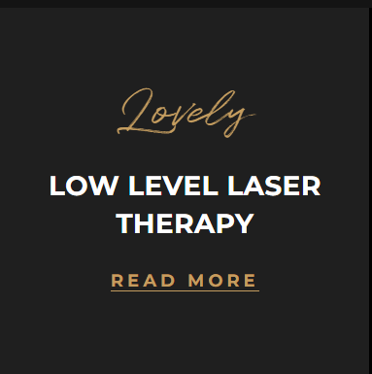

Our Services
Notes:
4

Slide 5


Our Services
Notes:
4

Slide 6
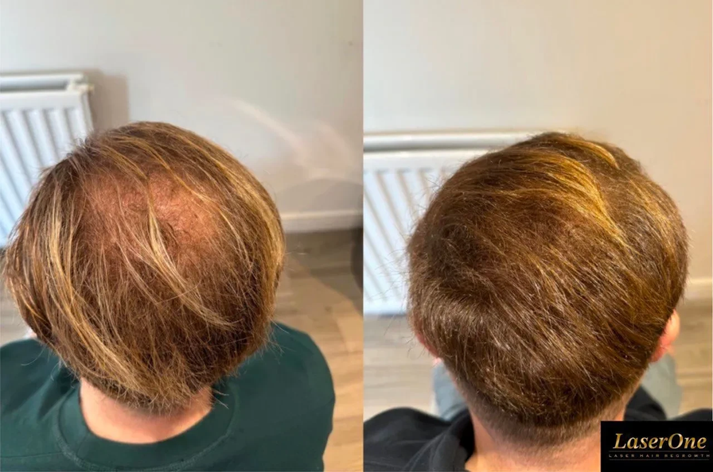
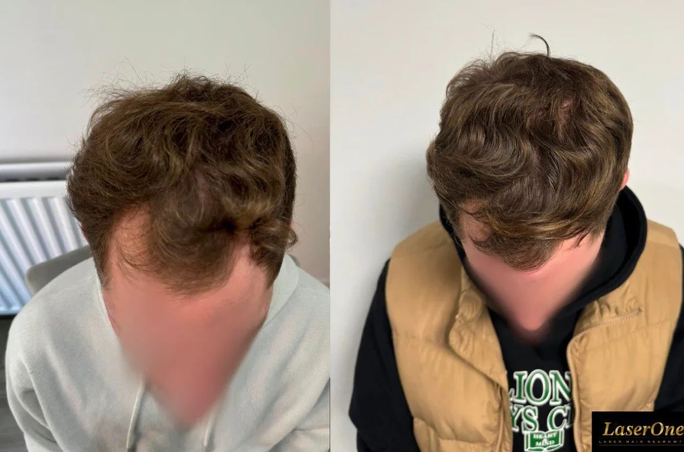
OUR CLIENTS
Dean
Lewis
Notes:
6

Slide 7
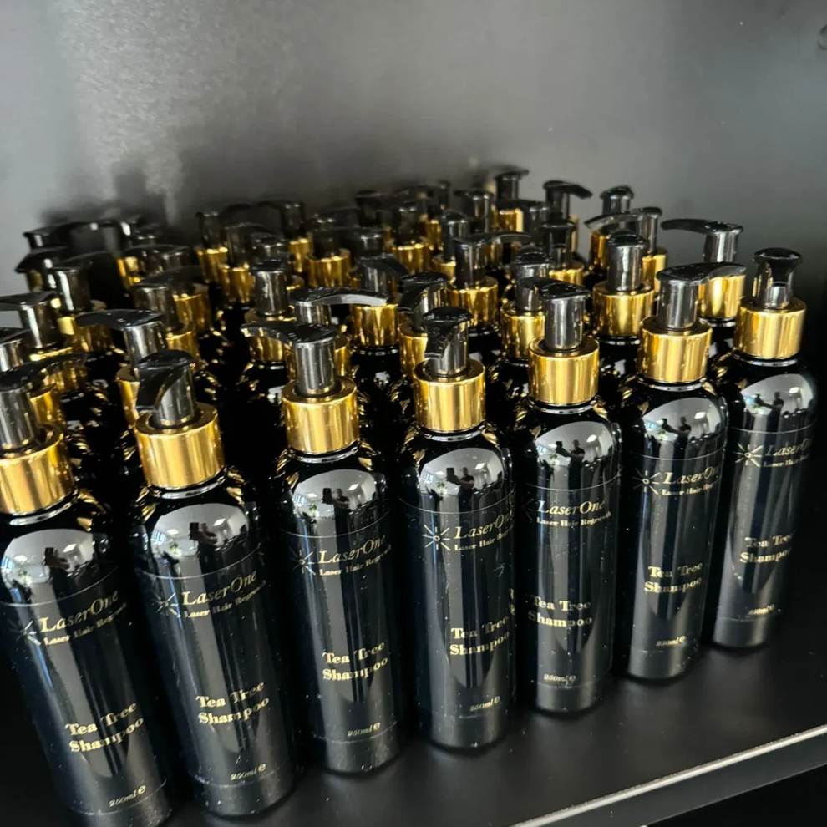



Contact Laser One
Reach out for a consultation.
laser-one.co.uk
+44 01206 687407
information@laser-one.co.uk
Suite 4, The Treble Tile
Colchester Road West Bergholt
Colchester CO6 3JQ
Notes:
8

