Slide 1

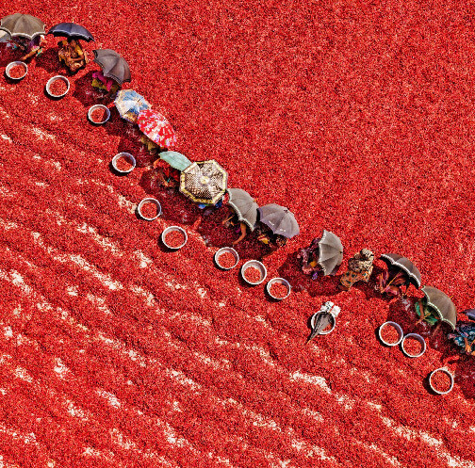
Agrocrops
Guntur Dry Red Chilli Exporters

Slide 2
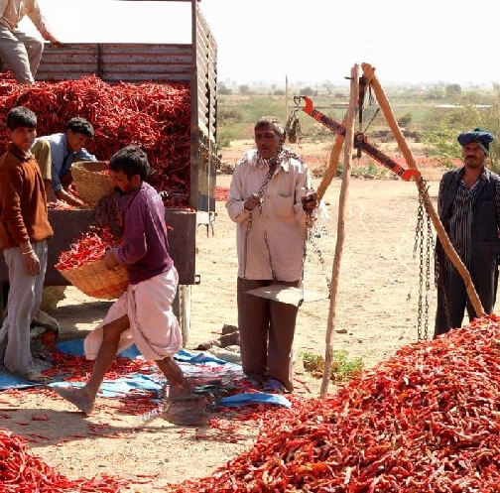
Special Featurers of Guntur Dry Red Chilli Exporters
  Relentless focus on chilli quality.
  Backed by global farming expertise.
  Supports farmers for better practices.
  Emphasizes technology for quality assurance.
  Dedicated to sustainable chilli production.

Slide 3
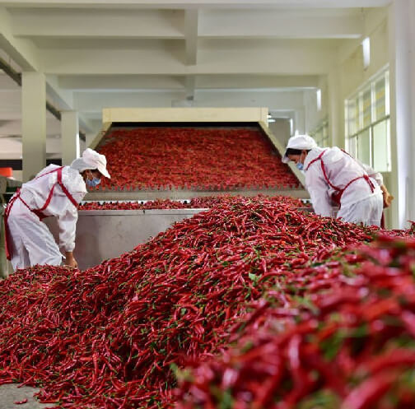
Address- D.No 25-16-180, 181,
Mirichi Yard Road, Guntur, Andhra Pradesh, 522005
Email Us - contact@agrocrops.com
Call us - +91 97013 63424
Website- https://www.spicesindia.net/us-and-chilli

Slide 4
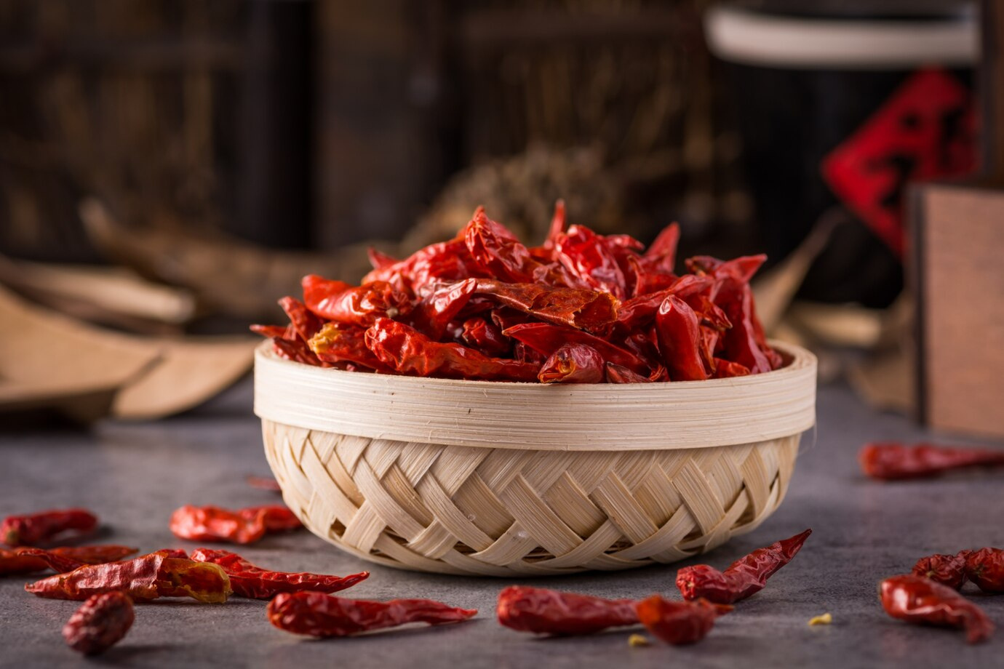
Thank You
Visit - https://www.spicesindia.net/us-and-chilli

