Slide 1

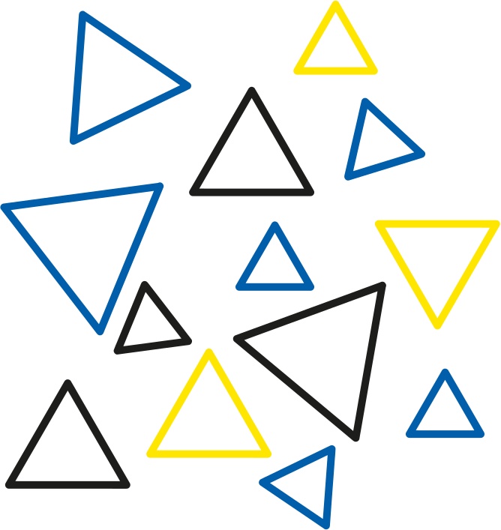

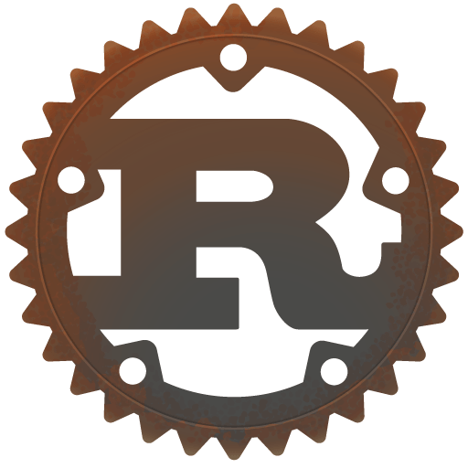

Hiring Rust Developers for Blockchain? Here’s What You Need to Know
www.blockchainx.tech

Slide 2
The performance, security, and reliability criteria matter greatly in today's world of blockchain development. Rust is systems programming built by Mozilla and is presently fast becoming an indispensable language among blockchain developers for the ultimate combination of security and speed. Memory safety guarantees with no garbage collection are a way to have fewer runtime errors and fewer performance bottlenecks. Therefore, with the scale and complexity of these decentralized applications on the increase, an increasing number of developers need tools that will enable him or her to build these high-performance systems with little overhead. This is the reason that most projects pursue this development language, for example, Solana, Polkadot, or Near. If you want to build or expand your own blockchain application, Hire Rust developers at the beginning of the development process to ensure that you are building everything secure and high-performance from the very beginning.

Slide 3
The Role of Rust Developers in Blockchain Projects
The programmers developing in Rust are quite unlike other software engineers. Having to serve a variety of roles ranging from protocol architects to crypto specialists to smart contract engineers, they are engaged in a variety of projects in the blockchain realm. They are also fighting the constraints put forth by decentralized networks to give birth to fast,secure and scalable code. The developers go on to design and maintain the core blockchain layers such as consensus mechanisms, transaction validation engines, peer-to-peer communications modules, and smart contract runtimes. Besides, they have to very often be meticulous about serialization of data, encryption standards, and error handling because a single error could in principle be scaled and exploited. Rust is ideal for high-risk environments like blockchain, given its excellent tooling, ranging from an uncompromising compiler through integrated testing frameworks, allowing developers to safeguard against bugs at compile time. If you want a robust and secure product delivered to your users, it is necessary to have experienced Rust developers in the team working on the blockchain.

Slide 4
Skills to Look for When Hiring Rust Blockchain Developers
When evaluating candidates for blockchain-related Rust roles, technical proficiency is just the starting point. Yes, they should be fluent in Rust syntax, lifetimes, ownership rules, and concurrency models—but they also need an in-depth understanding of blockchain fundamentals. Look for candidates with experience in developing or contributing to blockchain platforms like Substrate, Solana, or Cosmos SDK. They should be familiar with smart contract standards (such as Solana’s BPF or Ink! for Substrate), cryptographic techniques like elliptic curve cryptography, and networking protocols like libp2p. Experience with WebAssembly (Wasm) is highly desirable, as many Rust-based smart contracts compile to Wasm for execution. In addition to technical skills, strong problem-solving abilities, an understanding of decentralized application (dApp) architectures, and the ability to write clean, documented code are key traits to watch for. Developers who are active in the open-source Rust or Web3 communities often bring valuable experience and innovative thinking to the table.

Slide 5
Where to Find the Right Rust Talent
Finding skilled Rust developers, particularly in blockchain, has become a challenge since this is a relatively fresh space with a handful of talent entering its gates. Yet a good prospecting strategy can allow you to track down skilled developers throughout the world. Online coding communities like GitHub, Dev.to, and the Rust users forum are perfect for finding those developers who actively support Rust libraries and blockchain tools. Blockchain-specific platforms such as CryptoJobs, Web3.career, and AngelList provide access to developers looking for jobs in decentralized technologies. Other good sources for candidates include LinkedIn, RustConf events, and developer hackathons targeted toward Web3. Don't forget about remote hiring; this is a domain where some of the best Rust people work freelance or in global teams. Making your project attractive via innovation and flexibility will have high value on the radar of superior candidates. Building an excellent employer brand in the Rust and blockchain domain will also attract talent over time.

Slide 6
Why Rust is a Smart Long-Term Investment
Rust is a language oriented towards the future and beyond just a hot new thing. With fast-growing adoption at major companies such as Meta (for infrastructure), Microsoft (for secure development), and Amazon (for cloud services), Rust is proving more than capable of handling mission-critical applications. It brings great value to those in the blockchain industry, where scalability, security, and efficiency affect user trust and network adoption. Unlike more dynamic languages that may compromise on safety and performance, Rust offers guarantees on correctness via its compiler, helping crush entire classes of bugs before they ever reach production. Its growing ecosystem—mature libraries, async support, and framework Substrate—allows building full-featured blockchain applications from the ground up with astonishing ease. Choosing Rust cuts your tech debt and aligns your tech stack with a fast-growing developer community that is highly supported. An investment in Rust translates into ensuring your blockchain project is future-ready and resilient to ever-changing industry requirements.

Slide 7
Conclusion
The development team is equally important as the concept behind your project in the ever-evolving blockchain landscape. Technologies like Rust do provide a sturdy base on which the decentralized system can be made scalable, secure, and efficient, but to exploit its potential fully, the developers need to be well-versed with it. The decision to Hire dedicated Rust developers can profoundly affect the success of your project, whether it is a layer-1 blockchain, a DeFi protocol, or a decentralized identity platform. These developers will be instrumental in guiding performance optimizations, architectural foresight, and quality assurance of code, all needful in the high-octane world of Web3. Partnering with a technically brilliant and strategically aligned Rust team will allow you to innovate faster and reduce the security risks as you scale your blockchain activities. Your investment in Rust talent today is a strategic step toward building the ready-to-lead blockchain solutions of tomorrow's decentralized economy.

Slide 8





Thank You
CONTACT US
www.blockchainx.tech
contact@blockchainx.tech
+91 7708889555

