Slide 1



Holistic Healing Retreats – A Path To Wellness
Discover The Transformative Power Of Holistic Healing Retreats, Where Mind, Body, And Spirit Align For Rejuvenation. These Retreats Offer A Unique Opportunity To Escape Daily Stress And Embrace A Holistic Approach To Well-Being Through Meditation, Yoga, And Natural
Therapies.
JOIN NOW
WWW.PERUSHAMANS.COM

Slide 2
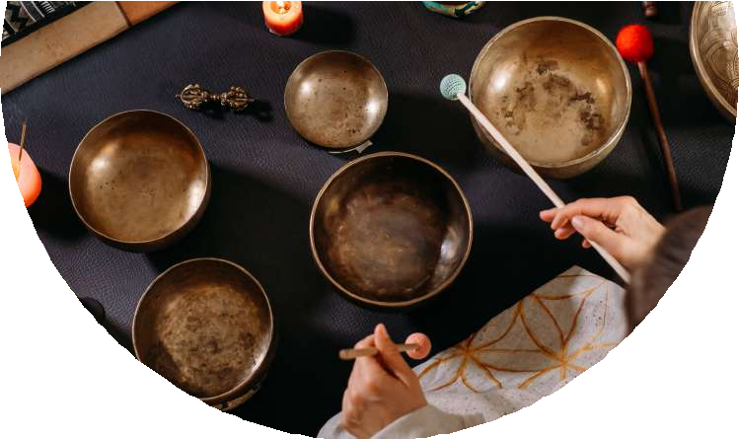

Understanding Holistic
Healing
Holistic Healing Retreats Focus On Treating The Whole Person By Integrating Mind, Body, And Spirit. Through A Combination Of Natural Therapies, Meditation, And Mindfulness Practices, These Retreats Help Individuals Achieve Deep Healing, Emotional Balance, And A Renewed
Sense Of Purpose.
JOIN NOW
WWW.PERUSHAMANS.COM

Slide 3
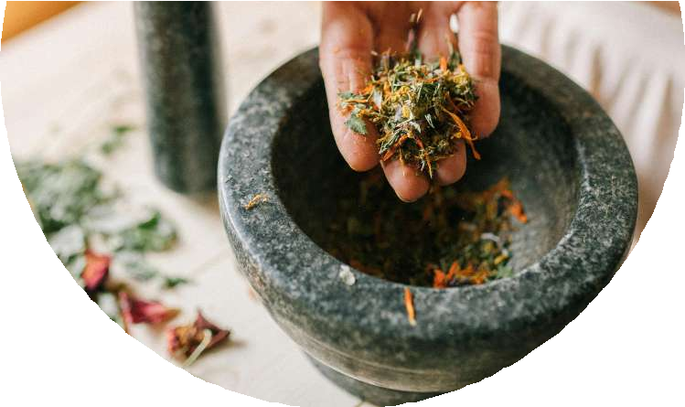

Wellness Through Holistic
Healing
Attending Holistic Healing Retreats Provides Many Benefits, Including Stress Reduction, Mental Clarity, Emotional Stability, And Physical Health. Through Various Healing Modalities, Individuals Experience A Transformative Journey Toward Self-Discovery, Inner Peace, And
Overall Well-Being.
JOIN NOW
WWW.PERUSHAMANS.COM

Slide 4


Essential Aspects Of Holistic
Healing
Holistic Healing Retreats Incorporate Key Practices Like Yoga, Meditation, Nutritional Guidance, Energy Healing, And Nature Immersion. These Elements Work Together To Support Physical, Emotional, And Spiritual Growth, Creating Balance Between Mind,
Body, And Spirit.
JOIN NOW
WWW.PERUSHAMANS.COM

Slide 5


Diverse Retreat Experiences
Holistic Healing Retreats Vary In Focus, Offering Meditation Retreats, Ayurvedic Healing, Detox Programs, And Energy-Based Therapies. Each Retreat Caters To Specific Wellness Goals, Allowing Individuals To Choose The Best Option For Their Healing Needs.
JOIN NOW
WWW.PERUSHAMANS.COM

Slide 6


Serene Destinations For
Healing
Holistic Healing Retreats Are Often Located In Tranquil Natural Settings, Such As Mountains, Forests, And Beaches. These Calm Environments Enhance Relaxation And Self-Reflection, Helping Participants Disconnect From Stress And Engage In Deep Healing.
JOIN NOW
WWW.PERUSHAMANS.COM

Slide 7


A Retreat For Everyone
Whether Seeking Stress Relief, Emotional Healing, Or Spiritual Growth, Holistic Healing Retreats Benefit Everyone. Professionals, Students, And Those Facing Life Changes Can Gain Emotional Balance, Mental Clarity, And Physical Renewal Through These Transformative Retreats.
JOIN NOW
WWW.PERUSHAMANS.COM

Slide 8


Transformative Journeys
Many Individuals Have Experienced Life-Changing Benefits Through Holistic Healing Retreats. Testimonials Highlight Emotional Growth, Renewed Energy, And Self-Discovery. These Stories Show The Powerful Impact Of Holistic Healing On Mental, Emotional, And Physical Well-
Being.
JOIN NOW
WWW.PERUSHAMANS.COM

Slide 9


Selecting The Perfect
Experience
Choosing The Right Holistic Healing Retreat Requires Considering Personal Wellness Goals, Preferred Location, And Offered Therapies. Researching A Retreat’s Approach, Instructors, And Facilities Ensures It Aligns With Your Unique Healing Journey And Lifestyle Needs.
JOIN NOW
WWW.PERUSHAMANS.COM

Slide 10


Embrace Holistic Healing
Today
Start Your Transformational Journey With Holistic Healing Retreats And Achieve A Renewed Sense Of Balance. These Retreats Provide The Perfect Space For Healing, Growth, And Well-Being, Encouraging A
Healthier, More Mindful Lifestyle.
JOIN NOW
WWW.PERUSHAMANS.COM

Slide 11



Thank You For Your Time
We Appreciate Your Interest In Holistic Healing Retreats. May Your Journey Toward Wellness Be Fulfilling And Transformative. Feel Free To Reach Out For More Information Or Assistance.
(51 935 648 193)
INFO@PERUSHAMANS.COM
WWW.PERUSHAMANS.COM

