Slide 1

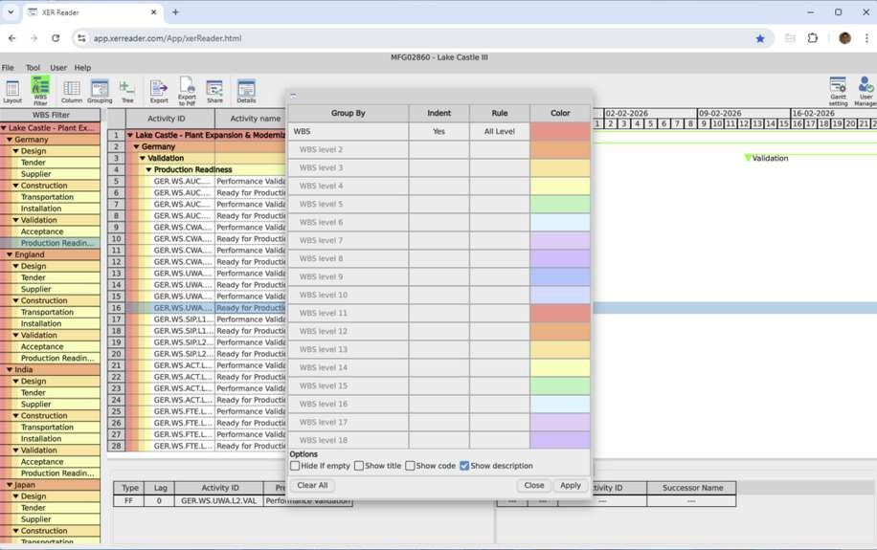

Discover The Power Of P6 Schedule In Project Planning
The P6 Schedule Is A Reliable Tool For Managing Project Timelines. It Helps Teams Plan Efficiently, Avoid Delays, And Monitor Progress. Whether You’re Leading A Small Team Or A Major Project, Using The P6 Schedule Gives You Better Visibility, More Control, And Improved Results From Start To Finish.
Www.XERreader.Com
Info@Xerreader.Com

Slide 2
Understanding What Makes P6 Schedule So Effective
The P6 Schedule Is A Professional Scheduling Software Developed By Oracle. It’s Used To Plan, Manage, And Control Complex Projects. This Tool Helps Organise Tasks, Assign Resources, And Forecast Outcomes. With The P6 Schedule, Teams Stay Aligned, Ensuring Every Part Of The Project Is Tracked And Completed Successfully.
Www.XERreader.Com
Info@Xerreader.Com

Slide 3
Key Benefits Of Choosing P6 Schedule For Projects
With The P6 Schedule, Project Managers Gain Greater Control Over Activities, Resources, And Timelines. Its Visual Interface Helps With Better Communication And Decision-Making. From Reducing Risks To Improving Collaboration, The P6 Schedule Ensures That Every Team Member Stays Focused, Productive, And Aware Of Their Role In Success.
Www.XERreader.Com
Info@Xerreader.Com

Slide 4
Where P6 Schedule Makes A Real Difference Today
The P6 Schedule Is Used Across Many Industries Like Construction, IT, Energy, And Manufacturing. Its Flexibility And Detailed Planning Tools Make It Ideal For Large, Complex Projects. No Matter The Field, The P6 Schedule Brings Structure, Predictability, And Efficiency To All Phases Of A Project Lifecycle.
Www.XERreader.Com
Info@Xerreader.Com

Slide 5
How Xer Reader Supports The P6 Schedule Format
Xer Reader Is Designed To Read And Interpret P6 Schedule Files With Ease. It Lets Users Open, View, And Navigate .XER Files Without Needing Oracle Software. This Allows Wider Access To Project Data, Making The P6 Schedule More Accessible, Collaborative, And Practical For Everyone On The Team.
Www.XERreader.Com
Info@Xerreader.Com

Slide 6
Simplify Access And Sharing Of P6 Schedule Data
Viewing And Understanding P6 Schedule Data Is Easy With Tools Like Xer Reader. Users Can Filter Tasks, Analyze Schedules, And Communicate Updates Clearly. Whether In The Office Or Working Remotely, Managing P6 Schedule Files Becomes Smooth And Straightforward, Helping Teams Keep Track Of Deadlines And Responsibilities.
Www.XERreader.Com
Info@Xerreader.Com

Slide 7
Improve Teamwork With Shared P6 Schedule Access
Teams Can Now Collaborate Efficiently By Accessing The Same P6 Schedule Files Online. This Real-Time Visibility Ensures Everyone Stays Aligned, Even When Working From Different Locations. Sharing Updates, Reviewing Tasks, And Resolving Delays Becomes Much Easier With A Shared P6 Schedule, Promoting Better Teamwork And Accountability Overall.
Www.XERreader.Com
Info@Xerreader.Com

Slide 8
Safe And Secure Way To Manage P6
Schedule Docs
Protecting Your Data Is Crucial, Especially With Project Files. Xer Reader Helps Keep P6 Schedule Documents Secure, Offering A Read-Only Format To Prevent Accidental Edits. With No Installation Required, Teams Can Trust That P6 Schedule Information Is Accessed Safely While Preserving The Integrity Of Every Schedule Version.
Www.XERreader.Com
Info@Xerreader.Com

Slide 9
Advantages Of Using Xer Reader For P6 Schedule
Xer Reader Provides Fast And Easy Access To P6 Schedule Files, With A User-Friendly Interface That’s Perfect For All Experience Levels. It’s A Lightweight Tool With No Setup Hassle. Whether Reviewing Timelines Or Sharing Reports, Xer Reader Simplifies How Teams Interact With P6 Schedule Data Daily.
Www.XERreader.Com
Info@Xerreader.Com

Slide 10
How The P6 Schedule Will Evolve With Technology
The Future Of P6 Schedule Includes More Automation, Cloud Integration, And Mobile Access. Tools Like Xer Reader Are Already Paving The Way. As Technology Improves, Expect Smarter Forecasting, Real-Time Updates, And Better Cross- Platform Compatibility—Making The P6 Schedule An Even More Powerful Tool In Project Planning.
Www.XERreader.Com
Info@Xerreader.Com

Slide 11
Thank You For Learning About P6 Schedule
Thank You For Exploring The Benefits Of Using The P6 Schedule And Xer Reader. We Hope You Found This Information Useful For Your Project Needs. Stay Connected, And Feel Free To Reach Out If You Have Questions About Using The P6 Schedule In Your Next Project.
Www.XERreader.Com
Info@Xerreader.Com

Slide 12
Get In Touch For P6 Schedule Solutions Today
Need Help With A P6 Schedule File? We’re Happy To Assist. Contact Us Anytime To Learn More About Xer Reader Or Discuss Your Project Requirements.
Address: Automatikvej 1, 2860 Søborg, Denmark
Zip Code: 2860
Phone: (+45) 88 70 77 22
Email: info@xerreader.com Website: https://xerreader.com

