Slide 1

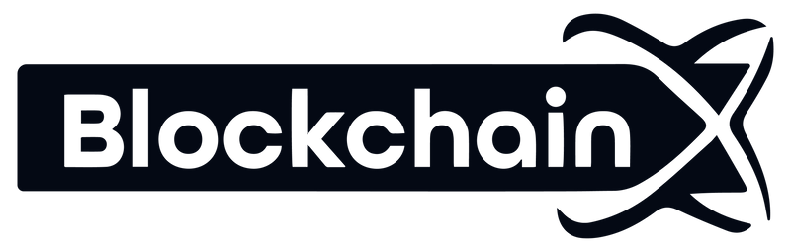

How Solana Developers Drive Growth for Blockchain Startups
www.blockchainx.tech

Slide 2
Startups have been severely pressured by time to innovate, scaling efficiently, and promising reliable solutions for a broader user base in the highly volatile world of blockchain and Web3. Choosing a proper blockchain infrastructure can be the difference between a startup that thrives and one that will be left nowhere. Solana shines from this horizon with the great transaction speed and extremely low cost in a lively ecosystem that enables innovation across different sectors. With lightning speed and processing capabilities of more than 65,000 transactions per second, it is well suited for building consumer-grade dApps, financial instruments, NFT platforms, and much more. As competition heats up in the blockchain space, it becomes increasingly important to Hire professional Solana developers, those who work on closely related aspects through their hands-on experience on Solana core technologies. The team's backbone technically should be made with such resource people to drive the start-up into product development immediately, along with speedy market strategies-it gives the transformation of idea without delay into a scalable end-product.

Slide 3
Building Efficient and Scalable Applications
Solana has one of the strongest features in giving room for high throughput applications, while at the same time allowing decentralization and performance within it. Innovations such as Proof of History (PoH), which timestamps transactions before consensus; and Sea Level, Solana’s parallel smart contract runtime, allow the simultaneous execution of multiple smart contracts. Solana developers add huge value here. They write optimized code, structure smart contracts efficiently and do architecture that supports vertical and horizontal scaling. Whether you are building a DEX, a GameFi, or a high-volume NFT marketplace, they ensure stability of the application under high load. Startups will benefit a lot from this, as they can brazenly onboard users knowing that there will be no bottlenecks, downtimes, or performance lags. It gives a competitive edge to pitch to investors or partnerships as well.

Slide 4
Reducing Time-to-Market with Solana Tools
The potential for startups rests on their speed of execution; if you are first to market in the blockchain environment, you have a good chance of securing market share or user loyalty. A whole host of instruments with which developers can terminate building processes in hours and days is made available in Solana—Solana CLI, Anchor framework, Solana Web3.js, etc. These tools foster accelerated smart contract generation, local testing, and deployment onto the live network with practically no downtime. Developers especially love Anchor for its human-readable syntax and built-in security checks. Good Solana developers will go further to build CI/CD pipelines for deployment automation and version control, hence establishing a smooth rollout process. This entails, for any startup, launching a minimum viable product (MVP) in weeks rather than in months, allowing fast feedback, fast iteration, and jumpstart user acquisition. The faster you get your product to market, the faster you get traction; traction is everything when it comes to raising funds and growing the business.

Slide 5
Unlocking DeFi, NFTs, and Web3 Opportunities
The Solana ecosystem is so varied that it powers DeFi protocols, NFT platforms, decentralized social apps, and even real-time gaming projects. Solana developers are the ones doing the innovative work of integrating next-gen blockchain features such as yield farming, liquidity staking, on-chain governance, and cross-chain swaps into the startups. NFT developers create smart contracts enabling seamless minting, royalty management, metadata storage, and even dynamic NFTs creation. In DeFi, their efforts are channeled into developing order books, lending protocols, synthetic assets, and DEXs that deliver real-time performance. These developers also produce integration on the wider Web3 world -between wallets like Phantom, oracles such as Pyth, and even liquidity access through Serum- enabling startups' multi-channel revenue diversification and boosting engagement or new business models exclusive to blockchain.

Slide 6
Enhancing Security and User Trust
In blockchain, there is no option for security but it is embedded into the base. Just one overlooked vulnerability can destroy trust and cost millions in losses or possibly end a project entirely. As such, seasoned Solana developers weave security into every layer of the product: From writing audited and gas-optimized smart contracts to implementing stringent key management protocols, all defense is put up first, through unit tests, integration tests, and security audits for possible vulnerabilities such as reentrancy, integer overflow, and front-running opportunities. Additionally, they follow some best practices of the Solana ecosystem about the safe usage of Program Derive Addresses and assurance during token handling. Besides the technical security aspect, developers also make sure to take account of aspects like open-source licensing compliance, network up-time maintenance, and design for secure upgrade paths for smart contracts as another protective coverage that is legal and technical for the startup but also establishes credibility for the startup among users, partners, and even investors-in high-stakes sectors like DeFi and Web3 identity.

Slide 7
Community Integration and Ecosystem Growth
Solana is not a mere tech stack; it is a deep and wide ecosystem of developers, investors, creators, and users around the world. Startups that find conducive integration into this ecosystem tend to benefit in terms of faster growth along the lines of collaborations, funding, and visibility. The experienced Solana developers are likely to be plugged into this network and are therefore wielding it as a weapon. They contribute to open-source works, participate in Solana hackathons, and join forums and GitHub discussions that help them stay ahead of trends. They know how to apply for grants from the Solana Foundation, work with ecosystem projects like Metaplex, and take advantage of infrastructure services such as Helium or Switchboard. Developers strengthen aforementioned startups through community relationships, allowing them to gain organic traction, early adopters, and listings in ecosystem updates or showcase events. Community-connected developers do not just create apps; they create pathways for startups into the Solana universe.

Slide 8
Conclusion
Solana is uniquely positioned as the perfect springboard for blockchain startups, possessing technical advantages, developer-friendliness, and an alive ecosystem. Fully exploiting this platform requires experience and strategic development; from building a scalable NFT marketplace to high-performance DeFi protocols and inventive Web3 apps, the success of any Solana startup is ultimately reliant on its developers. The Top remote Solana developers bring in best-class talent capable of building, securing, and scaling game-changing products. These developers write code that drives vision, accelerates timelines, and opens up new avenues for growth. In an industry where speed and innovation rule, the right Solana team becomes your strongest competitive differentiator.

Slide 9




Thank You
CONTACT US
www.blockchainx.tech
contact@blockchainx.tech
+91 7708889555

