Slide 1
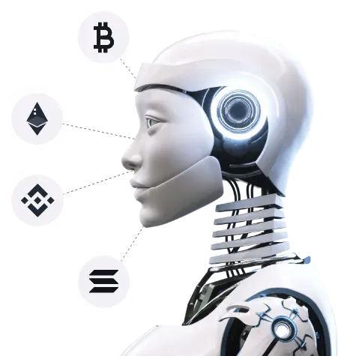

AI Crypto Token Development:
A Comprehensive Guide

Slide 2
Introduction
Technology advances steadily and AI integration with blockchain technology produced AI tokens as a major achievement during recent years. The innovation of AI tokens establishes a new method through which tech companies can utilize AI technology. The integration between blockchain technology and AI creates more powerful functionality for both systems which promotes fresh possibilities for AI innovations.

Slide 3
Role of AI in Token Development
The development of digital tokens heavily relies on Artificial Intelligence because it creates automated and intelligent features that enhance the token functionality. The development of self-administering and efficient tokens becomes possible through AI because it enables the evaluation of user data for customized services along with autonomous functionality based on predetermined rules.
AI tools assist token development service through different functions which include optimizing distribution systems and enabling predictive security analytics for fraud prevention and implementing automated interactions with digital assets. AI-driven tokens enhance operational efficiency because they decrease the requirements for human operator involvement which results in lower operational expenses and superior system performance.

Slide 4
  Conceptualization and Ideation
  Design and Architecture
How AI Tokens are Developed?
  Smart Contracts
  Tokenomics
  Development and Testing
  Deployment and Integration

Slide 5



Benefits of AI Token Development
The process of creating digital tokens that incorporate artificial intelligence technologies is known as AI token development. In a variety of ecosystems, including data markets, machine learning models, and automated decision-making systems, these tokens can be used to support, oversee, and reward AI operations. Numerous industries stand to gain greatly from the combination of blockchain technology and artificial intelligence.
Enhanced Security Features | Improved Transparency and Traceability | Automation of Processes

Slide 6

Top 5 Future of AI Token Development
  Decentralized AI Models
  Tokenized AI Services
  Governance via AI Tokens
  Integration with Web3 and the Metaverse
  AI Token Interoperability

Slide 7
Conclusion:
The creation of AI cryptocurrency tokens is transforming the way we create, distribute, and manage intelligent systems. These tokens open up new avenues for creativity, access, and cooperation by fusing the transparency and decentralization of blockchain technology with the strength of artificial intelligence. Projects that prioritize practical applications, robust tokenomics, and moral AI principles will set the standard for determining the direction of decentralized intelligence as the field expands.

Slide 8




Contact Us
7708889555
contact@blockchainx.tech
https://www.blockchainx.tech/

