Slide 1

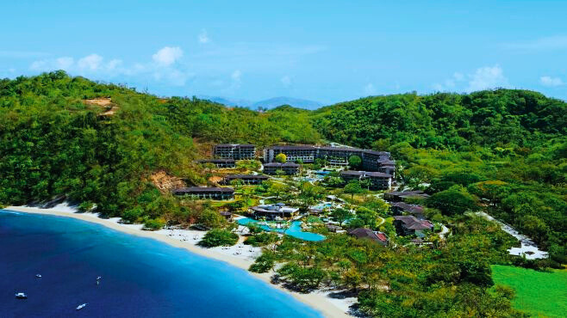
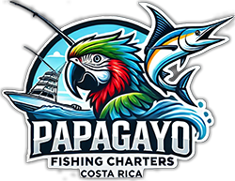
Quepos Fishing Charters
Quepos Fishing Charters offers thrilling deep-sea adventures, expert guides, and top-notch boats for unforgettable sportfishing experiences in Costa Rica’s rich waters.
papagayofishingcharters.com

Slide 2

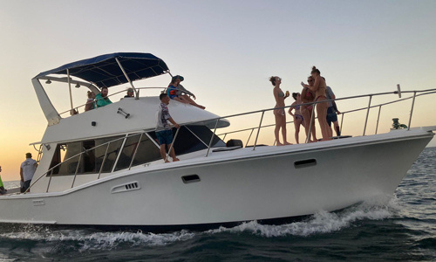

ABOUT
We are Professional and experienced guides who know the best fishing spots. We are Fully equipped boats with high-quality fishing gear and electronics. Our personalized trips tailored to your skill level and your goal of fishing. We provide comfortable amenities to make sure your day on the water is enjoyable.
papagayofishingcharters.com

Slide 3
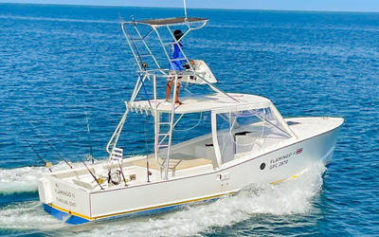
Why Choose Quepos Fishing Charters?
papagayofishingcharters.com
DIVERSE FISHING OPTION:
EXPERT GUIDES:
SUSTAINABLE FISHING:
ALL-INCLUSIVE PACKAGES:
Inshore and offshore fishing trips tailored to your preference.
Local captains and crew with extensive knowledge of the waters.
Fishing gear, bait, snacks, drinks, and fish cleaning included.
Strict conservation practices to preserve marine life.

Slide 4
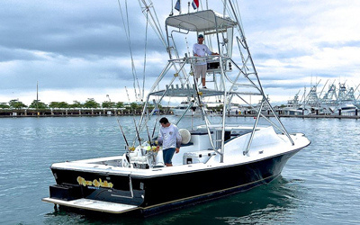
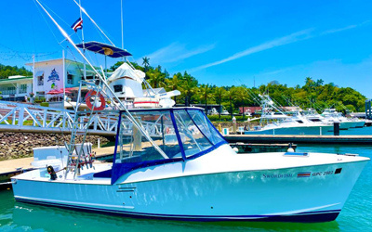
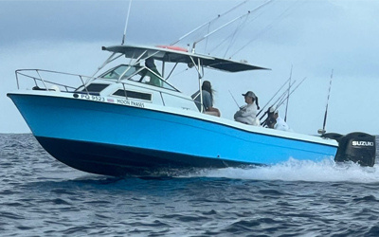
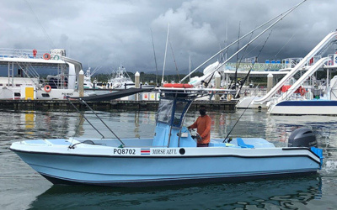
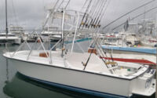

BOOK
NOW
Charter Boat
Options
papagayofishingcharters.com
  Mirse Azul (26ft): $950 (full-day offshore/inshore), $700 (half-day inshore).
  Moon Phases (28ft): $1,050 (full-day), $800 (half-day).
  COW BOY (30FT): $1250 (Offshore or Inshore) (full-day), $800 (Inshore) (half-day).
  Swordfish (31ft): $1,600 (full-day), $900 (half-day).Transportation
  Ravem (35ft): $1,900 (full-day), $1,300 (half-day).

Slide 5
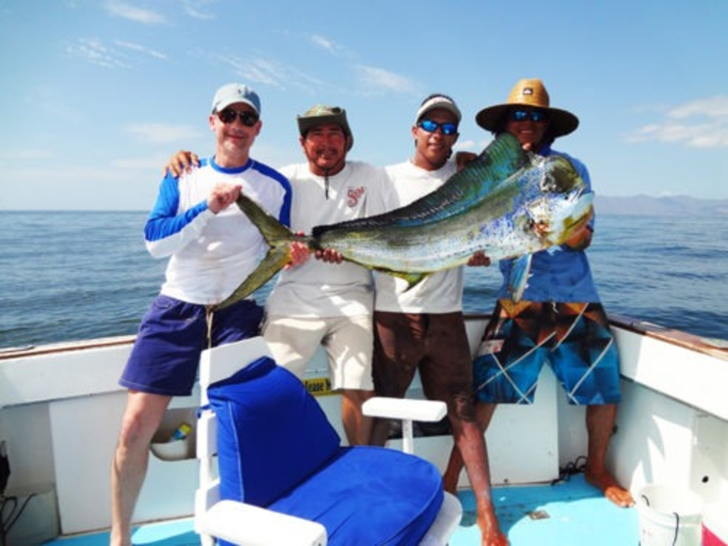
CONTACT:
Feel free to contact Capt. Fradian if you need to know boat availability, need personal assistance during the booking process, or need any further information you may need.
  Phone Number:
+1 914 881-2101
  Email Address:
info@papagayofishingcharters.com
  Website Address:
papagayofishingcharters.com
  Office Address:
Costa Rica, Ocotal Beach, Guanacaste

Slide 6
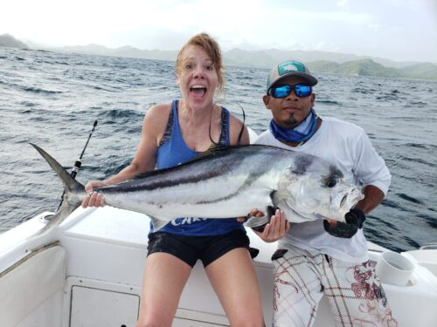
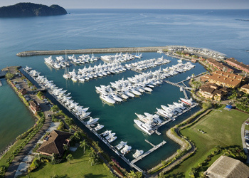
THANK
YOU
papagayofishingcharters.com

