Slide 1
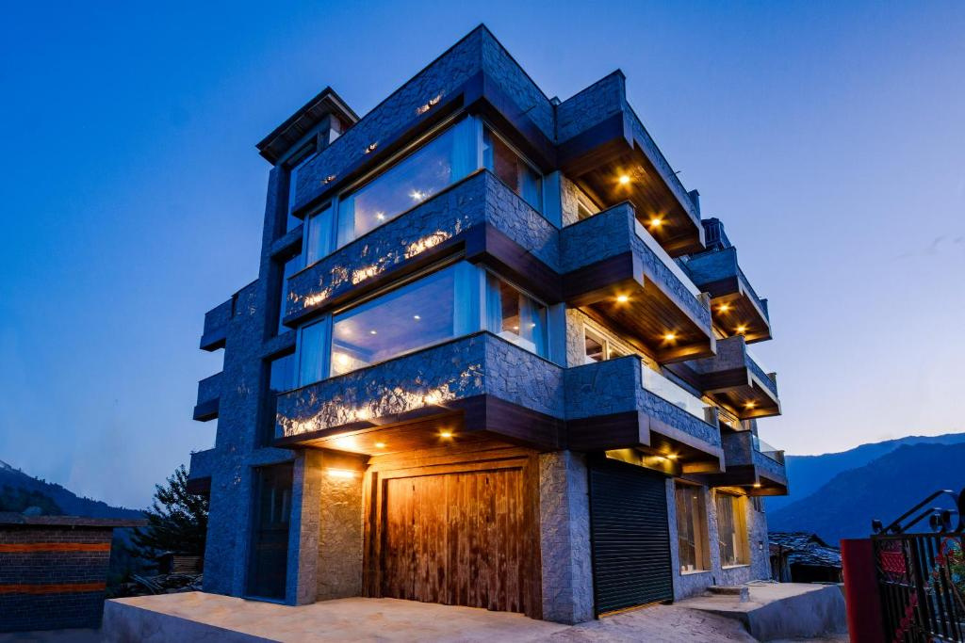

Premium Villa in Manali
Website :-
https://kenshohills.com/

Slide 2
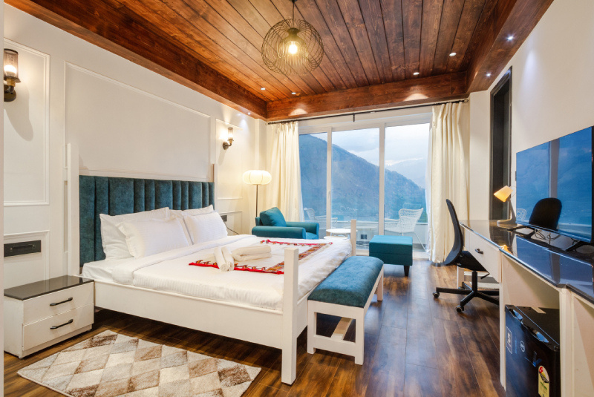
Home
Service
About Us
Contact
About us :-
Nestled in the heart of the Himalayas, Kensho Hills offers a luxurious escape with its premium villas in Manali. Combining elegance with modern amenities, our villas provide the perfect setting for relaxation and rejuvenation. Designed to blend seamlessly with the natural beauty of Manali, Kensho Hills is your ultimate destination
for a tranquil and unforgettable stay.
Website :-
https://kenshohills.com/

Slide 3

Premium Villa in Manali
Kensho Hills offers a luxurious premium villa in Manali, perfect for those seeking a peaceful and serene getaway. Surrounded by stunning mountain views, the villa features modern amenities, spacious rooms, and personalized services, ensuring an unforgettable stay. Whether you're looking for relaxation or adventure, Kensho Hills provides an ideal retreat in Manali.
Website :-
https://kenshohills.com/

Slide 4

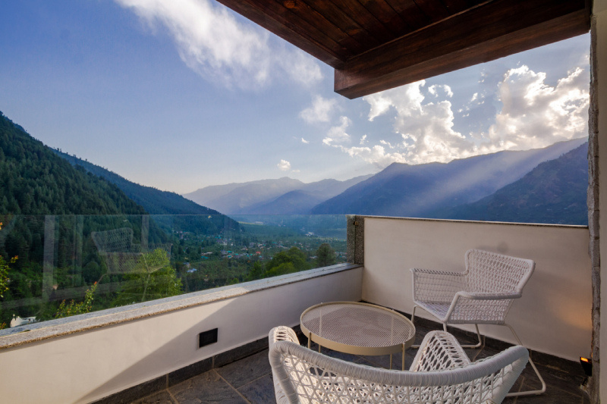

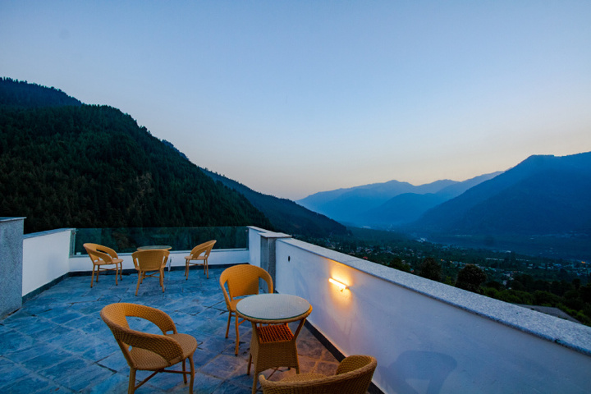
Home
Service
About Us
Contact
Unique Features
Our Facilities :
Single Room
Luxury Room
Deluxe Room
Rooftop Restaurant
Local Immersion
Breathtaking Panoramic Views
Website :-
https://kenshohills.com/

Slide 5

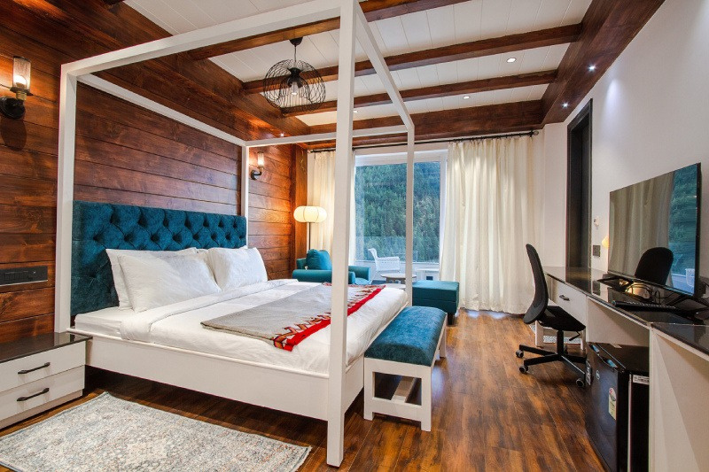
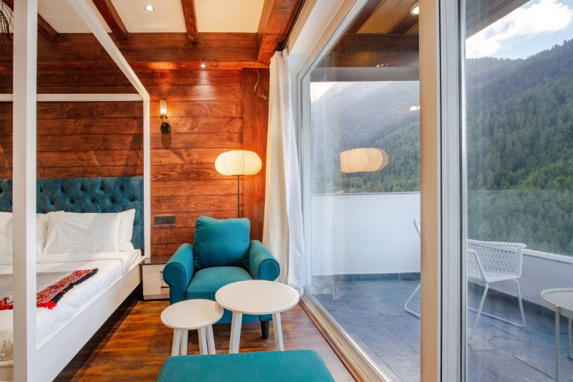
Home
Service
About Us
Contact
Our Room Gallery
Deluxe Room
Website :-
https://kenshohills.com/

Slide 6
Home
Service
About Us
Contact
Thank You
Get in Touch
Website Phone
Address
https://kenshohills.com/
+91-7018806079
Ward number-3 village soyal/P.O, Haripur, Manali, Himachal Pradesh 175131

