Slide 1


How to Choose the Best Social Media Marketing Services for Your Business
www.growthwayadvertising.com

Slide 2
Business achievement in contemporary digital times requires a solid online stance for organizations. Social media marketing services constitute an effective approach to connect with customers while expanding brand recognition and generating sales outcomes. Selecting the right social media marketing agency remains tough due to abundant agency options in the market. This guide will show you step-by-step how to find a matching partner that will boost your brand successfulness.
Understand Your Business Needs
Social media marketing company selection requires you to establish your business objectives first. Your organization needs help with follower growth along with higher engagement rates and lead generation while improving service assistance. The process of selecting a best social media marketing agency becomes easier when you define specific goals because this helps match your vision with an agency that produces measurable outcomes.

Slide 3
Look for Industry Experience
All social media marketing organizations differ in their capabilities and services. Most successful agencies achieve results because they demonstrate extensive experience working within your business sector. Experienced social media agencies have deep insights about your audience thus they develop strategies that effectively connect with them. Request data supporting their capabilities by asking for case studies and client testimonials along with performance marker information.
Evaluate Their Services
Complete social media management firms supply their clients with content development services as well as communal engagement platforms and analysis tools in addition to paid promotional methods. Review the social media management services the agency delivers because they should align with your company requirements. High-level organizations excel at social media digital marketing by integrating professional approaches between free and paid advertising strategies.

Slide 4
Consider Their Strategic Approach
The most effective social media marketing agency dedicates time to grasp your brand identity as well as both your industry rivals and market dynamics. The agency must develop a transparent direction via content calendars combined with KPIs and campaign planning. A results-oriented methodology allows your social media marketing services expenditures to generate positive returns.
Focus on Paid Advertising Expertise
Social advertisement effectiveness determines how well it can reach larger audiences. Look for a social media marketing company that demonstrates exceptional performance in managing precise advertising campaigns which operate simultaneously on Facebook along with Instagram and LinkedIn and Twitter platforms. Organizations need their management team to maximize ad spending while generating conversions in order to achieve return on investment.

Slide 5
Check Communication and Transparency
Open social media management collaborations need reliable communication alongside total transparency in their reports. The company should provide steady feedback together with evaluation reports as well as knowledgeable data which helps you understand better.
Social Media Services in India
If you're exploring social media marketing service in India, you’ll find a thriving market with skilled professionals and competitive pricing. Indian social media marketing services that lead the market segment deliver customized strategies which benefit businesses at every level including startups and established enterprises. Working with a top-rated Indian agency provides your business with substantial benefits for both specified market areas and worldwide operations.

Slide 6
Conclusion
A company’s brand growth depends on selecting the perfect social media marketing services. Your process should start with goal evaluation then move into agency scouting and must focus on the elements of experience and strategy and communication. Your business success online will benefit from dedicated social media marketing agency support at any company size.

Slide 7

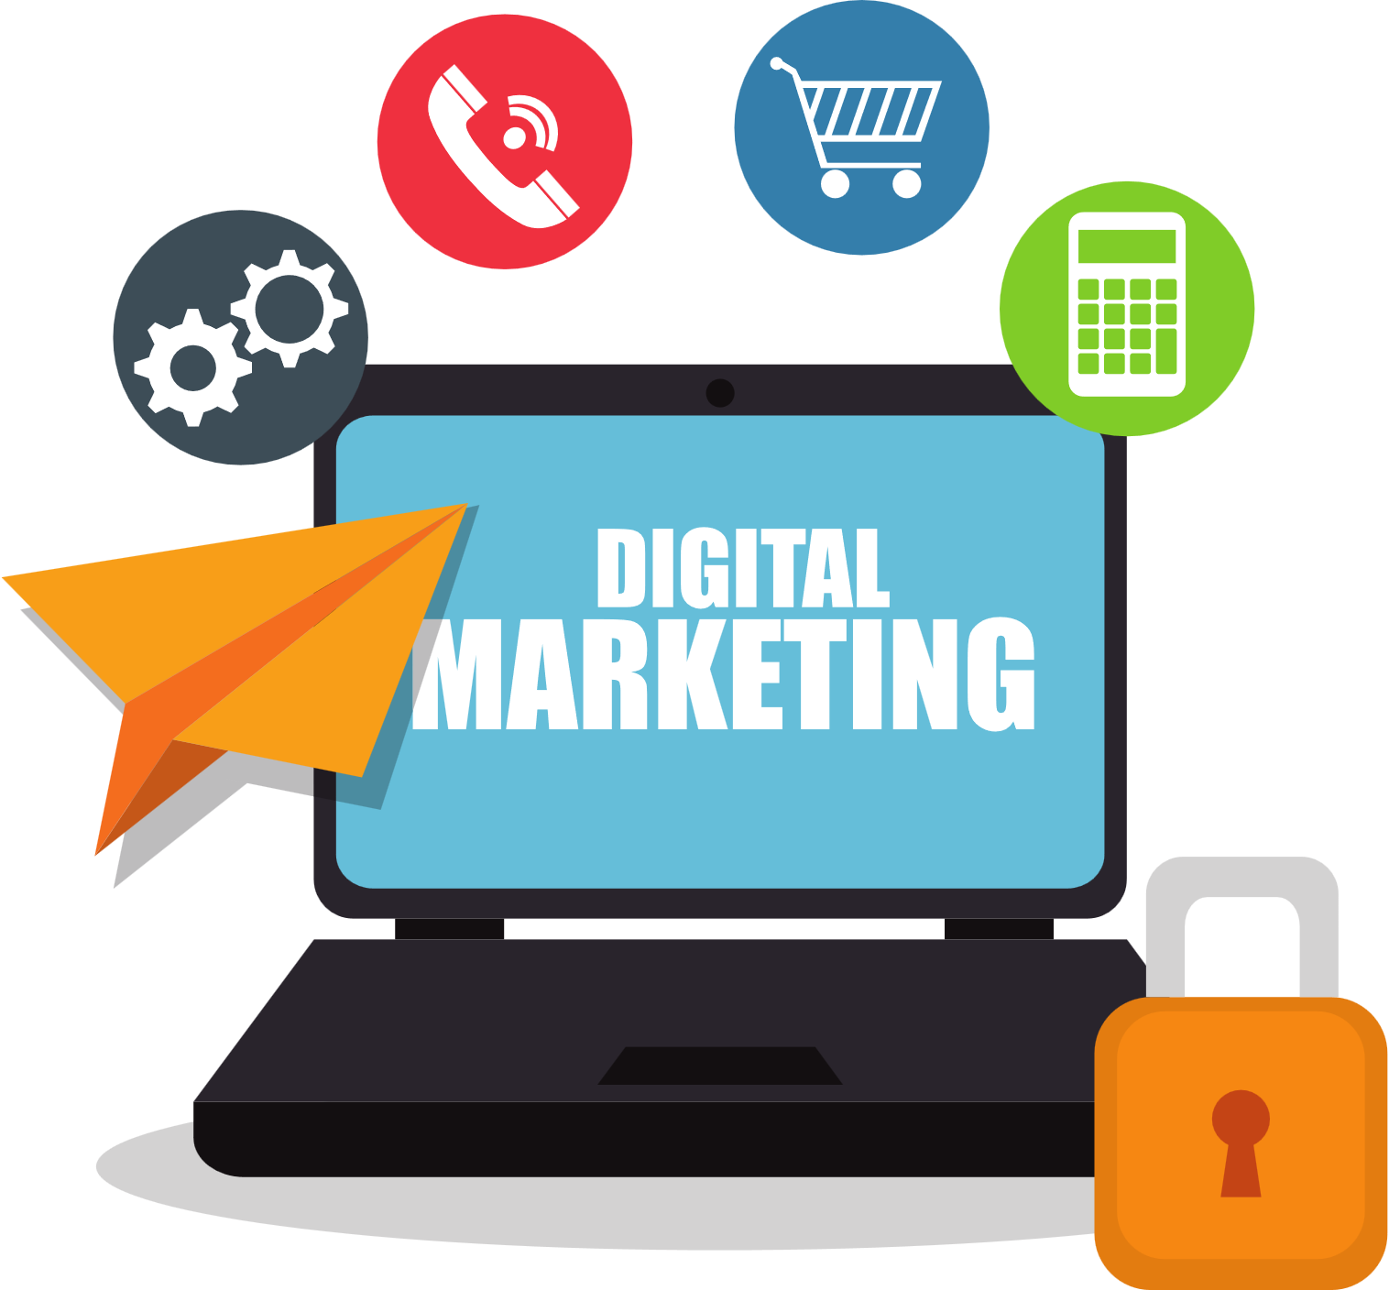
Contact us
  We combine creative marketing strategies with digital media and technology to drive your brand’s scalable and sustainable growth.
  With almost 10+ years of award-winning digital and creative marketing experience across start-ups, SMEs, and multi-national B2B and B2C brands, we love what we do!
  Visit: www.growthwayadvertising.com
  Call Us At: 91+ 7709280369
  Email: Bhavesh@growthwayadvertising.com
  Office No – 703, ANP Landmark, Sr. no. 89, Bhumkar Chowk,Hinjawadi – Wakad Rd, Pune, Maharashtra 411057

