Slide 1


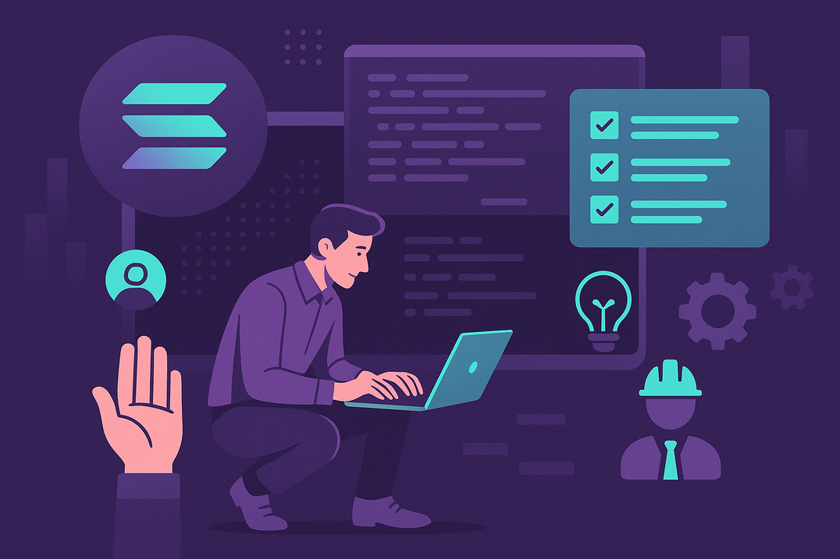
The Future of Solana Development: How to Hire for Long-Term Success
www.blockchainx.tech

Slide 2
Solana has quickly established itself among the leading blockchain platforms, offering unmatched speed, low transaction costs, and scalability that rivals those of traditional systems. Its unique architecture bolstered by innovations such as Proof of History (PoH) positions Solana to accommodate mass adoption levels that other blockchains barely cope with. As the ecosystem grows-from DeFi and decentralized exchanges (DEXs) to gaming, NFTs, and the tokenization of real-world assets-businesses are recognizing that building on Solana is not merely a fad but a long-term investment for the future of finance, technology, and digital ownership. It is crucial to Hire professional Solana developers who understand not only the present environment but who are also ready to adapt to the fast-changing world of this platform to stay competitive. The right team today ensures your success tomorrow.

Slide 3
The New Skill Set of a Modern Solana Developer
All that Solana developers used to know was at least a little programming in either Rust or C. They would also have to decipher smart contract security, optimization techniques required for Solana's highly parallel runtime (Sealevel), and concentrated knowledge about dApp architecture. Besides coding, ideal developers should know the basics of tokenomics, Layer 1 and Layer 2 designs, DeFi primitives, and the reason why user-centric design is so critical in Web3. Soft skills transformed into a team sport along with an adaptive creative problem-solving and a growth mindset are instead as important as technical know-how in such a rapid transitional space. The more developers get involved with Solana hackathons and open source projects and forums, the more they learn by bringing real-world knowledge that cannot be taught in the classroom.

Slide 4
Hiring for Potential, Not Just Experience
Traditional criteria for hiring, such as “years of experience,” may fall short in a field as new and rapidly evolving as Solana development. Most of Solana's top engineers just a few years back entered the blockchain space and are now outperforming their counterparts with sheer passion, rapid learning, and an unyielding focus on hands-on experimentation. Instead of finding candidates that check every technical box today, organizations should be looking for builders who show curiosity, have an intrinsic motivation to pioneer their ideas, and have a sincere interest in what blockchain technology can offer. Better outcomes can be achieved in the long term by investing in those hungry to grow—and enabling them through proper internal mentorship, educational resources, and chances for innovation—versus working with an exclusive pool of so-called “veterans” who may always be in demand and short.

Slide 5
In-House vs. Remote Teams: What Works Best for Solana Projects
The global and decentralized nature of Web3 does not make remote teams just a choice; it actually gives developers a competitive advantage. Solana developers are located worldwide, from North America to Europe to some of the fastest-growing hubs in Asia and Latin America. Remote working allows companies to recruit niche skills, work across time zones, and scale development work without the limitation of being at one place. For collaborative projects that require quick iterations, heavy cross-functional coordination, or protection of delicate IP, having an in-house team or hybrid team allows for greater control and cultural alignment. In practice, most successful Solana projects adopt a hybrid approach: a core team in close physical quarters, enhanced with remote contributors who have specialty in certain modules or areas of expertise.

Slide 6
Retention Is the New Recruitment
In the world of recruiting for blockchain talent, retaining your best developers probably could be given as much value as hiring. Losing even a single key Solana engineer may cost many months, if not years, of development on your project while causing a massive loss in knowledge. That's why it's important to create environments for your organization in which developers can get as much of a sense of ownership and mission alignment as well as personal career growth. Retention measures can include serious token equity, performance-based bonuses, continuous learning opportunities, leadership opportunities or even pathways that lead to product ownership. It's important to keep a culture of innovation and psychological well-being where developers can experiment, exchange ideas, and be considered more than just technical output. Companies investing in the long-term growth of their teams will naturally have strong loyalty toward their organization and a highly motivated workforce to meet the next level of innovation in blockchain.

Slide 7
Conclusion
Hiring for Solana development is not just about filling technical roles, but actually, building a robust and future-ready team around this swift-changing ecosystem where one of the fastest-evolving sectors in the tech world exists-in doing so, would possibly set long-term success for companies by focusing on hiring for potential rather than pure experience, by creating a strategic mix of in-house and remote team structures, and by putting the whole endeavor under a strong retention and career development agenda. All of that, whether you are developing your core engineering team or scaling out globally, will be critical to bringing in the very best of such a pool of Top remote Solana developers to scale fast and keep an edge on innovation. The Solana ecosystem will cast its web wider into new domains-from payments and gaming to AI-integration, and there the nimble, skillful, and passionate team of the future will emerge. Future-proof your Solana team today to seize tomorrow's greatest opportunities.

Slide 8
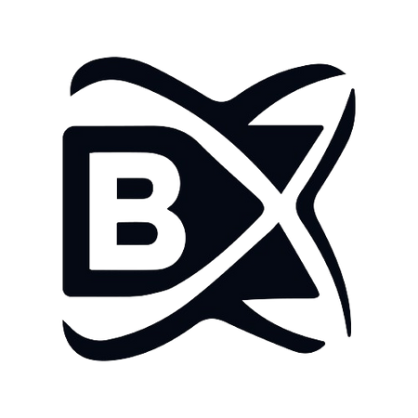



THANK
YOU
www.blockchainx.tech
contact@blockchainx.tech
+91 7708889555

