Slide 1

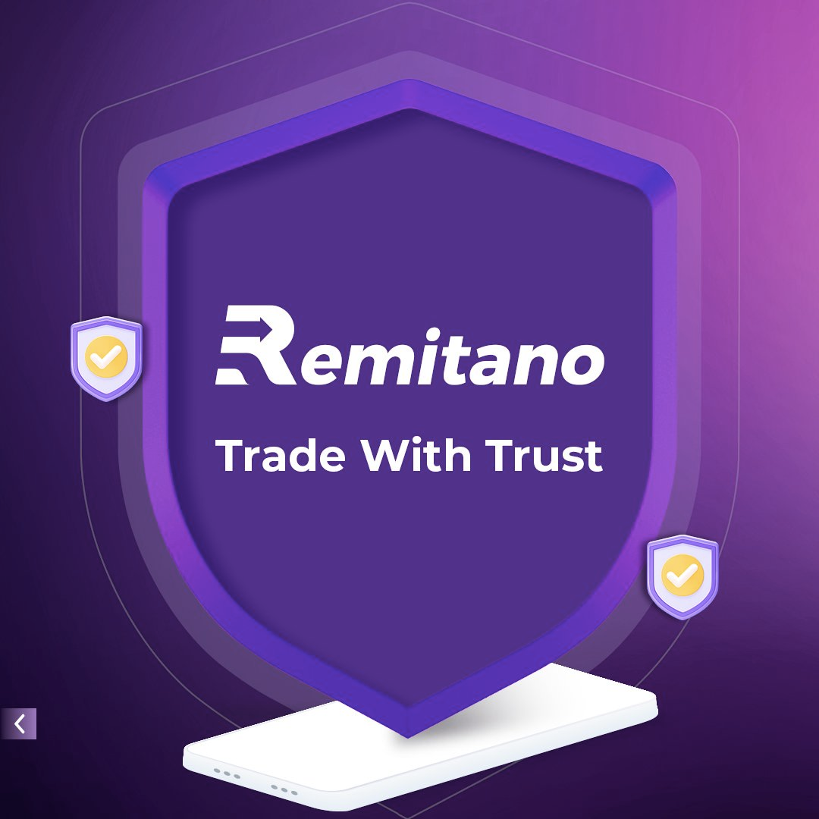

Start your own P2P crypto exchange like Remitano

Slide 2


INTRODUCTION
Cryptocurrency has established itself as a booming business as peer-to-peer (P2P) crypto exchanges receive significant growing popularity. P2P exchanges grant power to their users because they implement direct crypto trading without platform intermediary involvement. Remitano represents one of the top P2P platforms which has established its position through a user-friendly design and powerful security capabilities and personalized user services.
Entrepreneurs and startups seeking entry into the crypto field can create a profitable P2P crypto exchange such as Remitano. A Remitano clone script helps developers speed up project development and deliver efficient customized services. The following information outlines the process of founding a P2P crypto exchange through clone scripts while examining key features and benefits of using this development approach.

Slide 3

CONCEPT IN BUSINESS
A P2P crypto exchange runs through peer-to-peer protocols which enable users to conduct direct cryptocurrency trades via a decentralized platform. On P2P platforms users establish buy or sell offers for direct cryptocurrency transactions without the intervention of a third-party while the platform matches them by specific parameters like payment methods and prices and locations.
The P2P crypto exchange Remitano demonstrates successful implementation with its user-friendly security-driven platform that operates internationally.

Slide 4
REMITANO CLONE SCRIPT - OVERVIEW
The Remitano clone script functions as a pre-packaged software platform that delivers duplicate operation capabilities just like the official Remitano P2P exchange. A clone script incorporates all necessary features and backend frameworks together with design elements that enable fast exchange platform deployment. The main benefits of using clone scripts include:
  Reduced Development Time: Launch your platform in weeks instead of months.
  Cost-Effective: Save money on building from scratch.
  Customizable: Tailor the UI/UX, features, and branding as per your business needs.
  Scalable: Easily expand your platform as user demand grows.
Your business journey into crypto exchange development will get a strong start through implementing a Remitano clone script whether you operate as a new startup or an established organization.

Slide 5


Start Your P2P Crypto Exchange Like Remitano
01
02
03
Define Your Niche and Region
Choose the Right Tech Partner
Implement Strong Security
04
05
06
Focus on User Experience
Marketing and User Acquisition
Ongoing Support and Updates

Slide 6





Key Features of Remitano Clone Script
01
User Registration & KYC
02
Escrow System
03
Multiple Payment Options
04
Dispute Resolution

Slide 7
BEST P2P CRYPTO EXCHANGE LIKE REMITANO PROVIDER
The decentralized operation and privacy features together with flexible exchange systems of peer-to-peer (P2P) trading platforms have rapidly increased their popularity in the cryptocurrency market. The platform known as Remitano provides an industry-leading model of P2P crypto trading that maintains both security and efficiency. Entrepreneurs seeking to establish their own exchange should select BlockchainX because this company emerges as a top choice for technical partnership.
Users can find BlockchainX to be one of the leading providers of P2P crypto exchange scripts that enables startups to develop platforms which replicate Remitano's functionality. BlockchainX provides the necessary tools and technology which enables businesses to create either a regional market leader or a worldwide trading hub.

Slide 8


Conclusion
Initiating a P2P crypto exchange platform like Remitano represents an attractive business opportunity within the decentralized financial market of the present day. A properly designed strategy combined with suitable technology selected from available features helps develop a safe, convenient and successful cloud-based crypto platform within an expanding marketplace.
A Remitano clone script provides startups with an efficient platform to launch their operation because it reduces both market entry risks and operational costs. Your emphasis on branding and user base development can occur after you select a customizable script that also offers scalable security features.
The financial world moving toward decentralization means you possess the capacity to spearhead this revolution through proper tools.

Slide 9





Thank You
Connect with us.
7708889555
contact@blockchainx.tech
https://www.blockchainx.tech/

