Slide 1


BEST PRACTICES FOR CREATING HIGH-CONVERTING EMAIL CAMPAIGNS WITH EMAIL MARKETING SERVICES
www.growthwayadvertising.com

Slide 2
Companies depend on modern email marketing solutions to attract consumer participation and increase their sales performance in the current digital business environment. Your results from email marketing efforts will improve remarkably when you work with either an email marketing agency or self-service email marketing websites by implementing best practices. This article demonstrates essential methods to develop effective email promotion campaigns that drive conversions.
  Understanding Email Marketing Services
Email marketing services help businesses automate, personalize, and optimize their email campaigns.These services help both small startups along with large corporations to develop leads while promoting products and sustaining customer relationships. The leading providers of email marketing solutions provide their users with automatic processes and data segmenting features together with analysis tools for improved operational efficiency.

Slide 3
Best Practices for High-Converting Email Campaigns
1. Personalize Your Emails
Businesses achieve better results from messages which address specific audience needs. Your email marketing service provider data enables you to segment your audience into distinct groups through demographic and behavioral analysis and customer interests. Targeted communication that uses personal names increases the level of recipient interaction.
2. Optimize Subject Lines and Preheaders
The first impression matters! Design strong headers in your emails since they create motivation for people to open your messages. A/B testing, offered by many email marketing companies in India , helps determine what works best for your audience.

Slide 4
3. Use Responsive Design
More than half of email opens happen through mobile devices so it becomes essential to guarantee your emails remain mobile-friendly. Excellent email marketing service providers give their users responsive template options that enhance the reading experience for their recipients.
4. Include Clear Call-to-Actions (CTAs)
Through your email communications you must direct subscribers to complete particular actions including product buying and webinar signing up as well as eBook downloading. Once integrated properly CTAs boost conversion rates and generate improved financial returns for India-based businesses which use email marketing services.

Slide 5
5.Automate and Schedule Smartly
Email marketing agencies in India provide automation tools which enable businesses to generate timed messages that are relevant to customer behavior. Optimal time scheduling of emails leads to improved rate of email open actions and click-through engagements.

Slide 6
Choosing the Right Email Marketing Service Provider
Businesses should evaluate providers based on the following elements when choosing an email marketing service.
Features and Functionality: A right platform should incorporate automation together with segmentation and analytics and A/B testing functionality.
Ease of Use: A user-friendly interface enables both time-saving operation together with productivity improvement.
Integration Options: Investigate service providers that link with your existing CRM system and e-commerce platform and analytics solutions.
Customer Support: Customer Support functions as an essential feature since it assists businesses that are new to using email marketing.

Slide 7
The Growth of Email Marketing in India
Digital adoption growth creates an expanding market demand for email marketing solutions throughout India. Businesses which work with established email marketing agency can boost customer interaction through advanced tools that lead to improved ROI results.
Conclusion
Companies will achieve superior email campaign success by implementing these best operational practices. Every business that chooses between working with Indian email marketing agencies or utilizing self-service software should follow these successful strategies. The correct investment in email marketing service providers will produce significant conversion results.

Slide 8

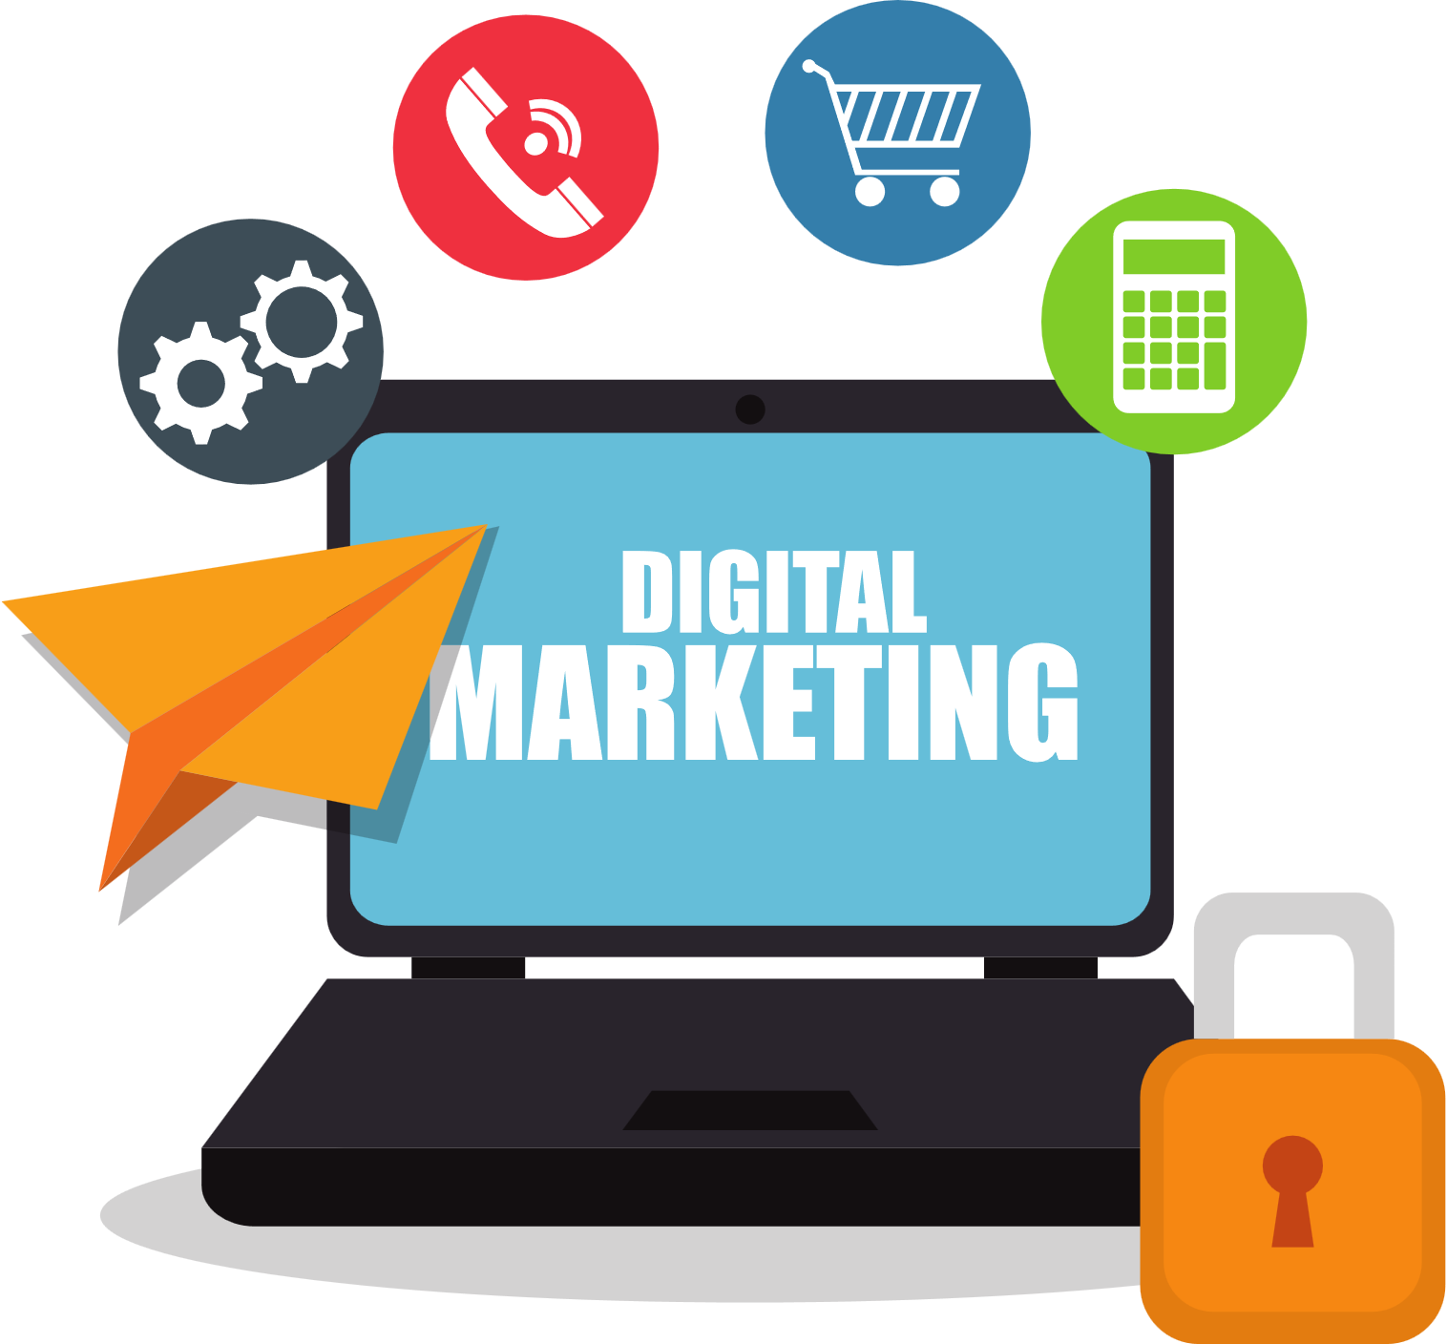
Contact us
  We combine creative marketing strategies with digital media and technology to drive your brand’s scalable and sustainable growth.
  With almost 10+ years of award-winning digital and creative marketing experience across start-ups, SMEs, and multi-national B2B and B2C brands, we love what we do!
  Visit: www.growthwayadvertising.com
  Call Us At: 91+ 7709280369
  Email: Bhavesh@growthwayadvertising.com
  Office No – 703, ANP Landmark, Sr. no. 89, Bhumkar Chowk,Hinjawadi – Wakad Rd, Pune, Maharashtra 411057

