Slide 1
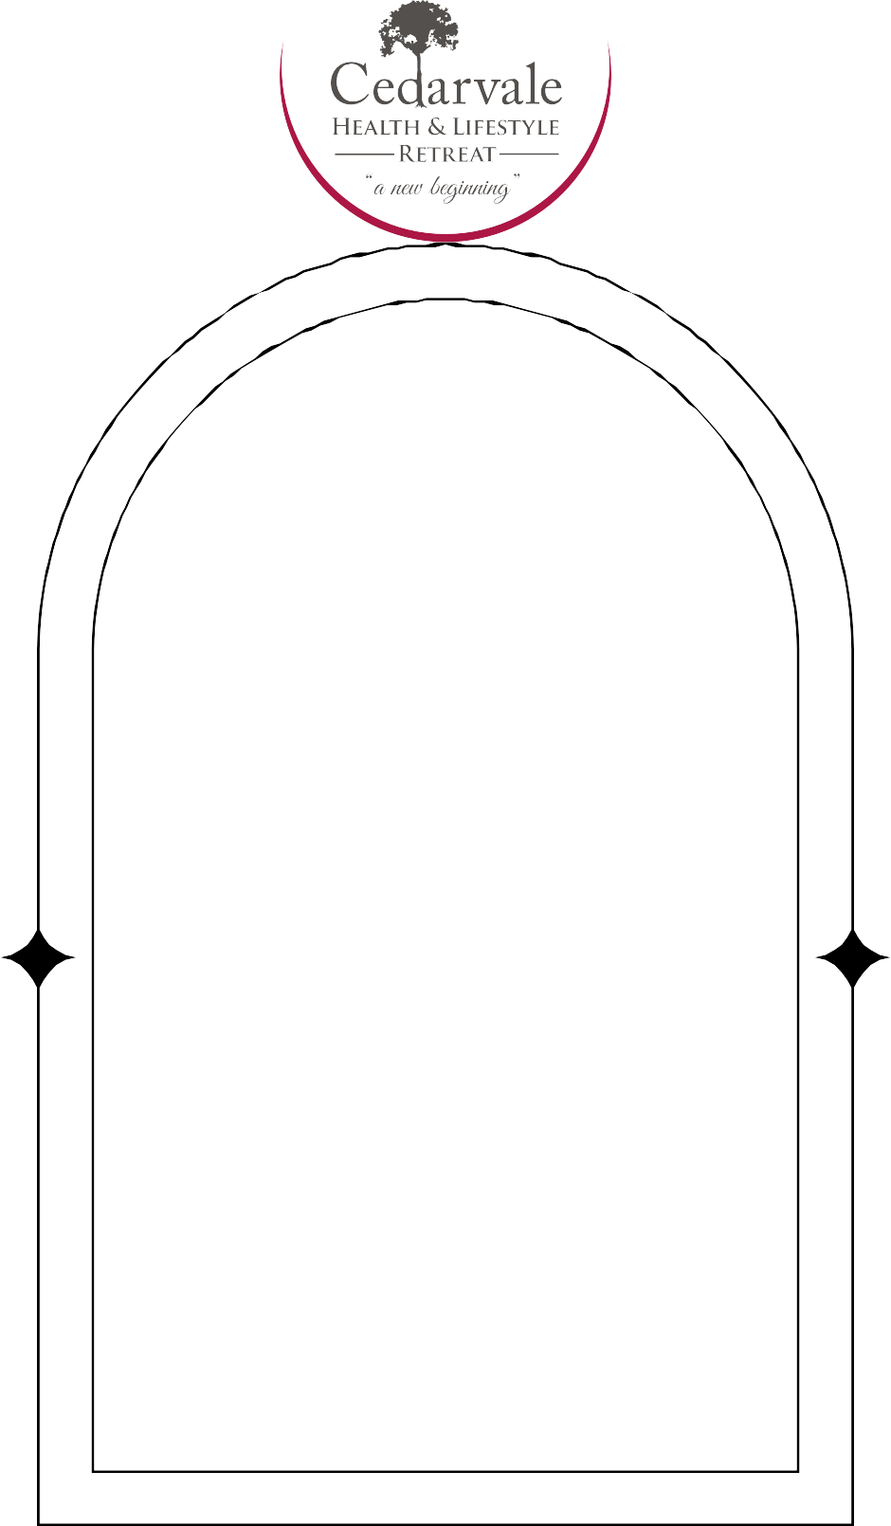
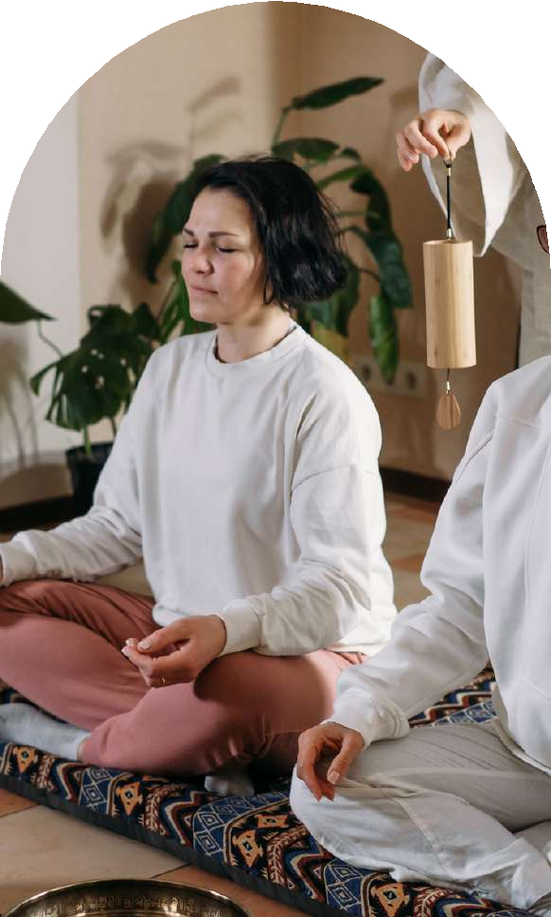
Finding Hope And Healing At A
cEDARVALE RETREAT
Mental Health Retreat
A mental health retreat opens the door to hope, healing, and self-discovery. It’s a place where your mind and heart can rest, reflect, and grow stronger, away from the noise and pressure of daily life.

Slide 2

The Powerful Impact Of A Mental
cEDARVALE RETREAT
Health Retreat Experience
Choosing a mental health retreat means choosing yourself. It’s a gift of time, space, and love an opportunity to rebuild inner strength, find clarity, and connect with a more peaceful, balanced version of your true self.

Slide 3
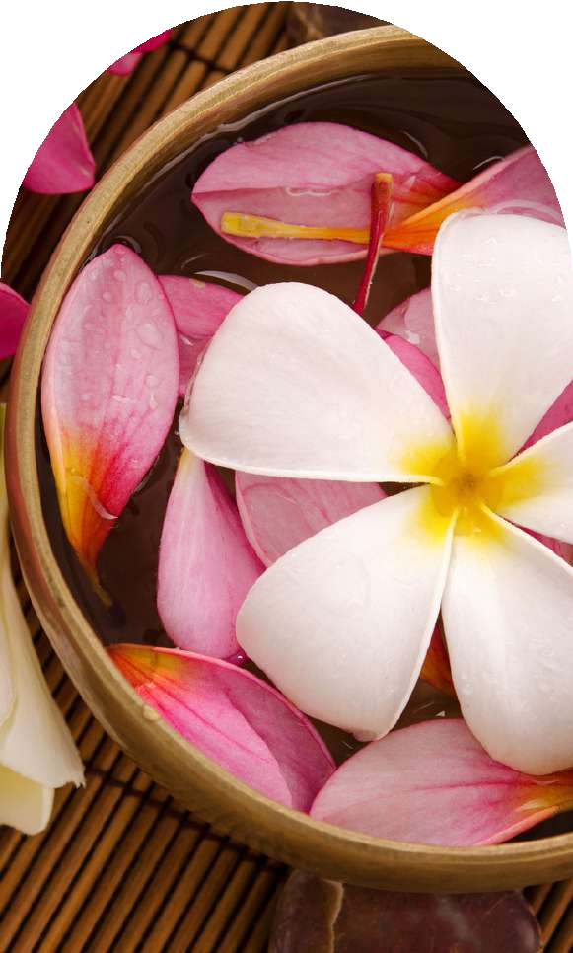
Understanding The Daily Journey At
cEDARVALE RETREAT
A Mental Health Retreat
During a mental health retreat, each day offers healing activities like therapy sessions, mindfulness practices, nature walks, and nourishing meals. A l are designed to gently guide you toward emotional renewal, inner peace, and lasting strength.

Slide 4

The Healing Benefits You’ l Find At
cEDARVALE RETREAT
A Mental Health Retreat
A mental health retreat brings powerful benefits like reduced anxiety, emotional breakthroughs, improved self-awareness, stronger coping ski ls, and deep, soulful rest. It’s a journey that nurtures your spirit and rebuilds your emotional foundations with love.

Slide 5

Choosing Between Therapy And A
cEDARVALE RETREAT
Mental Health Retreat
Unlike weekly therapy, a mental health retreat offers total immersion. It gives you the chance to break patterns, reset your mind, and fast- track your healing process while surrounded by supportive professionals and a nurturing environment.

Slide 6

Is A Mental Health Retreat Right
cEDARVALE RETREAT
For Your Healing Journey?
If you’re feeling overwhelmed, stuck, anxious, or lost, a mental health retreat could be your sanctuary. It’s a place for anyone ready to heal deeply, reconnect with themselves, and embrace positive, lasting life changes.

Slide 7

Finding Your Perfect Escape:
cEDARVALE RETREAT
Picking A Mental Health Retreat
Finding the right mental health retreat means considering your personal goals, emotional needs, and preferred healing methods. Look for a retreat that feels safe, compassionate, and designed to support your individual journey toward emotional we lness.

Slide 8

Heartfelt Transformations From A
cEDARVALE RETREAT
Powerful Mental Health Retreat
Guests often share inspiring stories of transformation after a mental health retreat. These are stories of renewed hope, stronger resilience, deeper self-love, and a profound sense of peace that stays with them long after returning home.

Slide 9
Simple Steps To Prepare For Your
cEDARVALE RETREAT
Mental Health Retreat
Before attending a mental health retreat, set clear intentions, a low space for emotions, and pack with comfort in mind. Be open to growth, trust the process, and prepare your heart for meaningful, beautiful change.

Slide 10

Your Healing Home: Cedarvale’s
cEDARVALE RETREAT
Mental Health Retreat
Cedarvale’s mental health retreat offers personalized care, expert guidance, and a nurturing environment. Through therapy, nature, community, and kindness, we help you heal deeply, rebuild your strength, and reconnect with the beautiful person you are.

Slide 11

Thank You For Exploring The
cEDARVALE RETREAT
Journey Of A Mental Health Retreat
Thank you for considering a mental health retreat as part of your healing journey. We hope you find the support, compassion, and lasting transformation you deserve. Your emotional we lness and happiness truly matter to us.

Slide 12

Let’s Start Your Healing Journey At
cEDARVALE RETREAT
A Mental Health Retreat
Take the first step toward healing at our mental health retreat. Reach out to Cedarvale’s caring team to discuss your needs, explore your options, and begin creating a beautiful new chapter for your life.

Slide 13

Contact Us
cEDARVALE RETREAT
Website - Www.Cedarvaleretreat.com.au info@cedarvaleretreat.com.au
2999 Moss Vale Rd Barrengarry, NSW 2577, Australia
291 Maroondah Hwy, Narbethong, VIC 3778

