Slide 1
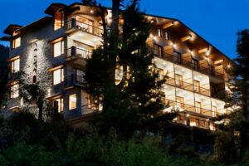


Home
About
Contact
WELCOME TO
ALOKA RESORT MANALI
WHERE COMFORT MEETS LUXURY
alokaresortmanali.com

Slide 2
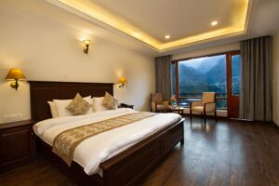
Home
About
Contact
ABOUT OUR RESORT
WHERE COMFORT MEETS LUXURY
​Aloka Resort, nestled amidst fir forests above the Beas River and overlooking Manali town, offers a luxurious retreat cradled by majestic mountain slopes. Each room provides stunning views of Himalayan peaks and valleys, combining modern comfort with the region's rich heritage. Our attentive staff ensures personalized service, making your stay memorable. Whether seeking adventure or relaxation, Aloka Resort serves as your gateway to the enchanting beauty and culture of Kullu Manali.
alokaresortmanali.com

Slide 3
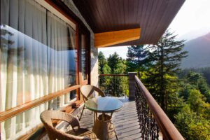
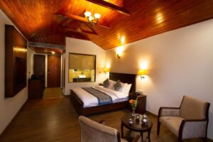
Home
About
Contact
ResoRT IN MANALI
Aloka Resort Manali offers a perfect escape for nature lovers and adventure seekers. As a top-rated resort in Manali, we provide stunning views, warm hospitality, and a luxurious stay amidst the Himalayan beauty.
alokaresortmanali.com

Slide 4
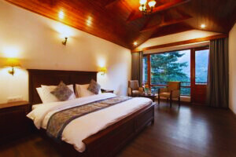
Home
About
Contact
CONTACT US
GET MORE INFORMATION
OUR ADDRESS :
OUR PHONE :
Chadyari, Tehsil Manali, Distt Kullu H.P, 175131, INDIA
+91 78386-09537, +91 98160-76122
alokaresortmanali.com

