Slide 1
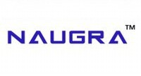
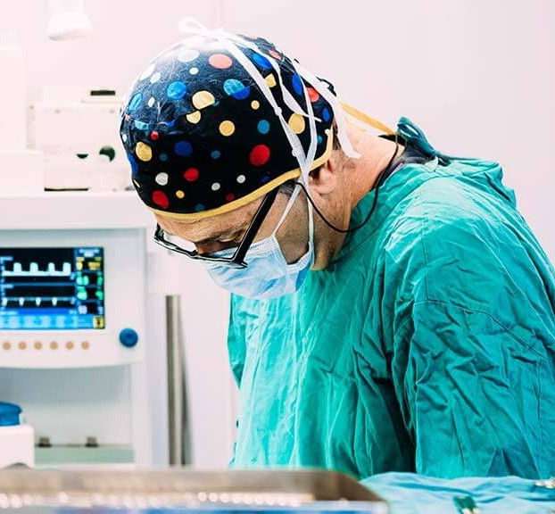
Naugra Medical
About us
Naugra Medical is a trusted manufacturer and exporter of high-quality medical, surgical, and hospital equipment. Based in Ambala, India, we supply a wide range of products to hospitals, clinics, and institutions across Asia, Africa, the Middle East, Europe, and South America. With a focus on innovation, quality, and affordability, we serve the healthcare and medical education sectors worldwide. Our commitment to excellence, timely delivery, and international standards makes us a preferred choice for reliable medical equipment solutions globally.
Laryngoscope Set and Spares Manufacturers
Laryngoscope Set and Spares Manufacturers specialize in producing high-quality tools essential for airway management in medical settings. These manufacturers offer durable, precision-crafted
laryngoscope blades, handles, and replacement parts. Trusted globally, they ensure compliance with safety standards and provide reliable products for hospitals, clinics, and emergency services, supporting critical care and anesthesia procedures with consistent performance and innovation.
Why Choose Naugra Medical?
Naugra Medical has over 20 years of experience in manufacturing and exporting high-quality medical equipment. The company exports to more than 80 countries, supported by a robust global logistics
network and dedicated customer service. All patient monitors from Naugra Medical are certified to international standards, including CE and ISO, ensuring compliance and safety. The brand also provides customized solutions tailored to specific client requirements, making them an ideal partner for healthcare projects of all sizes. With a proven track record of delivering excellence, Naugra Medical stands out as a reliable exporter in the global medical industry.

Slide 2
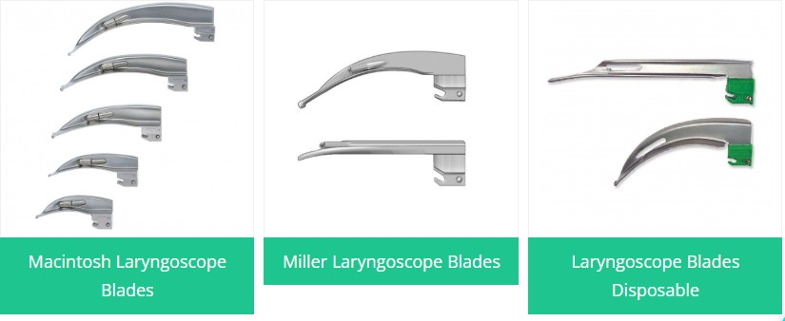
Contact us:
Email : sales@naugramedical.com
Telephone: +91-0171-2643080 , 2601773,
Fax: +91-0171-2607146
Website: Product

