Slide 1
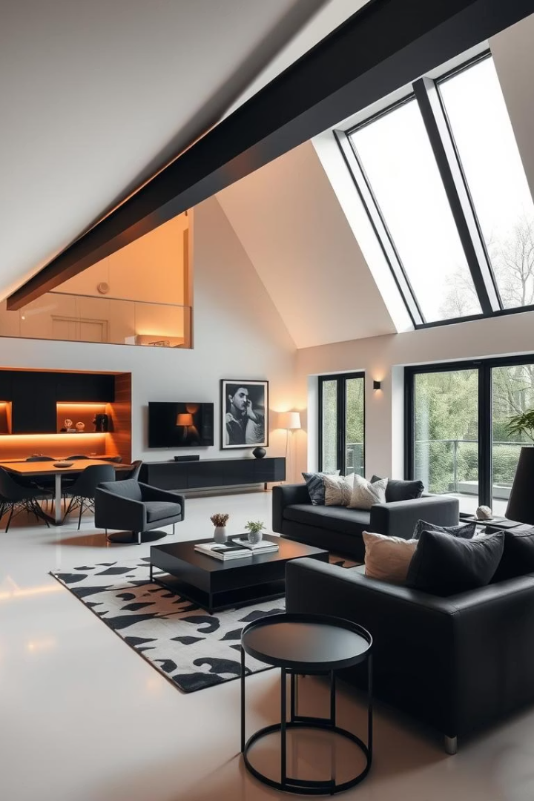

Unlock Your Home's Potential with The Loft Worm
Discover the possibilities of loft conversions with The Loft Worm. Maximize space and add value to your property. We specialize in mansard loft conversion cost, dormer conversions, and more. Let us help you transform your home.
Notes:
1

Slide 2
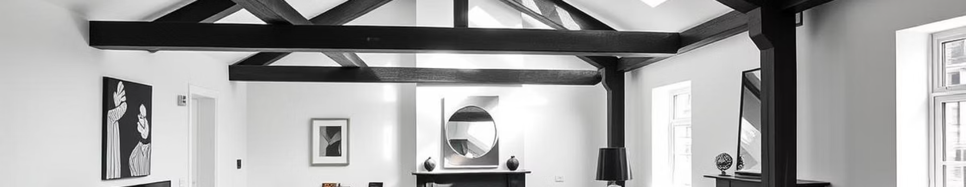



Why Choose a Loft Conversion?
Increase Living Space
Add Home Value
Tailored Designs
Expand your living area without the hassle of moving to a new house.
Loft conversions can significantly increase your home's value, up to 20%.
Custom designs to perfectly match your lifestyle and specific needs.
Notes:
2

Slide 3
Mansard Loft Conversions: Elegance & Space
Maximize Space
Planning Permission
Create a new top floor with maximized headroom and floor space. Ideal for period properties.
Considerations for mansard loft conversion cost. Understand the planning permission requirements and process.
  Flat roof extension
  Optimized space utilization
  Navigate regulations
  Expert guidance
Notes:
3

Slide 4
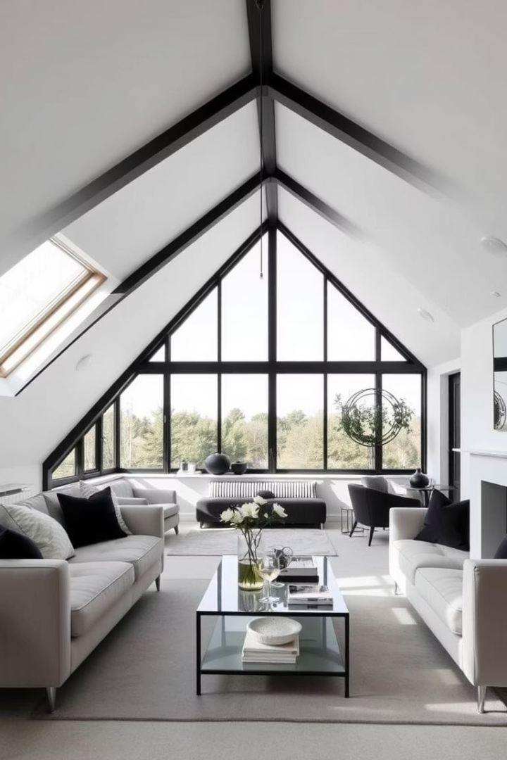




Double Dormer Loft Conversions: Light & Airy
Increased Light
Create symmetrical additions for maximum natural light.
Enhanced Appeal
Boost kerb appeal and add architectural interest.
Larger Spaces
Ideal for larger loft spaces, providing ample room.
Notes:
4

Slide 5
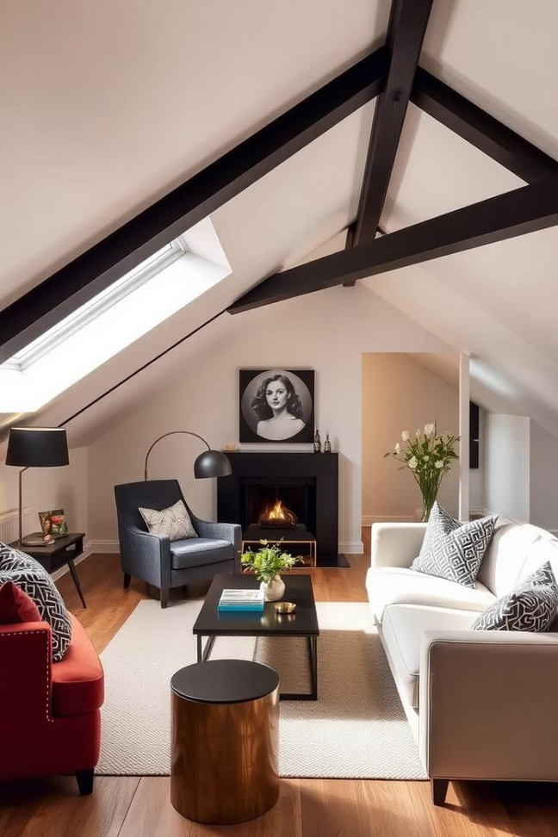
Dormer Loft Conversions: A Classic Choice
Cost-Effective
Variety of Styles
A simple and budget-friendly way to add headroom and usable space.
Available in various styles to suit different property types and preferences.
Tailored Solutions
The Loft Worm provides custom dormer attic conversion solutions.
Notes:
5

Slide 6
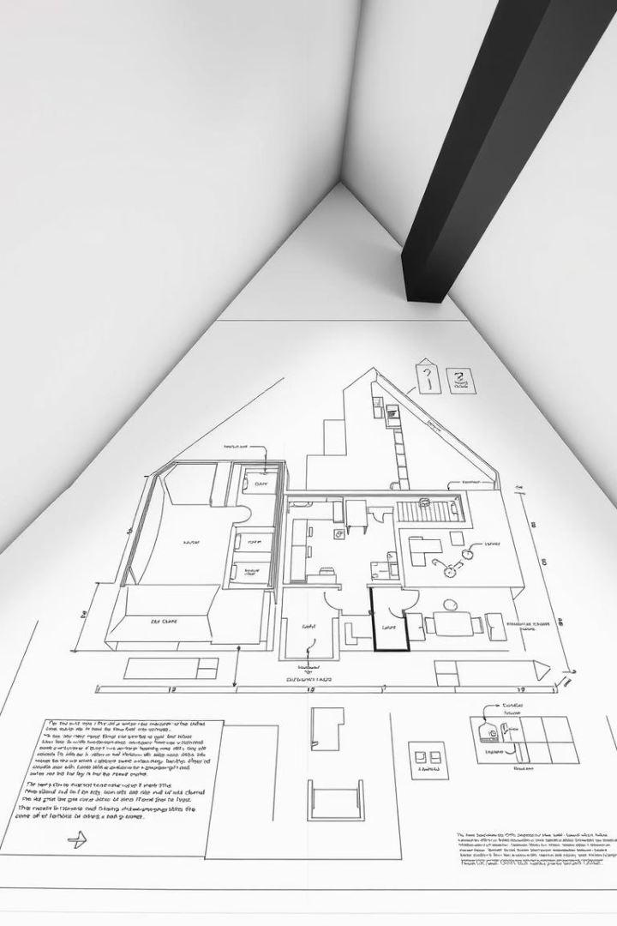
Factors Affecting Loft Conversion Cost
Size and Complexity
The larger and more complex, the higher the cost.
Materials and Finishes
Choice of materials can impact the overall price.
Planning Permission
Fees and regulations can influence your budget.
Contact us for a personalized quote on
double dormer loft conversion. We provide transparent and detailed cost breakdowns.
Notes:
7

Slide 7



Ready to Transform Your Loft? Contact Us Today!
Website
Phone
Email
theloftworm.co.uk
07967674495
info@theloftworm.co.uk
Let The Loft Worm help you create your dream space. Contact us today to start your loft conversion journey!
Notes:
8

