Slide 1


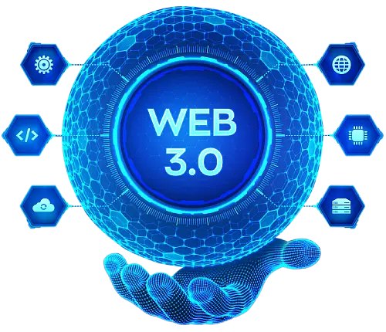
The Role of Web3 in Digital Privacy: Protecting User Data in Decentralized Systems
www.blockchainx.tech

Slide 2
Web3 development has engendered a shift of paradigm for the digital ecosystem focused on decentralization and user control over their data. In contrast to the traditional web models in which user data is controlled by a centralized entity, Web3 empowers users by using blockchain so that data is not stored in some centralized database that may be vulnerable to hacking or misuse. The ever-evolving digital world places paramount importance on the protection of user privacy, and Web3 has come up with solutions to counter these problems. Web3 development offers a decentralized structure that minimizes the risk of data breaches and ensures that individuals have control over sharing, storing, and accessing their private information. This decentralized architecture not only eliminates single points of failure but also guarantees transparency in making the web user-centric and safe. All in all, this turn represents a fundamental rethinking of how interactions are done online, with privacy being at the center.

Slide 3
Decentralization and Data Ownership
Decentralization is one of the core principles of Web3, transferring the power of data from centralized corporations directly into users' hands. This means that there is no central authority that can access, sell, or misuse an individual's personal data. In a Web3 ecosystem, blockchain technology creates a distributed ledger that will securely store user data, preventing a single point of control. Users decide what to disclose and have the ability to withdraw it at any time. Such change brings transparency as users can easily see who is accessing their data and under what conditions. Web3 helps to further minimize the chances of third-party interception and potential misuse because it gives users ownership of their data. This factor makes it far more difficult for corporations or hackers to profitably exploit private information.

Slide 4
Enhanced Security through Blockchain Technology
Blockchain technology, the basis of Web3, is essential to the enhancement of digital privacy. It does secure transactions and data exchanges by various cryptographic techniques in a transparent, immutable, and verifiable manner. Once information is registered onto a blockchain, its alteration or tampering becomes possible with the consent of network participants; its alteration or tampering without consent is nearly impossible. The decentralized nature of this platform makes hacking into useful user information immensely more difficult when compared to regular centralized structures. This is a great boon for privacy-centered users hoping to carve an extra layer of protection over their private information. In addition, when the blockchain is fully transparent, it allows everyone outside to verify the data; hence, detection of fraudulent activities or tampering becomes even easier, which in turn boosts the level of trust in digital systems.

Slide 5
Smart Contracts and Privacy Protection
Smart contracts help provide privacy and security in Web3 by being self-executing contracts coded into blockchain networks. They execute transactions without any third-party intervention once certain predefined conditions are satisfied. This way, the chances of data exposure and manipulation are minimal since users directly interact with one another on secure transactions. Additionally, some usage of zero-knowledge proofs (ZKPs) allows users to prove their identity or any other personal attribute without having to reveal sensitive information during the smart contract interaction. This capability for privacy-preserving authentication ensures that only the data required is shared, thereby minimizing the risks associated with unauthorized access to data. With their ability to limit interference and provide mechanisms to ensure privacy, smart contracts contribute to a secure and private digital environment.

Slide 6
The Role of Decentralized Identity Management
There is a big need for decentralized identity management (DID) systems in the Web3 environment as it continues to grow and give better protection for digital privacy. Just as with all other digital identities, DIDs reinforce the fact that users have control over their digital identity rather than have it placed under the governance of the central authority, which is the usual model for identity. The common feature in almost all traditional identity-based systems is that users authenticate themselves using a centralized identity provider and can thereby be vulnerable to fraud, identity theft, and data breaches. Thus, decentralized identifiers are different from the specific platforms or services, which means that a user controls his entire digital footprint across various applications and hence improves privacy and security. Such decentralized identities can also be very flexible and let users easily manage and share their credentials but not be required to share unrelated personal information. Therefore, such an environment will cut down significantly the possibility of identity theft and lacking track, which by consequence helps protect malicious actors more robustly against possible threats.

Slide 7
Challenges and the Future of Web3 Privacy
Web3 holds many righteous promises of developing advanced mechanisms for digital privacy protection; however, there are certain challenges yet to be addressed. The technology is still advancing; scalability and concurrent user adoption, however, remain considerably daunting tasks. The decentralized nature of Web3 challenges security; however, it is a double-edged sword, causing slower transactions and higher costs in comparison to centralized solutions. The assurance by blockchain of data integrity and security does not nullify hypothesized privacy breaches, especially concerning the public nature of certain blockchain networks. In particular, the personal data stored upon the public ledger may, under improper circumstances, lead to involuntary exposure of sensitive information. In the coming times, most probably, the focus of Web3 privacy will be on scalability solutions for decentralized systems; the development of a user-friendly tool for privacy management; and the fine-tuning of privacy-preserving technologies such as ZKPs and encrypted storage. While efforts will address these challenges, Web3 will lay the groundwork for a more secure and privacy-preserving digital world.

Slide 8
Conclusion
Future progress on digital privacy matters is linked to the ongoing development of Web3 technologies. As more and more individuals and organizations seek to explore what Web3 has to offer in application development, user privacy will only gain in importance in the context of data protection. The unprecedented security, transparency, and control offered by decentralized systems will empower people to determine for themselves how they would like to use the digital space. Web3 app development opens up new avenues for creating applications that are privacy-focused and allow users to control their personal data. Even as the Web3 ecosystem evolves, it will still be imperative that developers look into privacy and add next-gen security functionalities as part of their solutions. The progressive improvement of Web3 in application development will usher in a more secure digital experience that will not only be private but also user-centric, paving the way for a new era of data ownership, online privacy, and user autonomy. Decentralization and the power of blockchain will revolutionize the way personal data is protected and managed in the future with Web3 applications.

Slide 9




Thank You
CONTACT US
www.blockchainx.tech
contact@blockchainx.tech
+91 7708889555

