Slide 1


Introduction to Lifestyle Medicine Retreats
Lifesty le Medicine Retreats Provide A Holistic Approach To Health, Focusing On Preventative Care Through Personalized Wellness Programs. These Retreats Offer Evidence-Based Strategies To Improve Physical, Mental, And Emotional Well- Being.
Www.cedarvaleretreat.com.au

Slide 2

Core Principles of Lifestyle Medicine
Lifesty le Medicine Retreats Emphasizes Nutrition, Physical Activity, Stress Management, Sleep Optimization, And Social Connection. These Principles Address Root Causes Of Chronic Diseases, Promoting Sustainable Health Improvements And Long-Term Well-Being.
Www.cedarvaleretreat.com.au

Slide 3

Benefits of Lifestyle Medicine Retreats
Participants Experience Improved Energy Levels, Reduced Stress, Better Sleep Quality, And Enhanced Mental Clarity. These Lifesty le Medicine Retreats Offer A Supportive Environment For Long-Term Health Transformations Through Guided Expert Interventions.
Www.cedarvaleretreat.com.au

Slide 4
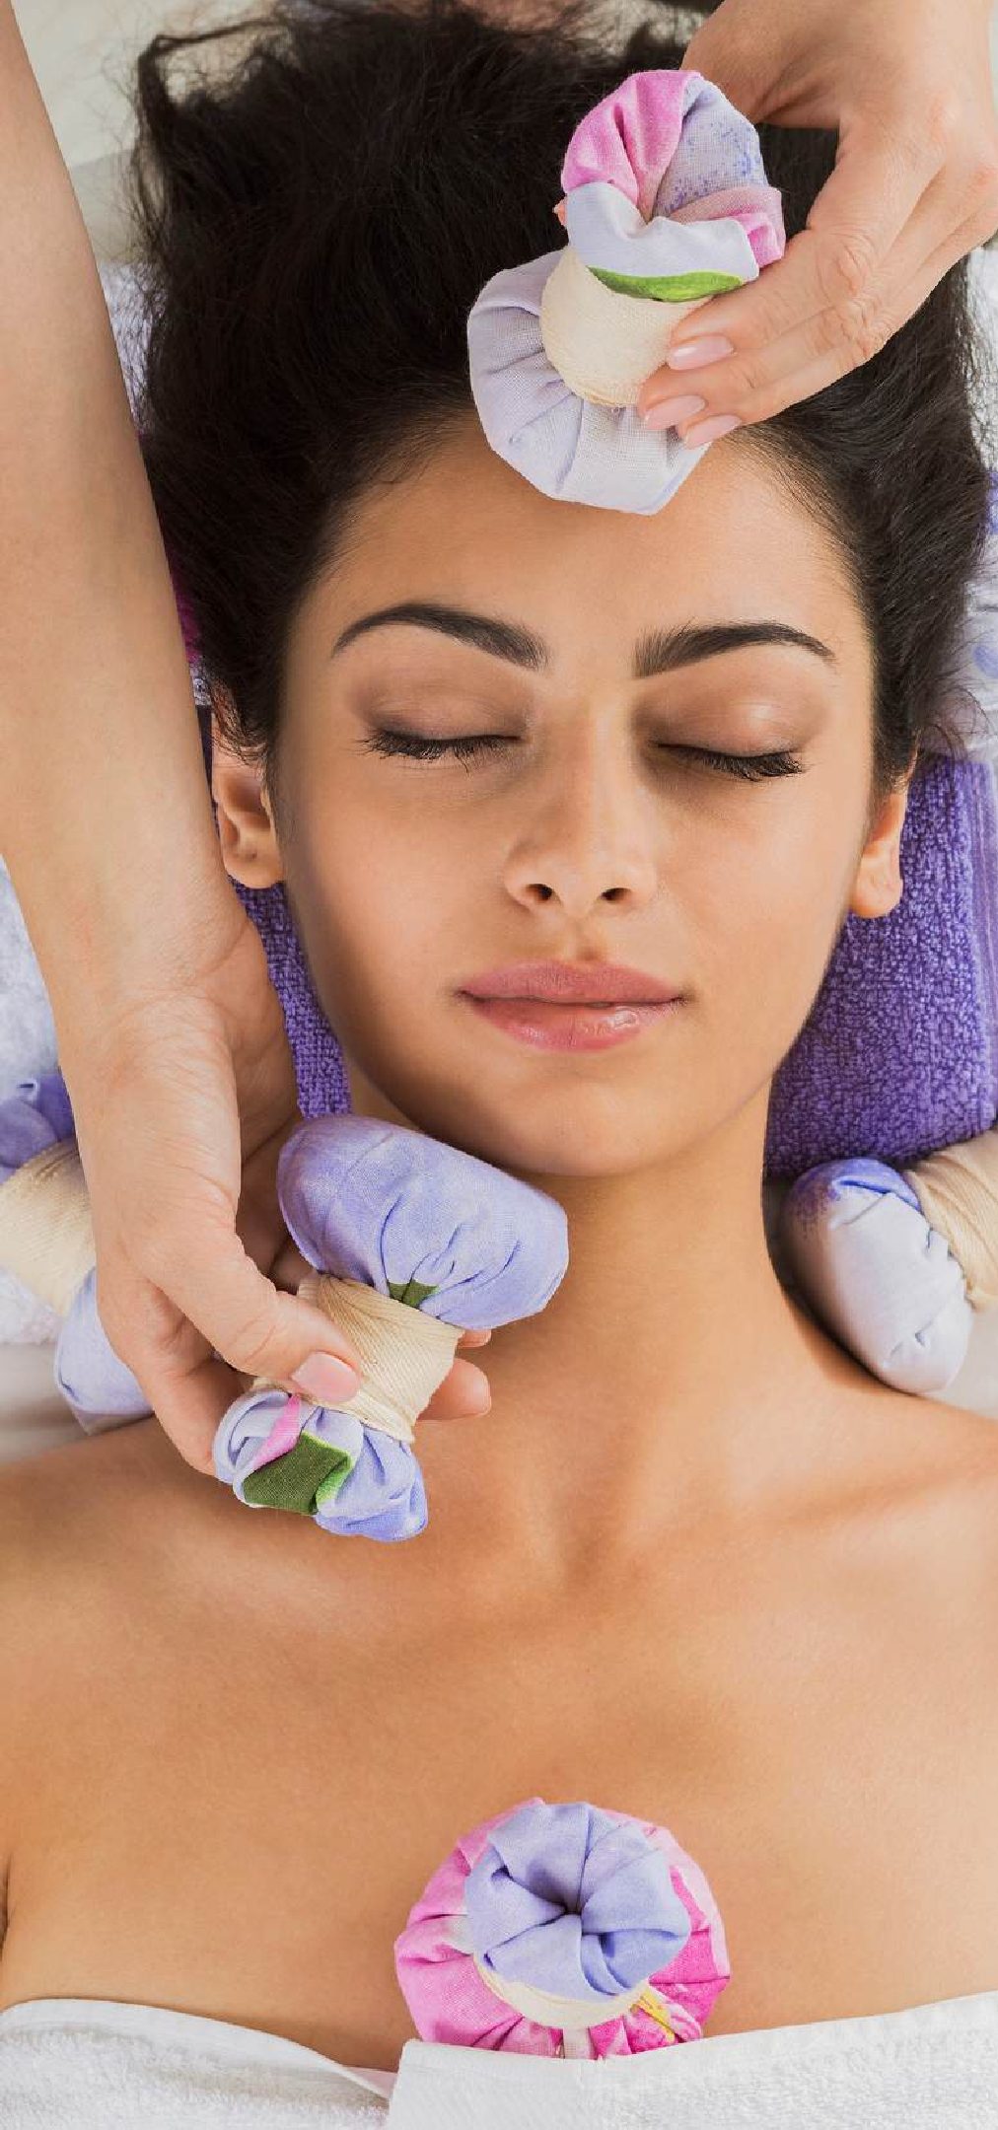
Personalized Wellness Programs
Each Lifesty le Medicine Retreats Offers Tailored Wellness Plans, Addressing Individual Health Concerns. These Programs Include Comprehensive Assessments, Lifestyle Coaching, And Evidence-Based Interventions To Optimize Overall Well-Being.
Www.cedarvaleretreat.com.au

Slide 5

Nutrition and Healthy Eating
A Key Focus Of These Lifesty le Medicine Retreats Is Nutrient- Dense, Whole-Food Diets That Support Optimal Health.
Participants Learn Practical Strategies For Sustainable Healthy Eating Habits That Prevent And Reverse Chronic Conditions.
Www.cedarvaleretreat.com.au

Slide 6

Physical Activity and Fitness
Daily Exercise Sessions Are Designed To Improve Cardiovascular Health, Strength, And Flexibility. Lifesty le Medicine Retreats Incorporate Tailored Fitness Routines, Promoting Consistency And Long-Term Commitment To An Active Lifestyle.
Www.cedarvaleretreat.com.au

Slide 7

Stress Management Techniques
Mindfulness, Meditation, And Relaxation Techniques Help Reduce Stress And Enhance Emotional Well-Being. Lifesty le Medicine Retreats Provide Tools To Cultivate Resilience, Balance, And Mental Clarity Through Holistic Approaches.
Www.cedarvaleretreat.com.au

Slide 8

Sleep Optimization and Recovery
Quality Sleep Is Essential For Health And Longevity. Lifesty le Medicine Retreats Educate Participants On Sleep Hygiene, Circadian Rhythms, And Natural Interventions That Improve Sleep Patterns And Overall Restorative Health.
Www.cedarvaleretreat.com.au

Slide 9

Social Connection and Community Support
Strong Social Connections Enhance Emotional Resilience And Overall Well-Being. Lifesty le Medicine Retreats Foster A Sense Of Community, Encouraging Participants To Build Meaningful Relationships That Support Long-Term Health Goals.
Www.cedarvaleretreat.com.au

Slide 10

Conclusion and Next Steps
Lifesty le Medicine Retreats Offer Transformative Experiences, Empowering Participants To Take Charge Of Their Health. With Personalized Plans And Expert Guidance, These Lifestyle Medicine Retreats Provide Sustainable Strategies For Lifelong Well-Being.
Www.cedarvaleretreat.com.au

Slide 11
Welcome to Lifestyle Medicine Retreats
Welcome To Lifestyle Medicine Retreats, Your Destination For Holistic Health And Well-Being. Visit Us At Cedarvale Retreat.
Contact: NSW (02) 4465 1362 | VIC (0423) 749 175. Email:
info@cedarvaleretreat.com.au. Address: 2999 Moss Vale Rd, Barrengarry, NSW 2577, Australia
Www.cedarvaleretreat.com.au

