Slide 1
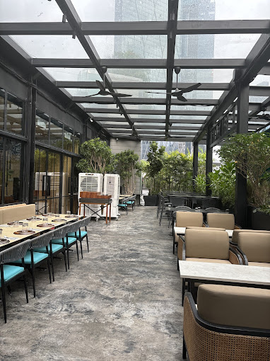
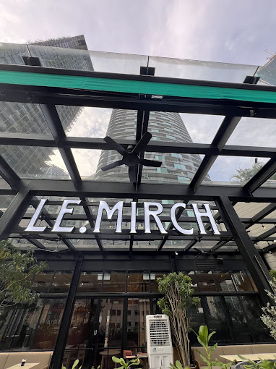

Slide 2
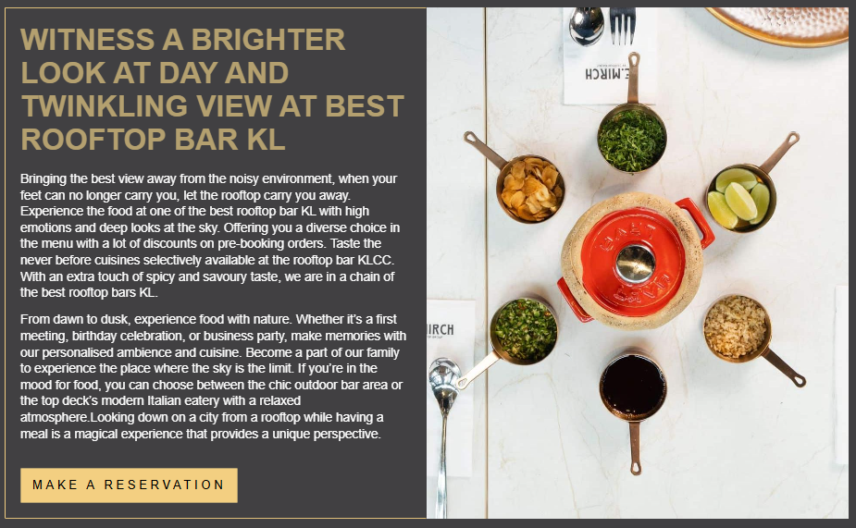

Slide 3

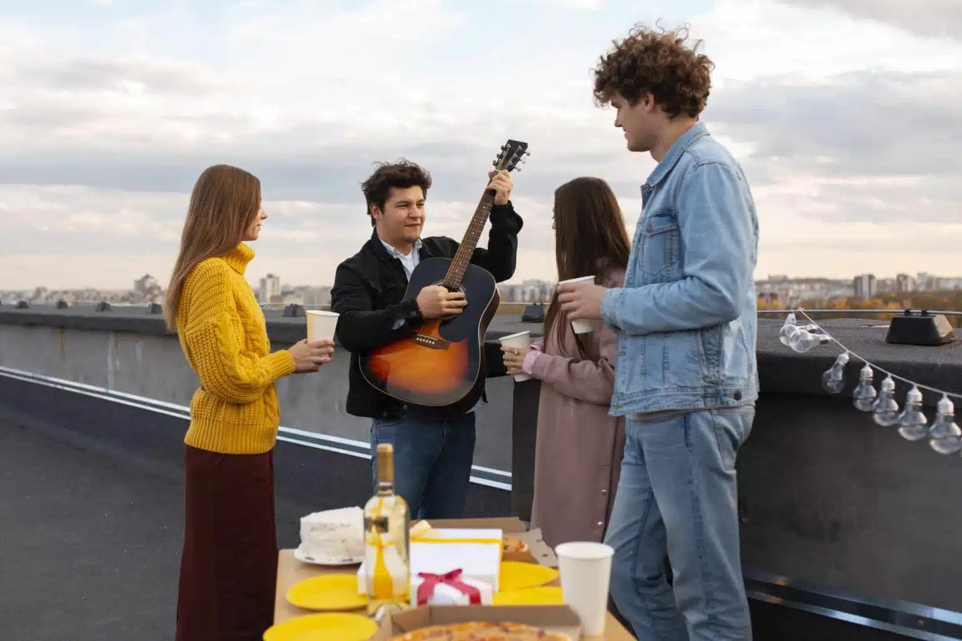

Slide 4
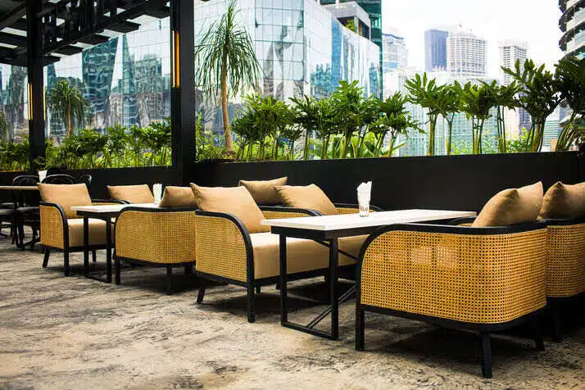

Bringing the best view away from the noisy environment, when your feet can no longer carry you, let the rooftop carry you away. Experience the food at one of the best rooftop bar KL with high emotions and deep looks at the sky. Offering you a diverse choice in the menu with a lot of discounts on pre-booking orders. Taste the never before cuisines selectively available at the rooftop bar KLCC. With an extra touch of spicy and savoury taste, we are in a chain of the best rooftop bars KL.

Slide 5
