Slide 1
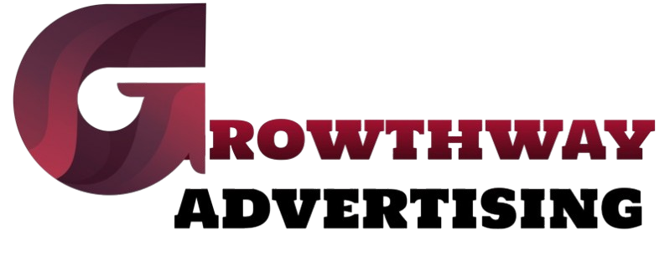
Why UI/UX Design is Crucial for Business Growth in 2025
https://growthwayadvertising.com/

Slide 2
Modern business success hinges on user experience in the digital market. A carefully designed website alongside an app produces powerful effects on customer commitment and both purchase rates and brand faithfulness. The year 2025 has presented UI/UX design services as a vital element for reaching business success.
The Growing Importance of UI/UX in 2025
Information technology continues to make rapid progress which results in customers demanding smooth digital transaction processes. A faulty design of websites or applications leads to customer loss which results in lost business revenue. Businesses will achieve competitive advantages by implementing UX design services because it enables their platforms to function with exceptional usability and attractiveness.

Slide 3
Enhancing User Experience to Boost Conversions
A perfectly designed user interface functions as a virtual tour guide that lets visitors navigate websites and apps with ease thus making action completion simpler. A professional UI/UX design firm provides users with a smooth process for completing tasks including form completion and newsletter signup and actual product purchases.
Building Brand Trust and Loyalty
Brand credibility increases as customers connect positive digital experiences to trust in a brand. Users will start to doubt the website if it proves difficult to navigate through a slow interface or possesses confusing design elements or unappealing visuals. Working with a professional UX design agency enables businesses to develop interfaces that boost customer satisfaction along with engagement and maintain consistent user visitation.

Slide 4
Boosting performance on mobile alongside new technology platforms
Since mobile usage continues to rise businesses need to put mobile-accessible interface and user experience design as their main priority. As AI technology develops so must companies that need to optimize their platforms to support voice search as well as AR/VR and emerging technologies. Experienced services providers who specialize in UI/UX design operations know how to stay flexible during these changing circumstances.
Professional UX/UI design reduces visitor website exits while simultaneously boosting user involvement.
Customers tend to leave sites immediately when they find an unclear layout with disorganized navigation. Professionally designed user interfaces and experiences developed by companies improve visitor retention and convert them into paying customers through designs that prioritize users.

Slide 5
Conclusion
Every business that plans operations until 2025 must recognize that UI/UX design services become mandatory instead of optional elements. Websites that offer premium digital platforms to their customers create happier users with stronger trust who help businesses achieve better growth outcomes. Working with a proficient UX design agency will keep your website or app in top position against competitors and create the best user experience while growing your profits.

Slide 6
Contact us
We combine creative marketing strategies with digital media and technology to drive your brand’s scalable and sustainable growth.
With almost 10+ years of award-winning digital and creative marketing experience across start-ups, SMEs, and multi-national B2B and B2C brands, we love what we do!
https://growthwayadvertising.com/
Office No – 703, ANP Landmark, Sr. no. 89, Bhumkar Chowk,Hinjawadi – Wakad Rd, Pune, Maharashtra 411057
Phone : 91+ 7709280369
Email: Bhavesh@growthwayadvertising.com

