Slide 1

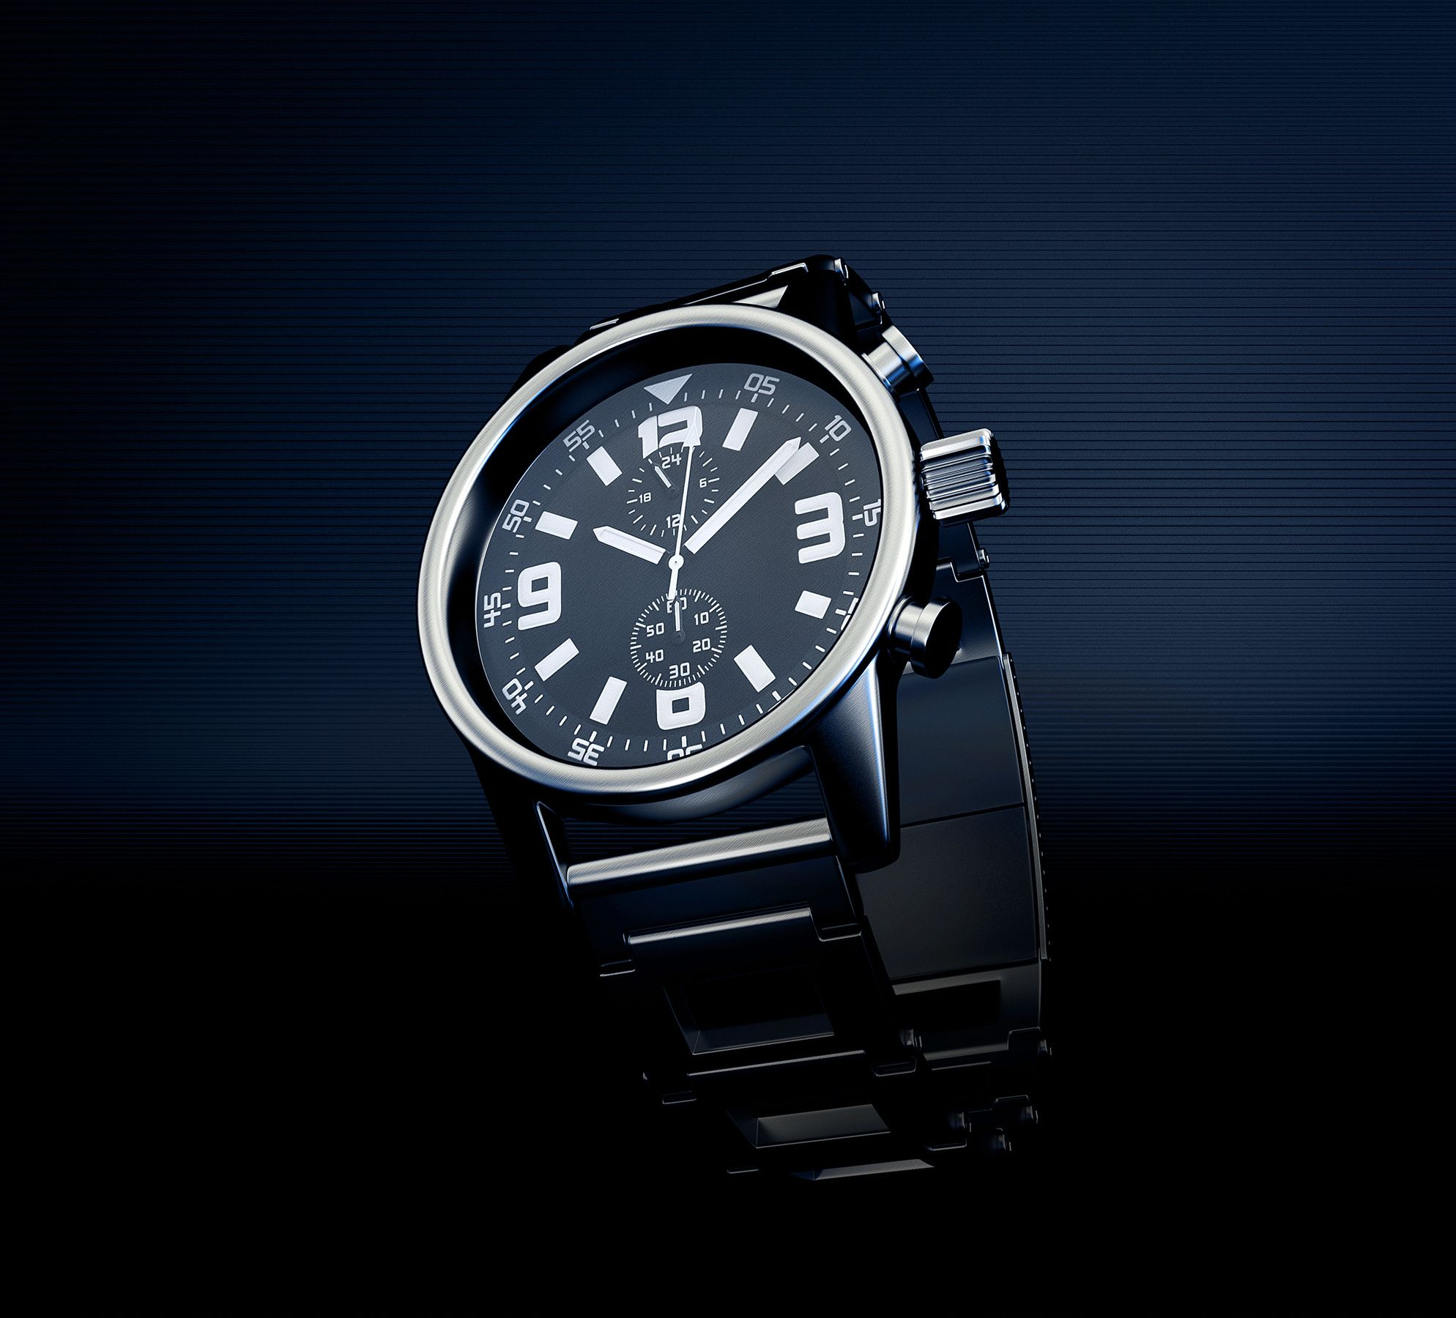


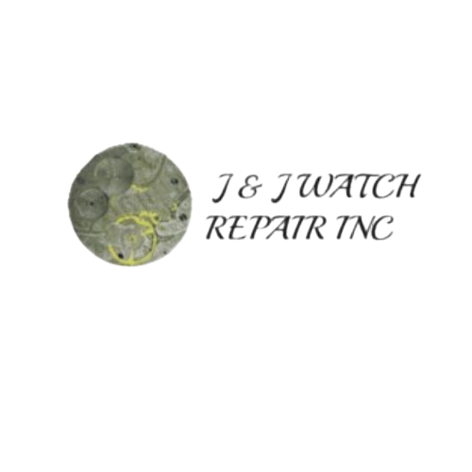

ACCUTRON WATCH REPAIR – PRECISION & CARE
Restoring Accutron Watches Requires A Unique Blend Of Technical Expertise, Patience, And Specialized Tools. These Watches Operate On A Tuning Fork Mechanism, Which Differs From Traditional Mechanical And Quartz Movements. Proper Repair And Maintenance Ensure Longevity, Accuracy, And Preservation Of Their Unique Horological Value.
https://jjwatchrepair.com

Slide 2
UNDERSTANDING ACCUTRON TECHNOLOGY
Accutron Watches Utilize Tuning Fork Technology, Which Vibrates At A High Frequency To Provide Exceptional Accuracy. Unlike Traditional Escapement Systems, These Watches Rely On An Electronic Circuit And Coils To Drive The Movement. Understanding How This System Works Is Crucial For Effective Repairs.
https://jjwatchrepair.com

Slide 3
COMMON ACCUTRON WATCH ISSUES
Some Common Issues Include Coil Failures, Battery Drain, Tuning Fork Misalignment, And Deterioration Of Lubrication. Regular Maintenance And Timely Repairs Prevent These Issues From Escalating.
https://jjwatchrepair.com

Slide 4
DIAGNOSING ACCUTRON PROBLEMS
Technicians Use Specialized Equipment Like Oscilloscopes, Frequency Counters, And Electronic Testers To Assess The Watch’s Condition. Accurate Diagnosis Helps Determine Whether The Watch Needs Cleaning, Calibration, Or Complete Component Replacement.
https://jjwatchrepair.com

Slide 5
ESSENTIAL TOOLS FOR ACCUTRON REPAIR
Key Instruments Include Ultrasonic Cleaners, Oscilloscopes, Micro-Screwdrivers, Frequency Counters, Specialized Electronic Testers, And Anti-Static Tools.
https://jjwatchrepair.com

Slide 6
BATTERY REPLACEMENT & POWER CHECKS
Using The Correct Battery Is Crucial. Incorrect Batteries Can Cause Overheating, Coil Damage, Or Insufficient Power. Regular Battery Checks Prevent Power Failures And Preserve The Watch’s Electronic Components.
https://jjwatchrepair.com

Slide 7
COIL & CIRCUIT BOARD REPAIRS
Damaged Coils Can Prevent The Tuning Fork From Functioning. Skilled Technicians Use Specialized Soldering Equipment To Repair Or Replace Defective Parts.
https://jjwatchrepair.com

Slide 8
TUNING FORK CALIBRATION
If The Fork’s Vibration Frequency Deviates, The Watch Will Lose Or Gain Time. Proper Calibration Ensures That The Fork Vibrates At The Correct Rate, Restoring The Watch’s Timekeeping Performance.
https://jjwatchrepair.com

Slide 9
CLEANING & LUBRICATION
Dirt And Old Lubricants Can Cause Friction And Slow Down The Accutron Movement. Ultrasonic Cleaning Removes Contaminants, And Proper Lubrication Prevents Gear Wear, Reducing Resistance And Improving Longevity.
https://jjwatchrepair.com

Slide 10
THANK YOU
WEBSITE.
HTTPS://JJWATCHREPAIR.COM
EMAIL US
INFO@JJWATCHREPAIR.COM
MOBILE NO
6314256309
ADDRESS
900 WALT WHITMAN ROAD, SUITE L L 14 • MELVILLE, NEW YORK, 11747
https://jjwatchrepair.com

