Slide 1


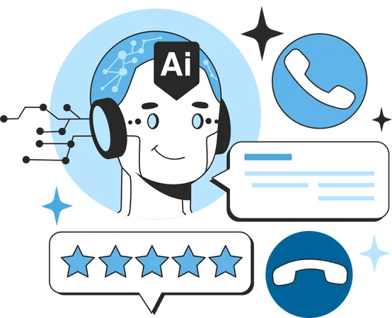
How AI Agents Are Transforming Customer Support and Service
www.blockchainx.tech

Slide 2
The advancement of artificial intelligence (AI) has notably penetrated different industries, among which customer support hardly misses any mention. AI Agent Development focuses on creating intelligent virtual assistants whose main objectives are to simplify customer interaction, responsiveness, and satisfaction. Such AI-driven solutions empower the company to run its customer support optimally, thereby reducing costs but still improving the service. AI agents mimic customer input in interpreting their needs, although from this point onward their responses are tailored to smoothen the support experience from A to Z. In the evolution of AI, organizations can further benefit from its advanced machine learning algorithms and automation tools for the continuous improvement of customer service operations. A fast-growing AI adoption in customer service can give businesses an edge over competitors with innovative and effective means of support. With an increase in AI capability refinement, companies can almost predict and resolve customer issues before they arise, creating an even better customer experience. AI-supported systems for customer care are now a crucial cog in modern business strategy, since they furnish businesses with actionable insights that help them improve service delivery and boost customer engagement.

Slide 3
Enhanced Customer Interaction
AI agents give an uninterrupted and customized experience, analyzing past interactions and rendering pertinent solutions. Unlike the antiquated systems of support, an artificial intelligence chatbot or virtual assistant marshals its competence to go through large pieces of data within seconds, to return the most accurate result. These AI agents can operate on different channels like websites, social media, and mobile applications to ensure that the customer is being helped whenever and wherever they need it. AI-powered customer support systems also understand the subtleties involved with human language by way of natural language processing (NLP), thus giving more significant responses in context. This kind of evolution keeps the customers satisfied and builds trust in the brand. AI agents also help a business design a more engaging user journey to provide recommendations, troubleshooting, and somewhat preemptive support. Moreover, AI-enabled support could serve a greater variety of audiences by way of multilingual support, offering top-quality service to customers from highly varied regions with diverse linguistic backgrounds.

Slide 4
24/7 Availability and Instant Responses
One of the major advantages of AI agents is that they work tirelessly without any fatigue 24/7. AI solutions can operate autonomously or semi-autonomously to handle multiple queries at once, thus reducing wait times and increasing efficiencies, which ensures immediate assistance to customers and better engagement and satisfaction. AI customer support implementation allows businesses to lend assistance to global customers in different time zones without requiring a huge customer support team. It can also identify issues that need immediate attention and escalate them to a human agent when needed, thus ensuring that complex issues are resolved while dealing efficiently with simple inquiries. AI chatbots and virtual assistants can also be integrated across channels, including email, SMS, and social media, to provide a consistent and unified support experience. An omnichannel approach enables customers to receive support through their channels of choice, ultimately boosting the overall customer experience.

Slide 5
Cost Efficiency and Scalability
To reduce operational costs, AI agents are used by companies to automate tasks that in the past required the intervention of a human agent. The human resource can then be deployed to solve more complex issues while the AI assists with more straightforward ones. Another advantage of AI-powered customer support solutions is that they can be ramped up or down easily with changing customer demands without significantly increasing the workforce. This is especially useful for companies that grow quickly or those that experience seasonal peaks in customer inquiries. By using AI agents to lessen the burden of human power for simple support tasks, companies act to considerably reduce labor costs while upholding exceptional customer service. Another advantage of AI-powered customer service solutions is that they reduce errors, ensuring more accurate responses while alleviating the human burden. Businesses can also leverage AI-powered analytics to gauge customer service efficiency, streamline workflows, and discover such areas for continuous improvement of support operations.

Slide 6
Improved Problem Resolution
Customer complaints can be analyzed and solved with the help of machine learning and natural language processing (NLP), which engage the AI agents in two activities: active and passive learning. In time, they will develop their ability to respond to complex queries through experience, as an end-to-end learning mechanism. In cases of exceptional needs, AI-powered customer service ensures they can be escalated to be attended to by a human representative. These agents also make use of past resolutions with predictive analytics to suggest possible solutions before customers can fully describe the problem. Thus, time to resolution decreases while the customer experience is much improved. In addition, these AI tools can collect information for diagnostics and thus reduce turnaround time for solving technical issues. AI-enabled self-service portals allow customers to solve issues by using rich knowledge bases, step-by-step instructions, and interactive AI assistants rather than having to go through service agents to get a resolution. AI will not only improve problem-solving efficiency but also make it easier for customers to find their own solutions.

Slide 7
Sentiment Analysis and Customer Insights
AI agents would analyze customer sentiments through text as well as voice interactions. Emotion detection and analysis of customers' feedback would identify pain points and enhance service strategies. In this way, organizations would re-evaluate their customer support ways, personalize interactions, and strengthen relationships with their audiences. Companies can use AI-based sentiment analysis to measure the early frustration or dissatisfaction of customers in an interaction, so they can act before the experience becomes negative. Also, it can be used to train human agents against better quality support in the future and create a more empathetic situation. AI enable analytics tools also assess customer engagement patterns for the benefit of understanding customer needs by businesses. Trends in behavior alone allow a business to personalize recommendations for its consumers. These trends can also be usado for targeted marketing programs and better alignment in support services.

Slide 8
AI Agent Development Solutions for Future Growth
As AI advances, innovative solutions for AI Agent Development are increasingly being adopted by businesses to improve their customer care services. Very soon, this will all be history as AI continues to combine with predictability analysis, voice recognition, and augmented reality to become "that" voice in transforming customer interactions. Organizations will gain significant advantages over their competitors by investing in AI-enabled customer service strategies that offer extraordinary customer journeys and eventually lead to long-term loyalty among customers. It's also expected that AI-powered customer support tools will become even more user-friendly, thanks to the development of deep learning technologies enabling AI agents to hold conversations with humans. AI innovations are bringing a paradigm shift in business models: businesses using its technologies will be at the innovation end of the spectrum, offering a diverse high-quality, efficient, and personalized customer care experience. Such transformation would not only make operational processes streamlined via automation but improve decision making based on real-time customer insights. By such transformation, organizations would proactively manage the needs of customers, thus creating an intelligent support ecosystem. This would also work through hyper-personalization, as AI allows organizations to tailor support interactions as per customer preference, past behavior, real-time interaction, and predictive insights, thus giving way to a journey that is more pleasing from a customer's perspective.

Slide 9
Conclusion
Everything that can be done is being done in the realm of customer support with AI agents: cost-effective solutions engineered for scaling. AI Agent Development Solutions will assist organizations in molding their support structure to deliver a friendly experience and grow their innovation in delivery of services. While AI technology thrives, firms adopting it will actually have an edge within the competitive market, ensuring the customer experience is fully integrated and intelligent. Companies equipping AI to the greatest would work towards enhanced efficiency to back the service but without compromising the great explanatory service that will be involved in loyalty and customer success-on the other. For the future, AI scenery is there; thus, any company adopting such new technologies today will pave the way for tomorrow. This means that investments in such AI solutions will translate into gains in customer trust and reputation over time for these companies. Tomorrow, AI-enabled customer service will become even smarter, more proactive, and personalized, giving them the liberty to redefine the way customer experience and satisfaction are defined in this digital age.

Slide 10





Thank You
CONTACT US
www.blockchainx.tech
contact@blockchainx.tech
+91 7708889555

