Slide 1

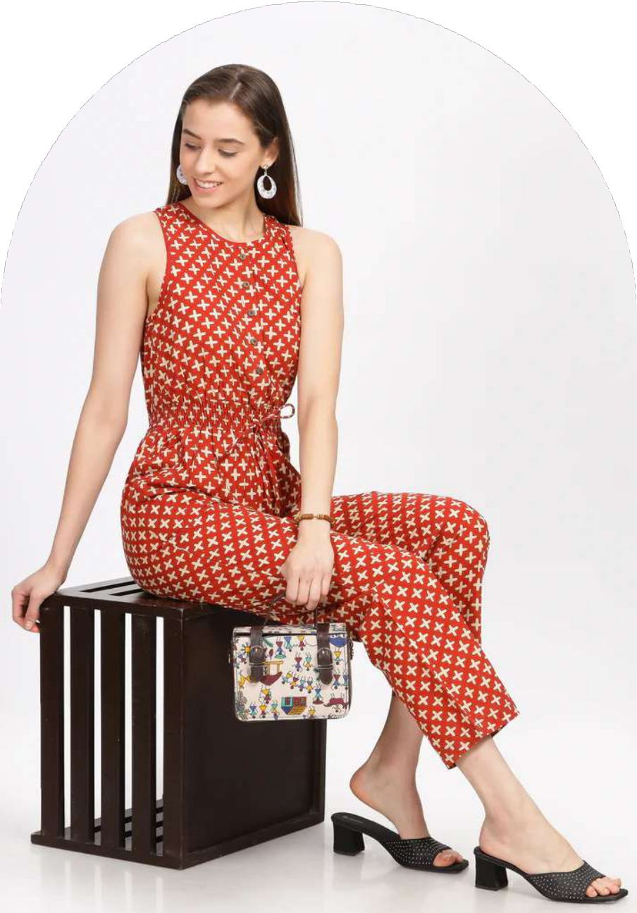

1
Casual Jumpsuits For Women
Discover The Perfect Blend Of Style And Comfort With Casual Jumpsuits For Women. Explore Versatile Designs, Trendy Styles, And Essential Tips For Choosing The Best Jumpsuit For Any Occasion.
Www.Reepeatshop.Com

Slide 2
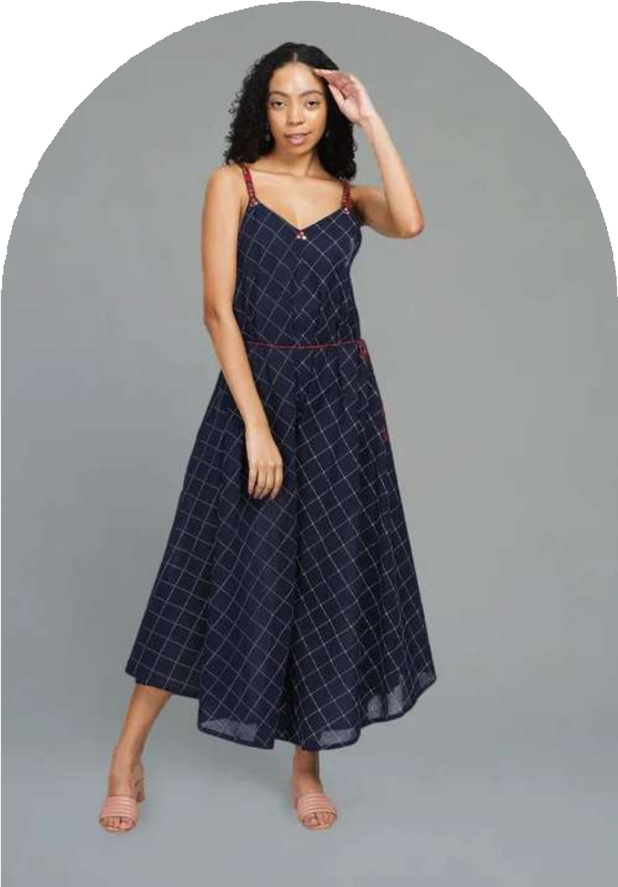
2
The Appeal Of Casual Jumpsuits
Casual Jumpsuits For Women Offer Effortless Elegance, Comfort, And Versatility. Ideal For Various Occasions, They Provide A Chic Yet Relaxed Look That Complements Different Body Types And Personal Styles.
Www.Reepeatshop.Com

Slide 3
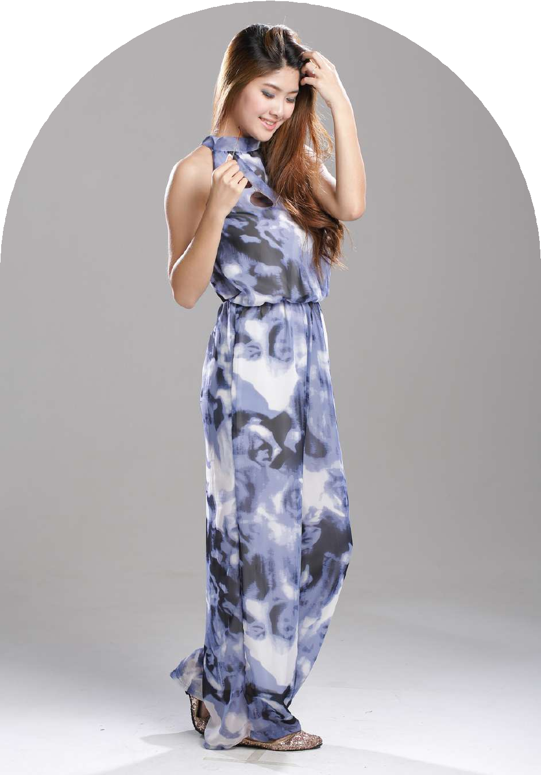
3
Styling Casual Jumpsuits For Every Occasion
From Brunch Dates To Evening Outings,Casual Jumpsuits
For Women Can Be Dressed Up Or Down. Pair With Sneakers For A Relaxed Look Or Heels And Accessories For A Polished Outfit.
Www.Reepeatshop.Com

Slide 4

4
Choosing The Right Fabric
Opt For Breathable Fabrics Like Cotton And Linen For Summer, While Knit And Wool Blends Keep You Warm In Colder Months. Casual Jumpsuits For Women Should Prioritize Both Comfort And Durability.
Www.Reepeatshop.Com

Slide 5
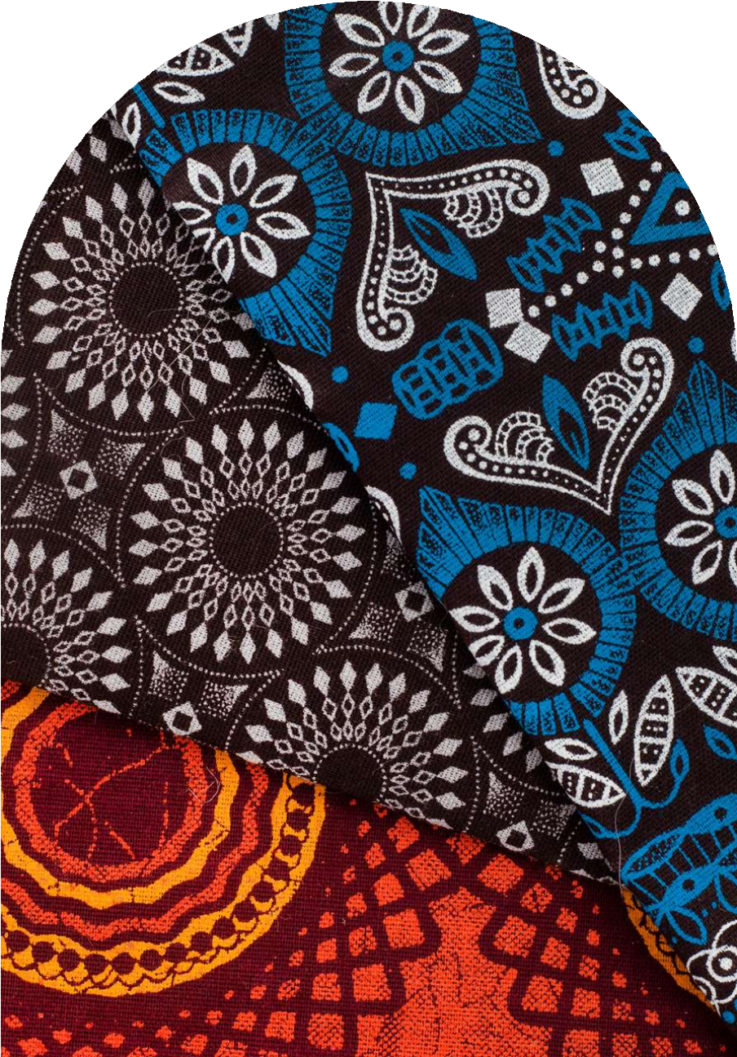
5
Trendy Colors And Prints
Neutral Shades Provide A Timeless Look, While Floral Or Geometric Patterns Add A Fun Touch. Casual Jumpsuits For Women Come In A Variety Of Colors And Prints To Suit Every Preference.
Www.Reepeatshop.Com

Slide 6

6
Enhancing Your Look With Accessories
Elevate Casual Jumpsuits For Women With Statement Jewelry, Stylish Belts, And Trendy Handbags. Accessories Can Transform A Simple Outfit Into A Fashion-Forward Ensemble.
Www.Reepeatshop.Com

Slide 7
7
Finding The Perfect Fit
A Well-Fitted Jumpsuit Enhances Your Silhouette. Consider Waist-Cinching Designs For A Flattering Look. Casual Jumpsuits For Women Should Balance Comfort With A Tailored, Stylish Fit.
Www.Reepeatshop.Com

Slide 8
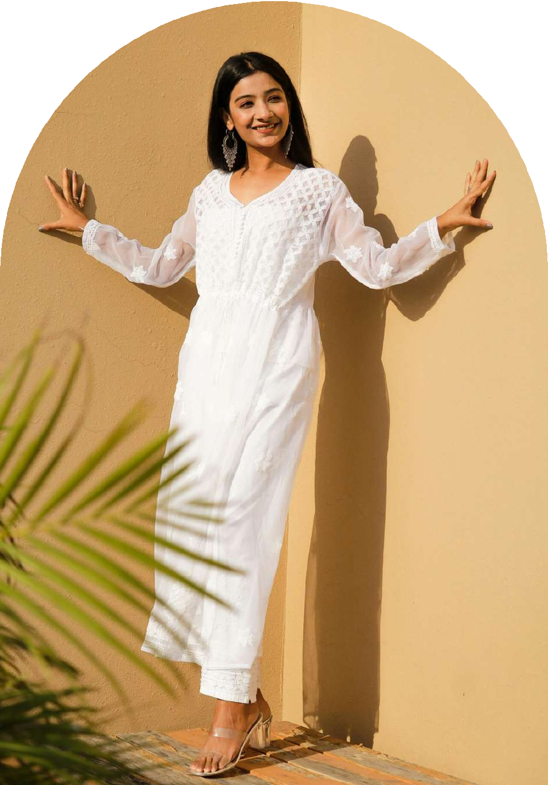
8
Fashion Trends In Casual Jumpsuits
Stay Updated With Seasonal Trends. Casual Jumpsuits For Women Feature Vibrant Hues In Summer And Cozy Layering Styles In Winter, Ensuring Year-Round Fashion Versatility.
Www.Reepeatshop.Com

Slide 9

9
Smart Shopping Tips
Consider Factors Like Fabric Quality, Fit, And Price Before Purchasing. Reading Reviews And Checking Sizing Guides Can Help In Selecting The Best Casual Jumpsuits For Women Online Or In Stores.
Www.Reepeatshop.Com

Slide 10
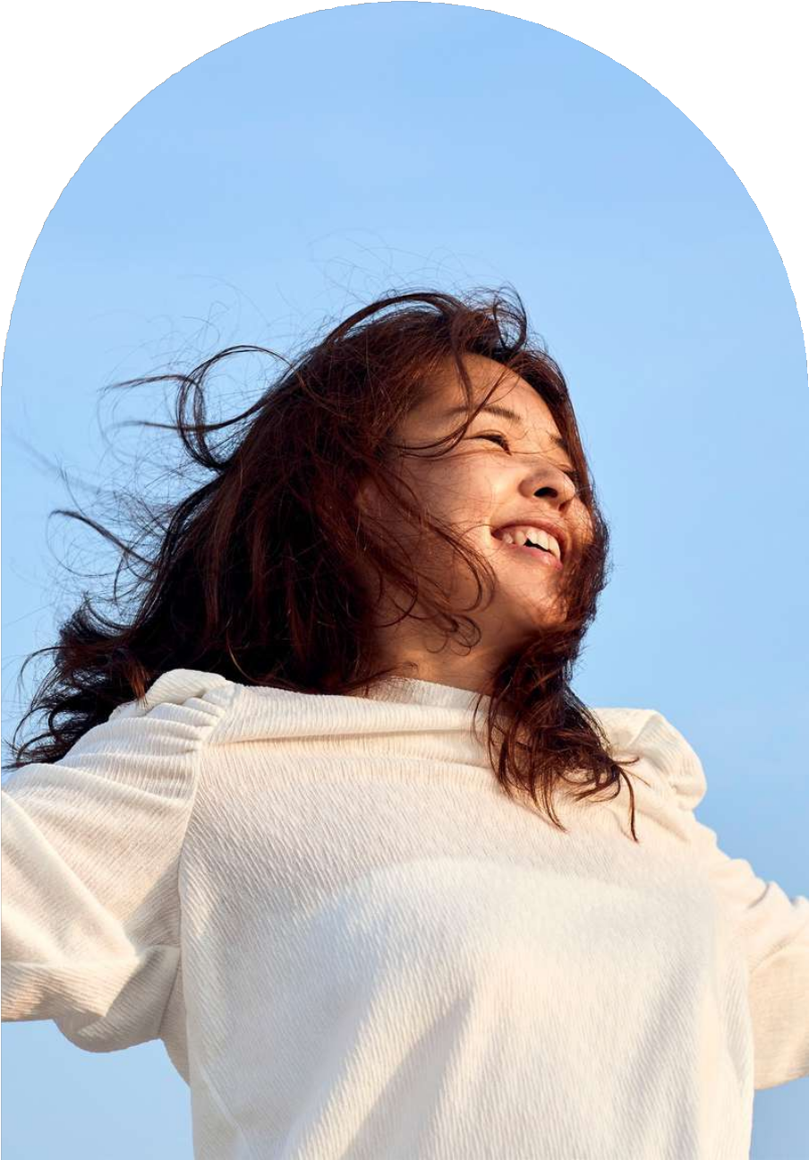
10
Embrace Effortless Style
With The Right Choice, Casual Jumpsuits For Women Offer A Stylish And Practical Wardrobe Essential. Experiment With Different Styles To Create Your Unique, Confident Look.
Www.Reepeatshop.Com

Slide 11

10
Thank You For Watching
We Appreciate Your Time And Interest In Casual Jumpsuits For Women . Stay Stylish And Confident! Feel Free To Reach Out For More Fashion Tips And Trends.
📧 Email: Reepeatclothing@gmail.com
📞 Phone: +91-90082 00995
Casual Jumpsuits For Women
Www.Reepeatshop.Com

