Slide 1

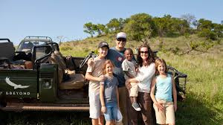

BEST SAFARI DESTINATIONS IN TANZANIA
www.professional-safari-africa.com

Slide 2

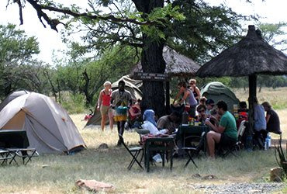
About Us
Tanzania has some of Africa's finest safari locations. The Serengeti National Park is renowned for the Great Migration, where millions of wildebeest and zebras migrate. The Big Five call Ngorongoro Crater, a UNESCO site, home within a stunning caldera.
www.professional-safari-africa.com

Slide 3
Best Safari Destinations In Tanzania features big elephant herds and baobab trees, while the Selous Game Reserve features a far-off, off-the-tourist-path experience. Ruaha National Park, Tanzania's largest, offers varied wildlife and fewer tourists for a private safari experience.
www.professional-safari-africa.com

Slide 4
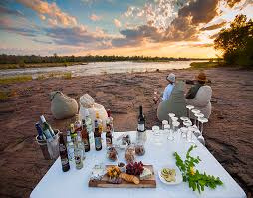






CONTACT US
Phone
+255788249264
Email
info@professional-safari-africa.com
Website
www.professional-safari-africa.com
Location
Sakina, Arusha,Tanzania

Slide 5
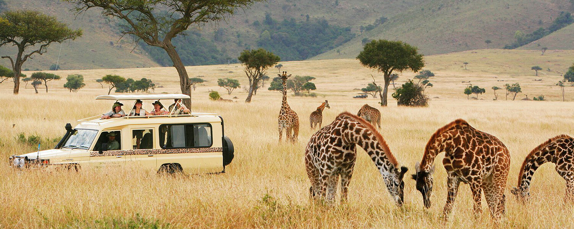
THANK YOU
www.professional-safari-africa.com

