Slide 1

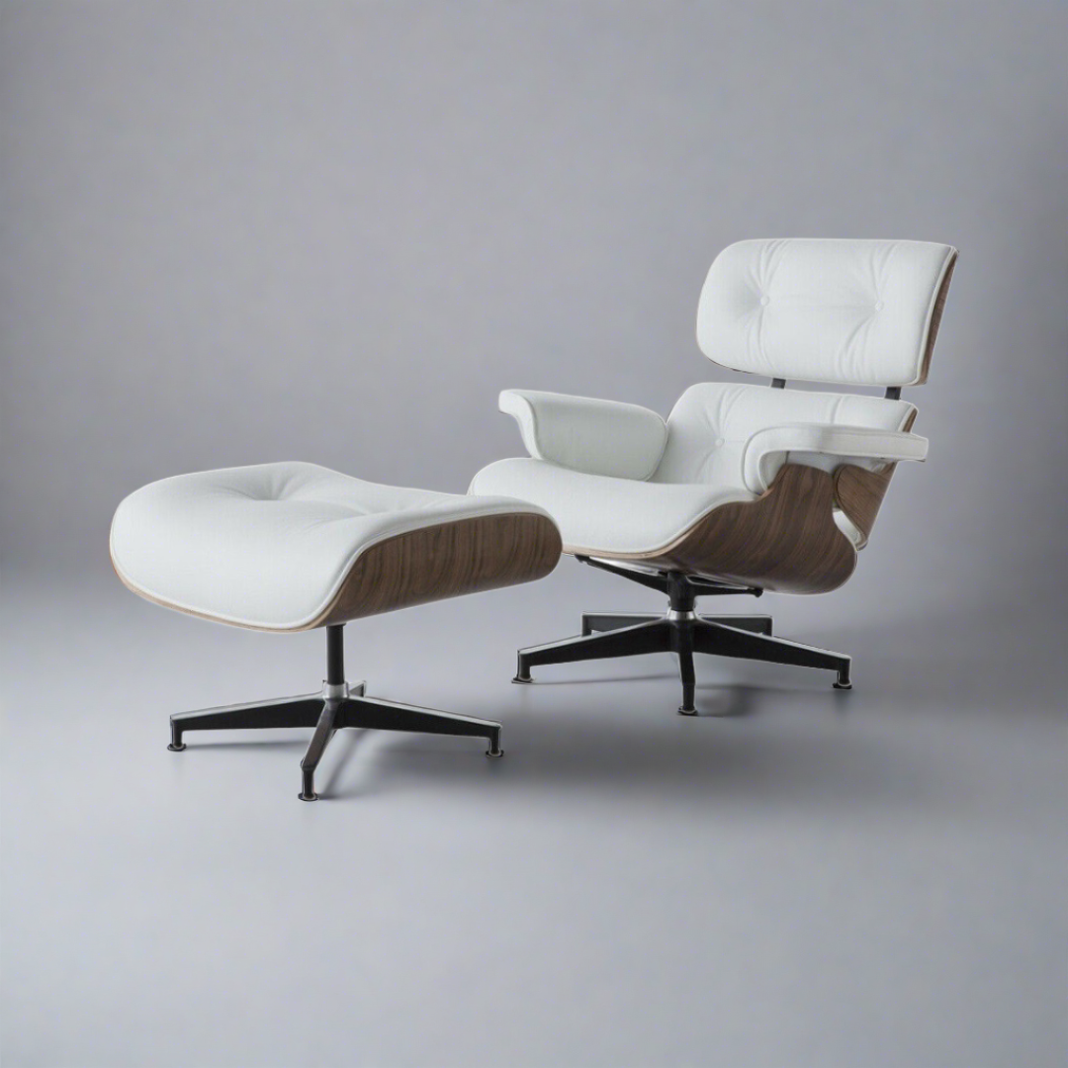

THE ICONIC WHITE EAMES CHAIR
TIMELESS DESIGN UNMATCHED COMFORT
https://www.luxefurnishes.com
+44 (0)75 6475 0525
Contact@luxefurnishes.com

Slide 2
A MID-CENTURY MASTERPIECE
THE WHITE EAMES CHAIR IS AN ICONIC CREATION BY CHARLES AND RAY EAMES, BLENDING FORM AND FUNCTION SEAMLESSLY. ORIGINALLY DESIGNED IN THE 1950S, THIS CHAIR CONTINUES TO BE A SYMBOL OF INNOVATION AND ELEGANCE, MAKING IT A MUST-HAVE FOR DESIGN ENTHUSIASTS.
https://www.luxefurnishes.com
+44 (0)75 6475 0525
Contact@luxefurnishes.com

Slide 3
MINIMALIST AESTHETIC
ITS CLEAN, WHITE FINISH ENHANCES ANY INTERIOR, FROM MODERN TO SCANDINAVIAN STYLES. THE SIMPLE YET SOPHISTICATED DESIGN OF THE WHITE EAMES CHAIR ADDS A TOUCH OF REFINEMENT WITHOUT OVERWHELMING A SPACE, MAKING IT A VERSATILE PIECE IN ANY SETTING.
https://www.luxefurnishes.com
+44 (0)75 6475 0525
Contact@luxefurnishes.com

Slide 4
VERSATILITY AT ITS BEST
IDEAL FOR VARIOUS SPACES, THE WHITE EAMES CHAIR FITS PERFECTLY IN HOMES, OFFICES, CAFÉS, AND CREATIVE WORKSPACES. WHETHER USED AS A DINING CHAIR, OFFICE SEAT, OR ACCENT PIECE, IT EFFORTLESSLY ADAPTS TO DIFFERENT ENVIRONMENTS WITH ITS TIMELESS CHARM.
https://www.luxefurnishes.com
+44 (0)75 6475 0525
Contact@luxefurnishes.com

Slide 5
BUILT FOR COMFORT
THE SMOOTH, CURVED SEAT AND ERGONOMIC SHAPE OF THE WHITE EAMES CHAIR PROVIDE EXCELLENT SUPPORT, ENSURING A COMFORTABLE SITTING EXPERIENCE. ITS LIGHTWEIGHT YET STURDY DESIGN ALLOWS FOR EASY MOVEMENT WITHOUT COMPROMISING ON STABILITY OR RELAXATION.
https://www.luxefurnishes.com
+44 (0)75 6475 0525
Contact@luxefurnishes.com

Slide 6
DURABLE & SUSTAINABLE
MADE FROM HIGH-QUALITY MATERIALS, THE WHITE EAMES CHAIR IS BUILT TO LAST. THE STURDY WOODEN OR METAL LEGS, COMBINED WITH A MOLDED PLASTIC OR FIBERGLASS SHELL, ENSURE LONG-TERM DURABILITY. ADDITIONALLY, ECO-CONSCIOUS VERSIONS USE SUSTAINABLE MATERIALS, ALIGNING WITH MODERN ENVIRONMENTAL STANDARDS.
https://www.luxefurnishes.com
+44 (0)75 6475 0525
Contact@luxefurnishes.com

Slide 7
A DESIGN LEGACY
MORE THAN JUST A PIECE OF FURNITURE, THE WHITE EAMES CHAIR REPRESENTS A LASTING LEGACY OF CREATIVITY AND CRAFTSMANSHIP. ITS TIMELESS APPEAL ENSURES THAT IT REMAINS A BELOVED CHOICE FOR GENERATIONS TO COME, EMBODYING THE PERFECT BALANCE OF STYLE AND FUNCTION.
https://www.luxefurnishes.com
+44 (0)75 6475 0525
Contact@luxefurnishes.com

