Slide 1
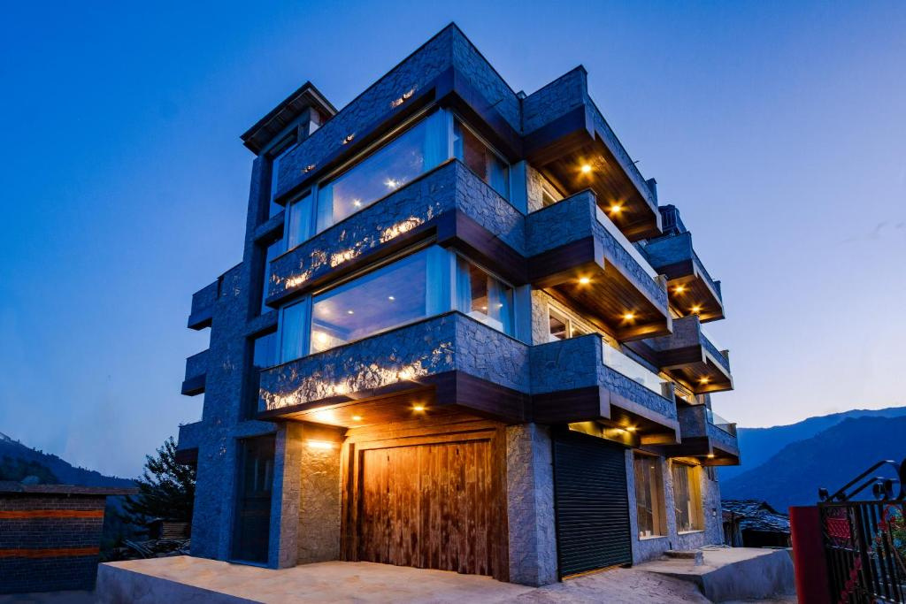

Manali Luxury Villas
Website :-
https://kenshohills.com/

Slide 2
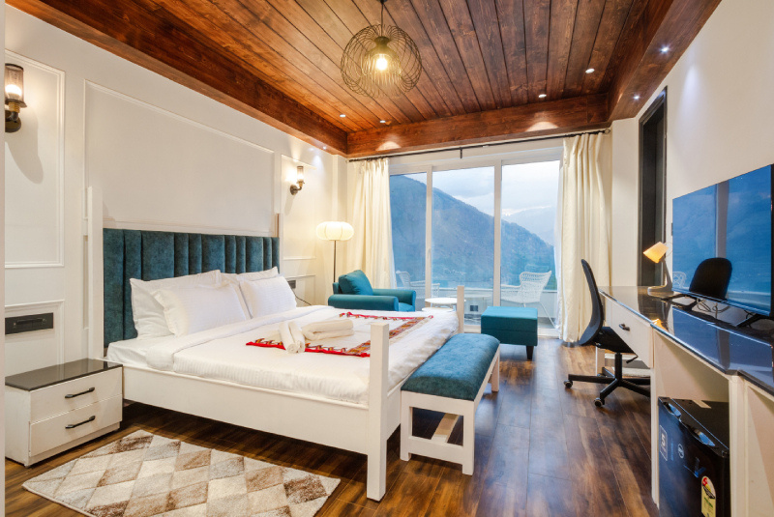
Home
Service
About Us
Contact
About us :-
Nestled in the heart of the Himalayas, Kensho Hills offers a luxurious escape with its premium villas in Manali. Combining elegance with modern amenities, our villas provide the perfect setting for relaxation and rejuvenation. Designed to blend seamlessly with the natural beauty of Manali, Kensho Hills is your ultimate destination
for a tranquil and unforgettable stay.
Website :-
https://kenshohills.com/

Slide 3

Manali Luxury Villas
Experience the finest Manali Luxury Villas at Kensho Hills, where elegance meets nature. Enjoy breathtaking mountain views, premium amenities, and a serene ambiance for a perfect getaway. Whether for a romantic retreat or a family vacation, Kensho Hills offers unmatched luxury and comfort in Manali’s picturesque setting.
Website :-
https://kenshohills.com/

Slide 4

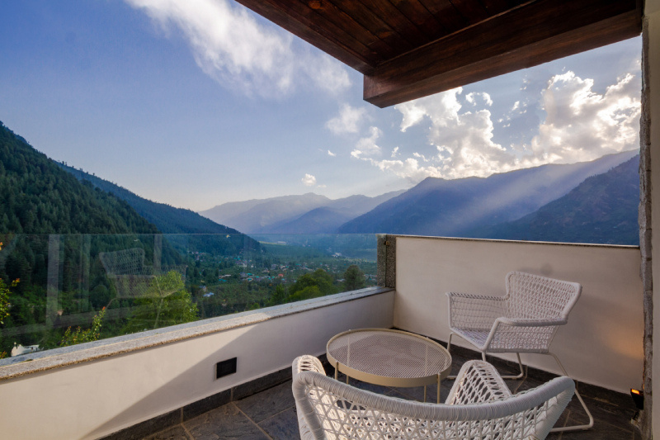

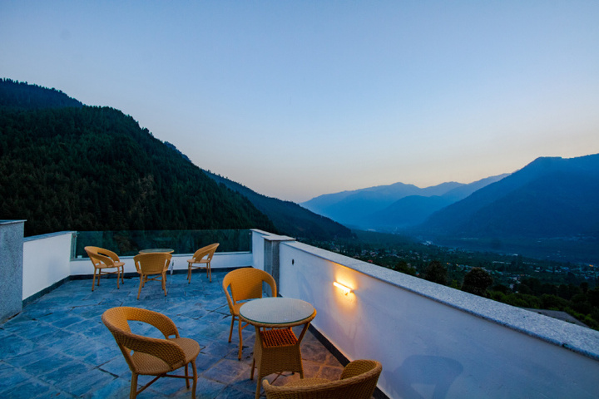
Home
Service
About Us
Contact
Unique Features
Our Facilities :
Single Room
Luxury Room
Deluxe Room
Rooftop Restaurant
Local Immersion
Breathtaking Panoramic Views
Website :-
https://kenshohills.com/

Slide 5

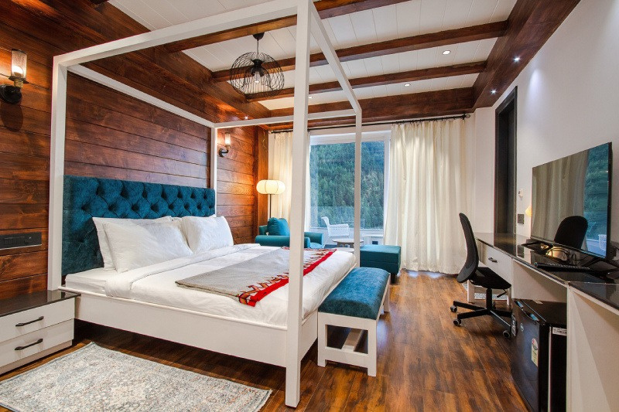
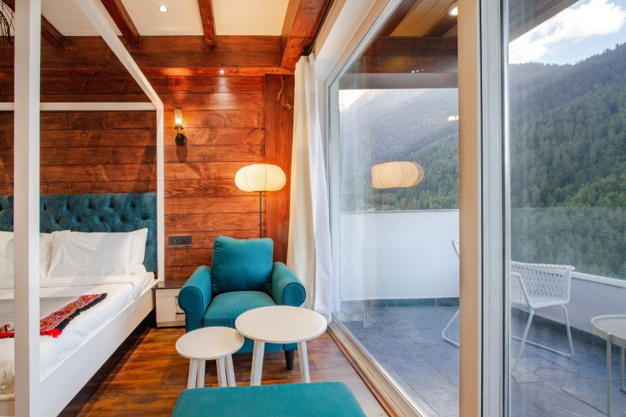
Home
Service
About Us
Contact
Our Room Gallery
Deluxe Room
Website :-
https://kenshohills.com/

Slide 6
Home
Service
About Us
Contact
Thank You
Get in Touch
Website Phone
Address
https://kenshohills.com/
+91-7018806079
Ward number-3 village soyal/P.O, Haripur, Manali, Himachal Pradesh 175131

