Slide 1


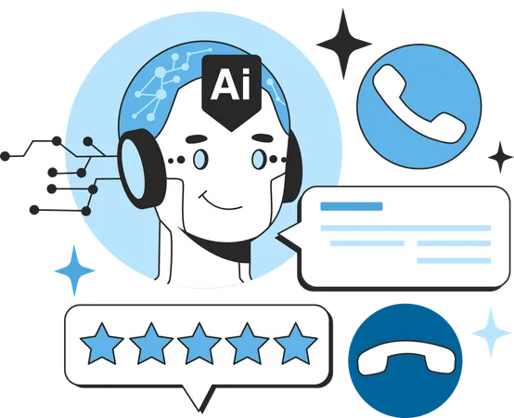
How AI Agents are Transforming Business Automation
www.blockchainx.tech

Slide 2
AI Agents for Businesses Today As the business world becomes a complex and fast-changing information system, it is running to AI agents to simplify operations, cut costs and time, and increase productivity. AI Agent Development has become an important element of such modern strategies to automate business processes in corporations, as it enables operators to merge intelligent systems that do repetitive and comprehensive tasks. Data analysis causes better operational efficiency, providing better information to make decisions. AI Agent Development will have a leading role in creating scalable, adaptable, and highly intelligent automation systems that define constant improvement as business needs change. Customer service and supply chain management are examples of applications that AI agents are bringing to redefine how businesses operate; that is how they become more agile, data-driven, and adaptive to market demand. With the rapid development of AI technology, companies investing in AI agents will continue to enjoy the competitive edge in productivity and resource optimization. Such agents will also be emerging with advances of other technologies, such as the Internet of Things (IoT) and blockchain, further multiplying their leverage and opportunities.

Slide 3
The Role of AI Agents in Business Automation
AI agents are applications or software programs designed to perform certain tasks with little or no human involvement. Intelligent systems are characterized by machine learning, natural language processing, and automation working to enhance business workloads. They can sift through large volumes of data, examine trends, and make real-time decisions, thus greatly improving productivity and operational efficiency. With AI agents, businesses can mitigate human errors, accelerate processes, and increase accuracy throughout several processes, culminating into further optimized and even more efficient organizations. Besides, considering that AI agents can easily integrate with existing enterprise software, it means that companies will automate processes without having to fully revamp their IT infrastructure. AI algorithm enhancements have resulted in increasingly capable agents of performing complex decisions that are conventionally thought to involve human judgment. The AI agents are therefore becoming more capable, carrying out complex decision-making previously thought to require human input.

Slide 4
1. Enhancing Customer Support
The most remarkable shift that AI agents have created is in the field of customer service. AI-enabled chatbots and virtual assistants run 24/7 customer service, fielding inquiries, resolving customer complaints, and even processing transactions. Such automations increase customer experience and help human agents reduce their work. AI agents can analyze customer interactions, predict questions, and personalize responses for more meaning and engagement. In addition, they improve their response through learning from previous interactions; thus gradually eliminating inefficiencies from customer support. AI-driven customer support has resulted in faster query resolutions, higher customer satisfaction points, and stronger brand loyalty for many businesses. With AI-led customer support systems that function 24/7 and handle numerous queries simultaneously, wait times for customers are alleviated, and business resources are efficiently utilized to cater to an extensive customer base. In addition, the analysis of sentiment can be powered by AI to enable companies to understand the sentiments of their customers and mold their responses further, thereby refining the quality of support services they offer.

Slide 5
2. Optimizing Supply Chain Management
Supply chain automation also avails its services by means of AI agents that analyze market trends, predict demand shifts, and optimize inventory management. With this information derived from AI, the enterprises can curtail wastage, lower costs, and ensure the timely arrival of shipments. These intelligent systems also provide real-time monitoring and tracking of shipment movements where it can identify any possible disruptions and suggest options to mitigate those risks. In short, AI gives better control over logistics, suppliers, and overall operational efficiency to businesses, leading to more risk-resilient and responsive supply chains. AI agents can also forecast material shortages and recommend procurement strategies so that businesses may remain proactive instead of reactive in supply chain management. Automated demand forecasting also allows businesses to prevent stockouts and overstocking, thereby promoting efficient resource utilization and sound financial planning. AI-based route optimization tools enable logistics companies to select the most optimal delivery routes, thereby minimizing transportation costs, reducing fuel consumption, and ultimately achieving quicker deliveries.

Slide 6
3. Automating Marketing and Sales
AI agents assist companies in customizing their marketing campaigns, using analytics for customer behavior, and optimizing lead generation. By enabling repetitive marketing tasks, which include email outreach and ad targeting, a company can focus more on strategic decision making and holding hands with the customers. AI-powered marketing channels, including email-based engagement of customers, can segment audiences according to behavioral predictions in purchase patterns and presentation of the content. Also, AI-based sales assistants can recommend opportunities for up and cross-sell revenue generation along a seamless customer journey. AI-enhanced automation can have superior customer engagement while lowering acquisition costs and increasing conversion rates. AI also facilitates predictive analytics that would prioritize high-quality leads for sales teams as well as enhance best practices for sales. It is possible to further refine marketing approaches using AI-based A/B testing, which assesses different strategies to determine the most efficacious model for the campaign. Entrepreneurs can also leverage AI-enabled chatbots that support sales and guide customers through their buying journey while answering their queries related to the product in real-time.

Slide 7
4. Improving Workflow Efficiency
AI agents in business processes reduce inefficiencies by automating administrative tasks that include scheduling, document processing, and entries. This enables employees to focus on the high-value aspects of work, promoting innovation and creativity. AI agents can also promote real-time collaboration through integrations with ATOs throughout the enterprise, improving communication and ensuring the business runs smoothly. Companies that implement AI-powered workflow automation generally have more productive employees, shorter turnaround times, and fewer operational bottlenecks. AI-integrated automation also offers actionable analytics that will allow management to make the right decisions regarding workforce optimization and resource allocation. AI agents can additionally be used to track employee performance and recommend enhancements to productivity based on individual work patterns. Assigning work on automation ensures equitable distribution of workloads, thereby working against burnout and enhancing the efficiency of overall operations.

Slide 8
Conclusion
Business automation is changing with the advent of AI agents. Efficiency improves; costs decrease and better, more intelligent decision-making is performed. The AI Agent Development platform is, however, not the end of the line, and companies must integrate new technologies into their traditional practices. In essence, this is AI-driven automated growth opportunities, innovation, and customer satisfaction for the company's future. The smart proactive adoption of AI agents by companies not only enhances operational performance but also provides them with a competitive advantage in futuristic market conditions. Future business automation will take place through independent, intelligent, adaptive AI agents, which are capable of working in association with the humans involved in any business processes. In today's market, investing in AI technology means to place itself at the head of the competition in the economy of the future as an organization being ready for a time when AI-driven automation becomes the norm. AI-enabled automation will continue to spread across industries and help organizations innovate faster, improve customer experience and achieve long-haul sustainability in an increasingly competitive marketplace.

Slide 9




Thank You
CONTACT US
www.blockchainx.tech
contact@blockchainx.tech
+91 7708889555

