Slide 1


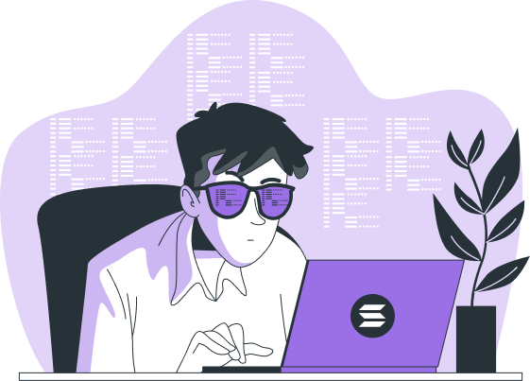
Why Web3 Companies Are Prioritizing Solana Development
www.blockchainx.tech

Slide 2
Solana is now becoming a favorite among various Web3 companies for its virtues in speed, low fees, and scalability. With the growth of the blockchain industry, solutions must support big applications that do not face traffic jams or exorbitant fees. Solana, with its decentralized system capable of processing thousands of transactions in a single second, stands out as an obvious choice for industries wishing to deploy state-of-the-art decentralized applications (dApps). Besides that, with all the DeFi, NFT, and GameFi projects that are springing up right now, the Solana ecosystem is rapidly growing. This is why firms Hire Solana experts for blockchain architecture, smart contract development, and performance tuning: for maximizing the use of Solana's capabilities. Their expertise ensures that today, in a fast-evolving Web3 world, dApps run smoothly, securely, and efficiently.

Slide 3
Solana’s Competitive Edge in Web3
Solana distinguishes itself with high-speed transactions and low latency, in contraction to many others in the blockchain arena. Ethereum usually suffers from congestion and high gas fees for its PoW/PoS hybrid model, whereas Solana introduces its innovative proof-of-history (PoH) consensus mechanism. PoH does this by timestamping a transaction prior to its being processed, thus consequently allowing the validators a faster time-frame for verification and the faster, cheaper finalization of the transaction. This segues into the unhindered operation of Web3 applications, from decentralized finance (DeFi) and NFT markets to supply chain solutions and gaming ecosystems, without being burdened by slow processing times or exorbitant fees. Such efficiencies give a competitive edge to Web3 companies, which further creates pressure on them to deliver seamless user experience through their applications. Solana's increased adoption by big-name projects adds to its reliability and scalability credibilities as a real contender in the blockchain arena.

Slide 4
Scalability and Developer-Friendly Ecosystem
A fundamental reason for Web3 companies to be interested in Solana development is relative scalability without match. The network is designed for handling as much as 65,000 TPS, which is a far cry from Ethereum, hardly able to tolerate 30 TPS without the implementation of Layer 2 solutions. Such scalability can be especially essential for a variety of Web3 applications that require very high transaction throughput, including high-frequency trading platforms, decentralized exchanges (DEXs), blockchain gaming ecosystems, and projects revolving around the Metaverse. Solana is thus also providing assistance in developer-friendly programming languages like Rust and C to allow developers to create extremely powerful and efficient applications with the aid of optimized performance. Running code in an environment that doesn't require specialized programming languages for the blockchain makes Solana easier for developers to move into blockchain-based solutions. Companies interested in building truly high-performance applications will usually seek to recruit these Soleria experts with this existing knowledge for scalable, secure dApp development.

Slide 5
Cost Efficiency and Network Stability
The Web3 projects need a blockchain network with stability, security, and cost-effectiveness for sustainable growth. Solana boasts one of the lowest transaction fees in the blockchain industry: on average, it costs a fraction of a cent per transaction. This cost advantage is highly beneficial for businesses in the DeFi and NFT sectors-since such projects require frequent transactions. Ethereum-based projects are known for high variations in transaction fees during major congestion times, whereas Solana guarantees the same fee on any given day. Due to this, business operators gain better predictability and management of their working costs. Solana's robust infrastructure guarantees high uptime for the network, translating to stability and a minimum risk of service interruptions and failed transactions. Thus, Solana emerges as a primary choice for startups and established companies that want to deploy dependable and cost-effective blockchain applications.

Slide 6
Conclusion
As Web3 continues to evolve, Solana has become a disruptor for blockchain innovation. The platform supports the development of a variety of decentralized applications, from financial services to gaming and social networking, due to its high-speed transactions, low fees, and scalability. With more companies trying to leverage blockchain technology for efficiency and innovation, Solana's importance in the Web3 ecosystem will further increase. Conversely, to reap the full benefits that Solana has to offer, companies need qualified professionals to build and optimize blockchain applications. Hence, many enterprises prefer to Hire Solana blockchain developers who know how to build secure, scalable, and high-performance dApps. Web3 companies are giving themselves an opportunity for long-term success in the changing digital economy by engaging the best Solana talent.

Slide 7




Thank You
CONTACT US
www.blockchainx.tech
contact@blockchainx.tech
+91 7708889555

