Slide 1

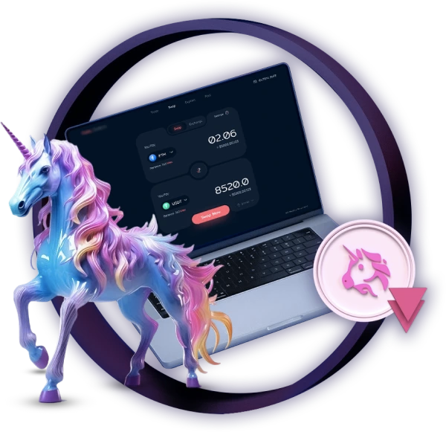
Top 10 Advantages of Trading on Uniswap DEX

Slide 2
  Decentralization and improved Security
  Not Required for KYC and Registration
  Simple Token Swaps and Liquidity Pools
  The Wide Variety of Supported Tokens
Top 10 Advantages of Trading on Uniswap DEX
  Low Fees and Cost-Effective Trading
  Uniswap V3 and its Advanced Features
  Complete Transparency
  Uniswap Token Listing and Growth Opportunities
  Community-Driven and Open Governance
  Uniswap Listing Services

Slide 3
1. Decentralization and improved Security
Decentralization is one of the great advantages of Uniswap DEX. It is differentiated from traditional centralized exchanges in that they control people’s funds and private information that Uniswap DEX manages wholly through decentralized blockchain (in this case, Ethereum), thus maintaining the custody of their funds.
Whenever you trade on Uniswap clone script DEX, you do not need to deposit your crypto assets on the platform. You trade directly from your wallet, and no one else holds the keys to your funds. This reduces the risk of hacks and fraudulent activity that comes with centralized exchanges.

Slide 4
2. Not Required for KYC and Registration
Another very attractive thing about using Uniswap DEX is that it does not ask for KYC verification or registration. Unlike centralized exchanges that mostly will require a user to tender personal documentations and subject that person to an extensive verification process, Uniswap DEX allows anonymous trades.
This implies that one can begin trading cryptocurrency without the fear of sharing sensitive information, delivering enhanced privacy and security. Make it fast because you can begin trading immediately after connecting your wallet.

Slide 5
3. Simple Token Swaps and Liquidity Pools
Uniswap DEX is centered on the easy use of liquidity pools for token swapping. Unlike a traditional order book system that many centralized exchanges use, it applies the Automated Market Maker (AMM) system-instead, users do trade liquidity pools formed from pools of tokens provided by other users.
They can also provide liquidity into such pools and earn a share of the trading fee, thus bringing such opportunities to both traders and investors. As a liquidity provider on Uniswap DEX, contribute to its liquidity and earn passive income from transaction fees.

Slide 6
4. The Wide Variety of Supported Tokens
One of the best features that Uniswap DEX has is all types of tokens that it supports. Would you like to trade some well-known tokens such as Ethereum, one of the most robust pieces of software for trading, or perhaps Litecoins or any other minor tokens? Well, Uniswap DEX will have something for everyone.
Any decentralized cryptocurrency is a part of Uniswap DEX because, as we know, DEX is completely created on the Ethereum-based blockchain system; therefore, the DEX can operate with any ERC-20 token, making it accessible to a broad range of digital assets. Without much stress, developers and projects can list tokens on Uniswap DEX, allowing them to publicly sell these tokens or expose them to a larger audience.

Slide 7
5. Low Fees and Cost-Effective Trading
Uniswap operates with lower fees than the Centralized exchanges, which makes it a cost-effective trading platform. The Ethereum gas fees fluctuate based on network congestion, but Uniswap DEX, in that regard, is competitive.
Users do not have to pay high trading fees prevailing on centralized exchanges. Instead, in Uniswap DEX, these fees benefit the liquidity providers who earn a percentage of the transaction fees. With a combination of liquidity providers and the platform retaining certain fees, this lowers the overall cost and creates a fair experience for traders.

Slide 8
6. Uniswap V3 and its Advanced Features
Uniswap V3 has come with many innovations that take trading beyond imaginable limits. The most important, in fact, is concentrated liquidity, which allows liquidity providers to concentrate their capital within specific price ranges. It clearly becomes more capital-efficient with better price execution as well as lower slippage.
Traders benefit from improved concentrations of trade conditions and tighter spreads, which can be used to execute significant trades with limited price impact. There is also a new concept in slippage reduction during trades in volatile or in large decimals of cryptocurrency.

Slide 9
7. Complete Transparency
Transactions executed on the Uniswap DEX are recorded on the Ethereum blockchain, thus ensuring full transparency. This level of transparency affords you the opportunity to monitor all trades, Token transfers, and Liquidity pool alterations in real-time.
Since Uniswap DEX is open-source, people can get the source code, analyze it, and verify all platform activities.
Transparency is a big plus for traders. One can check trades for manipulation if any and thereby ascertain that the platform operates on fair grounds.

Slide 10
8. Uniswap Token Listing and Growth Opportunities
For developers and crypto projects, Uniswap DEX provides a straightforward and efficient method for listing tokens. Uniswap Token Listing is an essential service for new projects looking to gain exposure and liquidity. Listing a token on Uniswap DEX ensures that it can be easily traded by users, gaining access to a global audience.
If you're a project owner looking to list your token, Uniswap DEX Listing services offer a seamless way to integrate your token with one of the most popular decentralized exchanges in the market. This can help increase the token’s visibility and credibility.

Slide 11
9. Community-Driven and Open Governance
Uniswap DEX indeed governs itself in every way by the community of token holders. All decisions concerning upgrades or changes to the platform are being made in accordance with a governance system whereby token holders can vote for or against various proposals. Open governance yet guarantees that the Uniswap DEX remains community-driven and steers development along with the needs of the users.
Through this, users contribute to the governance process and will have their say in all matters concerning their destined future for the platform. This creates a sense of ownership and involvement among them.

Slide 12
10. Uniswap Listing Services
There are listing services available to facilitate the launch of tokens and gain access to Uniswap DEX liquidity. Uniswap listings services offer the required tools and assistance for projects to list their tokens on the platform.
From token listings and liquidity pools to Uniswap Token Swaps, all these projects are aided by a complete service offering starting with initial formation and culminating with successful Decentralized finance (DeFi).

