Slide 1
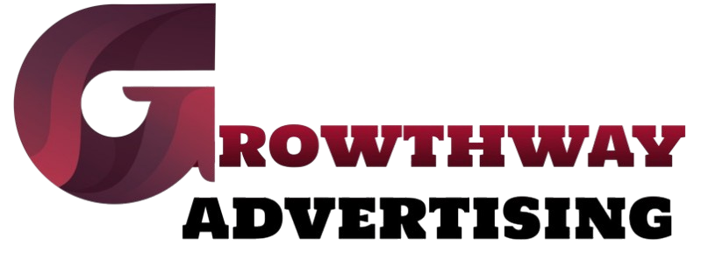
How Social Media Marketing Services Can Skyrocket Your Business Growth
https://growthwayadvertising.com/

Slide 2
The digital transformation requires businesses to build robust web-based platforms which maintain their standing in the market. Social media marketing services represent an effective approach to reach this objective. Billions of users currently active on Facebook together with Instagram and LinkedIn and Twitter provide businesses with a vast market to extend brand recognition and develop customer contacts for enhanced sales opportunities.
Why Social Media Marketing is Essential for Business Growth
Any business strategy currently requires social media digital marketing because of digital marketing development. Businesses using social media get direct contact with their audience that enables them to develop relationships and foster loyal customer communities. Social media management strategies properly developed by businesses lead to the following benefits:
Increase brand awareness
Drive website traffic
Generate quality leads
Improve customer engagement
Enhance brand credibility

Slide 3
The Role of a Social Media Marketing Agency
Social media management proves challenging for numerous organizations to handle without enough expertise. A social media marketing agency stands ready to provide help at this moment. Facing businesses these organizations create content and handle management duties alongside pay advertising services and audience relationship activities. Social media agencies that deliver reliable service know precisely which platforms lead to the highest reach and return on investment.
Benefits of Social Media Marketing Services
The following benefits demonstrate that business growth stems from utilizing social media marketing services:
1. Increased Brand Awareness
Billions of platform users make it possible for businesses to achieve fast and widespread customer contact. The combination of interesting content along with regular posting activity as well as purposeful advert placements enables your brand to build credibility alongside becoming more recognizable.

Slide 4
2. Higher Engagement and Customer Interaction
Through social media management, businesses can interact with their audience in real time. Organizations that offer prompt support to clients while addressing their questions and developing interesting content create trust between them and consumers leading to sustained business relationships.
3. Improved Lead Generation and Sales
Marketers of social media platforms develop campaigns which attract high-quality customer prospects while guiding them toward making purchases. Three specific tools such as targeted advertisements together with engaging social media postings and personally tailored communications effectively increase business revenue.
4. Cost-Effective Marketing Strategy
Through social media marketing services india you can achieve business promotion at a reasonable price point than traditional advertising approaches. Small business owners can harness the advantage of paid advertising since it costs much less than TV or print advertising.

Slide 5
5. Competitive Edge
Social media marketing implementation from India provides companies the advantage of outrunning their business rivals. Your business advantage in the market will increase through competitor analysis combined with industry trend learning and innovative strategy deployment.
Choosing the Right Social Media Marketing Company
Selecting the right social media marketing companies is crucial for success. When looking for an agency, consider factors like:
Experience and track record
Client testimonials and case studies
Expertise in your industry
Ability to provide comprehensive social media management services
Transparency in pricing and strategy

Slide 6
Conclusion
Business success depends on the implementation of social media marketing services which have now become mandatory rather than optional. If you operate either a startup or an established brand a professional social media marketing agency can assist your business in growing its audience base while motivating more audience interaction and boosting sales. The use of social media digital marketing enables you to fundamentally change your business to experience dramatic market expansion.
Your brand needs professional advancement and we are here to deliver it to you. Entrusting your business to a leading social media marketing company will help your operations prosper.

Slide 7
Contact us
We combine creative marketing strategies with digital media and technology to drive your brand’s scalable and sustainable growth.
With almost 10+ years of award-winning digital and creative marketing experience across start-ups, SMEs, and multi-national B2B and B2C brands, we love what we do!
https://growthwayadvertising.com/
Office No – 703, ANP Landmark, Sr. no. 89, Bhumkar Chowk,Hinjawadi – Wakad Rd, Pune, Maharashtra 411057
Phone : 91+ 7709280369
Email: Bhavesh@growthwayadvertising.com

