Slide 1




Understanding the UK Spouse Visa: A Complete Guide

Slide 2
If you want to join your partner in the UK, obtaining a UK Spouse Visa is essential. This visa allows you to live, work, and build a life with your spouse in the UK. However, the application process requires careful preparation and meeting specific requirements.
Eligibility Criteria for a UK Spouse Visa
To successfully obtain a spouse visa, applicants must fulfill the following conditions:
  Genuine Relationship: You must be legally married or in a civil partnership with a UK citizen or settled person.
  Financial Stability: The sponsoring partner must meet a minimum income threshold to support the applicant.
  Accommodation: Adequate living arrangements must be in place.
English Language Requirement: The applicant must pass an approved English language test or provide a relevant qualification.

Slide 3
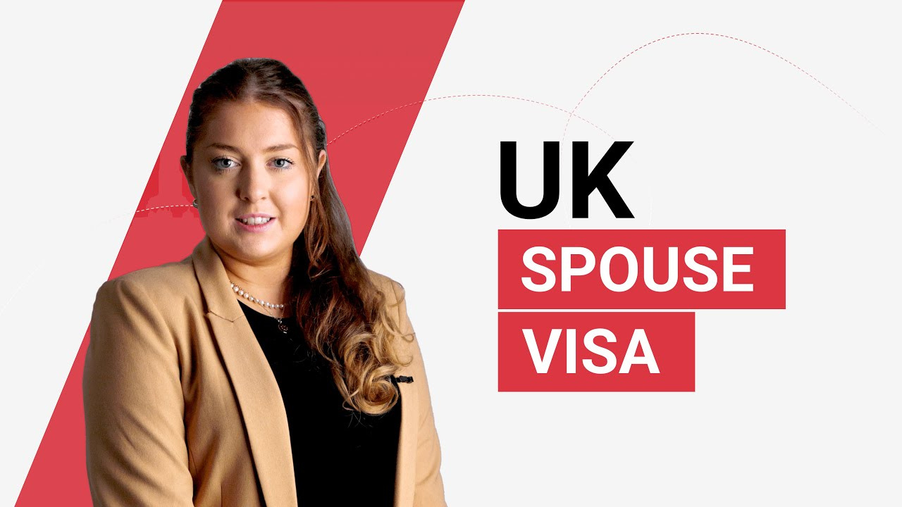

Slide 4
Required Documents for Application
Applying for a UK Spouse Visa requires submitting key documents, including:
  Marriage or civil partnership certificate
  Bank statements and payslips proving financial eligibility
  Proof of adequate accommodation in the UK
  English language test results
  Passport and previous immigration records
Common Challenges and How to Overcome Them
Many applicants face issues such as proving financial stability or the genuineness of their relationship. To avoid delays or rejections, ensure your application includes all required evidence, and consider seeking professional guidance.

Slide 5
Final Thoughts
The UK Spouse Visa application process may seem complex, but thorough preparation and understanding of the requirements can increase your chances of success. With the right documents and professional assistance, you can simplify the process and start your new life in the UK with your spouse.

Slide 6
THANK YOU
Phone:- +44 (0)20 3411 1261
Email: info@visaandmigration.com
Website:- https://www.visaandmigration.com/

