Slide 1


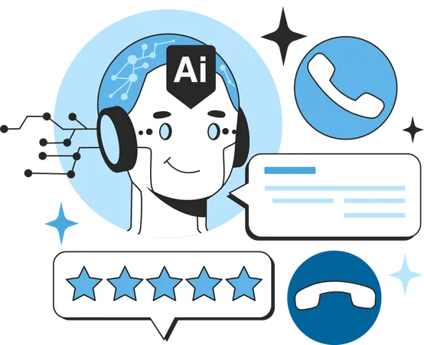
The Future of AI Agents: What’s Next in Intelligent Automation?
www.blockchainx.tech

Slide 2
Artificial Intelligence (AI) agents automating processes and increasing efficiency and user experience are considered to be some of the most disruptive forces in any industry. AI Agent development has matured to a point within enterprises where intelligent automation is being used for customer support, data analysis, and business decision-making. These AI systems could cut costs for an enterprise and help scale the enterprise processes while maintaining quality. As we move into the future with further evolution of AI, AI agents promise a lot more and may change how we interact with technology, which would also promote intelligent and seamless automation in our environment. Presently, its contribution is felt much in all industries: of finance and health, from retail to logistics, with optimal workflow and decision-making processes.

Slide 3
The Rise of Autonomous AI Agents
The development of AI towards greater autonomy means that it can now perform even the most complex tasks with little human intervention. Intelligent systems therefore benefit from machine learning, natural language processing, and reinforcement learning whereby they learn from experience and improve over time. Autonomous AI agents are the new wave, reducing manual effort and increasing productivity across industries from virtual assistants like Siri and Alexa to advanced AI customer service bots. As these systems go further, they will develop capabilities for multi-step processes, anticipate user needs, and provide highly personalized solutions. With increasing frequency, businesses are implementing these agents into their workflows, thereby improving decision-making and customer experiences. The increasing rollout of AI-powered automation is helping to boost efficiency in sectors such as e-commerce, banking, and manufacturing, allowing staff to concentrate on strategic and creative endeavors.

Slide 4
Integration with IoT and Edge Computing
The newest trend in intelligent automation is the integration of AI agents with the Internet of Things (IoT) and edge computing. AI agents inside IoT devices can carry out processing at the edge, thereby decreasing latency on all decision-making while improving the real-time quality thereof. The integration helps enhance further applications in smart homes, industrial automation, and healthcare monitoring systems by boosting their responsiveness and efficiency. In manufacturing and logistics, AI IoT systems have been enabling predictive maintenance and real-time monitoring for automated decision-making; hence, a solution to reducing downtime and ensuring optimal utilization of resources. The AI and edge computing convergence provides businesses with optimum efficiency, security, and agility in operations. With the advent of expanded 5G networks, the AI-enabled IoT devices will be interfaced with fast communication and information processing capabilities fueling a greater level of seamless automation across various sectors.

Slide 5
Advancements in Natural Language Understanding
Natural language understanding has a potentiality of improvement for AI agents. That means increased conversational context-awareness is rendering modern AIs to produce interactions akin to human interactions. Deep learning advancements have come to the fore, more in the case of transformer-based models, which allow for emotion, intent, and sentiment understanding for more relevant AI responses in areas like customer support, virtual assistance, and content generation. Such enhancements propose greater engagement in interaction through AI-based chatbots and voice assistants. As AI is improving in dialects and languages, businesses will be carrying local and culturally considerate AI solutions for greater customer satisfaction. Their recent ability to generate and summarize text adds another dimension to automated interaction; thus, aiding content generation and holding meaningful exchange.

Slide 6
Ethical Considerations and AI Governance
Improving the maturity of AI agents makes them require ethical considerations and governance frameworks for responsible development. Issues such as biases in AI algorithms, data privacy, and transparency need to be addressed. Governments and organizations are working on regulations to promote fair and accountable AI systems to make sure that the benefits of AI are broad with minimal risks. Companies, too, should focus on making AI agents explainable and interpretable, enabling the users to have an understanding of how decisions are made. Ethical AI development involves working together with technologists, policymakers, and industry leaders to set up systems that are inherently inclusive, unbiased, and in consonance with societal values. Lastly, as adoption gets more widespread, cybersecurity issues and misinformation driven by AI will require protective parameters and regulations that ensure AI becomes an instrument for constructive development rather than for misuse.

Slide 7
The Future: AI Agent Development Solutions for Businesses
The future of AI agents seems bright, for businesses have embraced AI Agent Development Solutions to improve the operational and customer engagement effectiveness. Intelligent automation is being used by businesses to forge ahead competitively, from AI chatbots to automated business analytics. As AI continues to develop, we expect AI agents to be more intuitive, proactive, and indispensable in all market sectors. Such Agents may orchestrate complex work processes, forecast evolving business trends, and provide real-time insights for strategic decision-making. Organizations leveraging AI-powered tools will be able to lead in speed of innovation, cost optimization, and unparalleled user experience. AI automation will introduce new business models that will allow the exploration of hyper-personalization in marketing, intelligent supply chain management, and advanced predictive analytics and thus will lay the foundation for a more intelligent and efficient digital economy.

Slide 8
Conclusion
The next phase in intelligent automation is expected to further increase AI agent participation in enterprise strategy formulation and user-experience development. Continuous improvement in AI Agent Development Solutions goes on, unlocking new avenues for automation, efficiency, and innovation in organizations. In future days, these AI agents will not only perform automation of tasks, but also lead intelligent decision-making transforming the future of the workplace and everyday life. The impact of AI appears not only on enterprises but also reaches farther, even into the fields of education, health care, finance, and entertainment. Those companies and individuals who prepare beforehand for the new entries of AI are expected to take full advantage of such technology to enable a smarter and more efficient future. These transformations will affect other aspects of daily life, too-from personalized digital advisers to completely automated business operations, all to create a more connected and intelligent world.

Slide 9




Thank You
CONTACT US
www.blockchainx.tech
contact@blockchainx.tech
+91 7708889555

