Slide 1


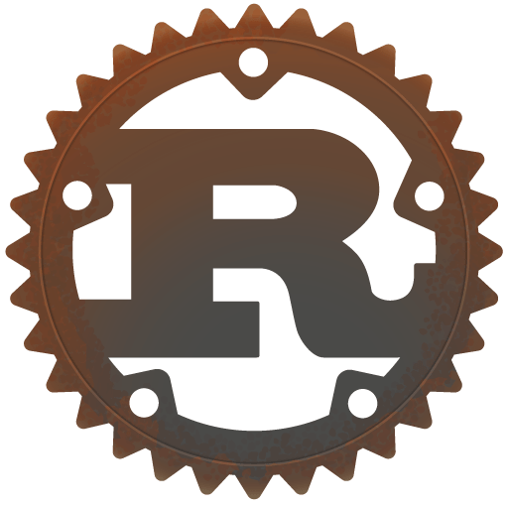
Why Hiring Rust Developers Can Reduce Technical Debt & Save Millions
www.blockchainx.tech

Slide 2
In this fast-paced digital world, companies in need of robust, effective, and secure software applications will remain competitive. One of the best places to do this is to hire a Rust developer who can build applications that scale and perform with the least possibility of failure. Rust's popularity has seen an explosion with the dangerous combination of memory safety, zero-cost abstractions, and concurrency support, and it has become the perfect language for companies wanting to reduce technical debt and optimize development costs. If a business can incorporate Rust's powerful features into any of its processes, it can significantly improve software reliability, system performance, and reduce a lot of money in terms of maintenance down the line. Also, with Rust, design-time safety guarantees provided by compile-time checks and ownership means whole classes of bugs-such as null pointer dereferences and data races-are simply not possible, resulting in more secure and stable code. A developing ecosystem, vigorous community support, and solid integration of modern developer tools make Rust an avant-garde option for companies that want to Hire a Rust developer and future-proof their technology stack.

Slide 3
Understanding Technical Debt and Its Cost Implications
Technical debt represents the hidden costs incurred by bad decisions in software development, which slowly pile up and call for the expenditure of more resources to remedy. A developer incurs technical debt when they take shortcuts on a coding assignment using limited best practices or fail to plan for future scalability. Usually, businesses gather technical debt because of rushed development cycles, work with little or no documentation, or use obsolete technology. This kind of debt will gradually translate into glaring disadvantages such as security vulnerabilities, increased maintenance efforts, and decreased efficiency in systems. Properly handling technical debt using good architecture with a capable programming language like Rust early on can save a lot of rework and operational costs for businesses.

Slide 4
How Rust Minimizes Technical Debt
1. Memory Safety Without Garbage Collection
Rust realizes its distinctive ownership model to guarantee memory safety without reliance on garbage collection. This keeps memory bugs, like buffer overflows, null pointer dereferencing, and use-after-free errors, away from the software developer's scope. For instance, bugs like these are regular occurrences in C and C++ and accompany hell for developers. Such situations are alternatively made rare in Rust since compile-time checks for these cases are treated very seriously; therefore, the issues get resolved not during production but during development. It ensures that debugging times are much lower and that there are no major system crashes leading to downtime and revenue loss.

Slide 5
2. Concurrency Without Data Races
Concurrency problems-the big driver of technical debt in today's software development-involve a multitude play of its own. Classical multi-threaded programming continues to be a breeding ground for such problems. In data races, multiple threads access shared data in unpredictable means, resulting in inconsistencies and crashes. Rust's ownership and borrowing system prohibits these races at compile time so that developers know that their applications will execute efficiently and without causing complex synchronization problems. High-performance concurrent applications can be developed with confidence, thus reducing the time to debug and tune for performance.

Slide 6
3. Long-Term Maintainability
A strict code standard is enforced by Rust, leading to a clean and maintainable code. It lays the burden of long-term maintenance on the developers who have to take care of issues upfront. Unlike dynamically typed languages that can have unexpected runtime errors, Rust being statically typed ensures predictability and stability. Another important advantage is that Rust has a good set of tools and libraries for code reuse and modularity, such that these can be best advertised to increase the ease of managing large projects over time and thus minimize long-term upkeep costs and downtime due to failures of software.

Slide 7
Financial Benefits of Hiring Rust Developers
1. Reduced Development Costs
Rust prevents common problems during software development which significantly reduces debugging and maintenance and saves a lot of money. Money is therefore wisely spent as organizations do not find themselves facing unexpected costs from poor-quality software. Development teams can now concentrate on building features instead of fixing bugs because Rust alleviates many of the common pitfalls in memory management and concurrency. Thus, it allows for faster time-to-market and better productivity.

Slide 8
2. Improved Performance and Scalability
Rust runs fast enough comparable to C and C++ to allow companies to build high-speed applications that scale without difficulty. Rust directly compiles into machine code, unlike interpreted languages, thus optimizing execution speed and resource usage. With this approach, companies do not have to keep upgrading their hardware or overhaul their systems needlessly, which can be a very costly endeavour. Whether cloud-based applications, embedded systems, or high-frequency trading platforms, Rust ensures enough efficiency to absorb heavy workloads without locking performance.

Slide 9
3. Lower Security Risks and Compliance Costs
Rust minimizes vulnerabilities that can lead to security breaches through its built-in memory safety and strict compile-time checks. Common security flaws like buffer overflows, race conditions, and memory leaks are therefore largely absent from the Rust world, making it a prime candidate for industries with the highest security requirements: finance, healthcare, aerospace, and so on. Such a prevention will save companies in millions on lawsuits, on regulatory fines, and on reputational damage following cyberattacks. The pinpointed nature of Rust, too, eases compliance for companies concerning industry regulations and security standards: another layer of reduced operational risk.

Slide 10
Conclusion
Investing in hiring Rust developers for software development in companies is one of the ways towards building future-proofing in software development with limited technical debt and operational cost benefits. Rust's ability to develop secure and high-performance applications with minimal maintenance makes it an excellent option for modern enterprises. Using strong features of Rust will assist businesses to minimize long-term technical debt and increase development efficiency while ensuring that the software will remain scalable and resilient. Rust's strong memory safety guarantees, ownership model, and built-in concurrency prevention minimize common vulnerabilities, making it its preferred language for critical applications such as finance, blockchain, and cybersecurity. If you seek Top Rust Developer for hire, having such experienced people will not only enhance your software but also save millions of potential technical overhead, securing your long-term business success. Besides, the ever-increasing community of active developers and improvements in Rust's ecosystem allows companies to future-proof their tech stack while retaining flexible movement to evolving industry demands.

Slide 11
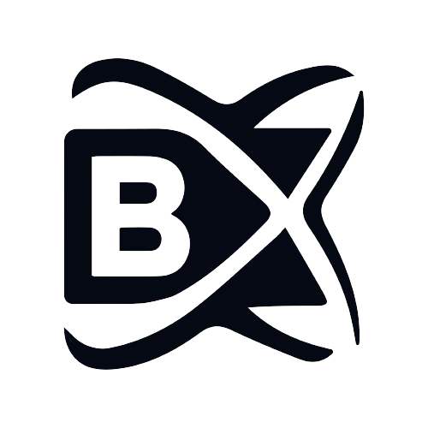



Connect with us.
contact@blockchainx.tech
www.blockchainx.com
+91 7708889555

