Slide 1


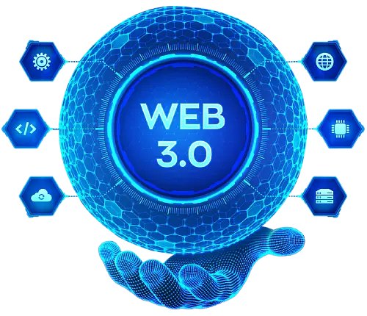
How Blockchain Works: The Foundation of Web3 Development
www.blockchainx.tech

Slide 2
Blockchain technology is the basis for Web3 development, allowing for the construction of decentralized applications (dApps), smart contracts, and assets. Within the Web3 ecosystem, users interact directly with decentralized networks instead of relying on centralized authorities such as banks or tech companies. The move towards decentralization cuts off intermediaries and allows the creation of a secure, transparent, and user-centric environment. Blockchain technology guarantees that all transactions are immutable, traceable, and verifiable, which encourages trust and accountability. Smart contracts are automatic, self-executing contracts that can be enforced without human intervention. A clear understanding of the working of blockchain becomes imperative for developers, businesses, and any stakeholders willing to innovate or pursue opportunities in the space pertinent to Web3 development, as it promotes an inclusive digital economy by providing security, transparency, and freedom from any intermediary.

Slide 3
What is Blockchain?
Blockchain is a completely decentralized form of distributed ledger technology that records a transaction very securely, transparently, and immutably. Unlike traditional databases managed by centralized entities, the blockchain is maintained over a decentralized network of computers, referred to as nodes, cooperating to keep the integrity of the ledger. Each event in the transaction is processed by the network, the transaction is then incorporated into a block, and the block links itself to the previous block, creating an ever-lengthening, unchangeable chain. The interconnectedness of the system thus ensures that once a block has been created containing the data, the integrity of the data can be altered only with the concurrence of the majority, thus making it highly secure and tamper-proof. Each block holds a number of transactions along with a timestamp and a cryptographic hash of the previous block to make sure that each link in the chain is securely bound together. This mechanism maintains the security of the blockchain but also renders it very transparent as every participant on the network has access to the same version of the ledger.

Slide 4
Key Components of Blockchain
Blockchain has a major role to play as the groundwork behind each and every Web3 development embraced, permitting one to design decentralized applications (dApps), smart contracts, and digital assets that do not rely on any central authority. Web3 thus becomes a paradigm shift from the current internet's infrastructure, where users are dependent on giant corporations to control their data, to an open and peer-to-peer system bestowing greater autonomy to users over their digital identities and assets.As the new elements for trustless applications, developers can use blockchain technology across multiple industries: finance, gaming, social media, and so on. The birth of Decentralized Finance (DeFi), in other words, finance without intermediaries, Non-Fungible Tokens (NFTs), and Decentralized Autonomous Organizations (DAOs) has helped blockchain creation to offer a new way for users to interact with the internet. This presents an interesting opportunity for innovation, especially in sectors such as finance, art, and gaming, where users are demanding more autonomy and privacy. Through this means, Web3 becomes an alternative framework to the current Web2 model with more transparency and user-oriented focus.

Slide 5
How Blockchain Powers Web3 Development
Blockchain is the center stage for Web3 development and is capable of transforming industries through decentralized finance (DeFi), non-fungible tokens (NFTs), decentralized autonomous organizations (DAOs), etc. It is the very foundation of an end-user-empowered internet where people have sovereignty over their data and digital assets and do not have to depend on tech giants. Blockchain offers all these features via distributed ledger technology, which improves transparency, mitigates fraud, and eliminates the need for intermediaries across diverse sectors including finance, art, supply chain, and governance. Furthermore, with the introduction of smart contracts, all transactions are seamless and automated, enabling the enforcement of agreement terms without the intervention of any human party. As the development of Web3 progresses, it is the blockchain infrastructure that makes the internet secure, inclusive, and resilient by giving users the ability to control their digital identity.

Slide 6
Conclusion
Web3 development is being carried out on blockchain technology which guarantees secure transactions, providing transparent information verification and running on complete decentralization ideas. Web3 development services are gaining traction as they build innovative solutions applied in finance, social networking, and gaming; the list is far longer. As blockchain technology matures, it will vastly redefine the digital landscape: these redefined business models will provide new and improved privacy for users while aiming to disrupt existing industries for a more open and decentralized internet. Thus, working with experienced Web3 development services will assist companies and individuals together to maneuver to this game-changing space.

Slide 7





Thank You
CONTACT US
www.blockchainx.tech
contact@blockchainx.tech
+91 7708889555

