Slide 1

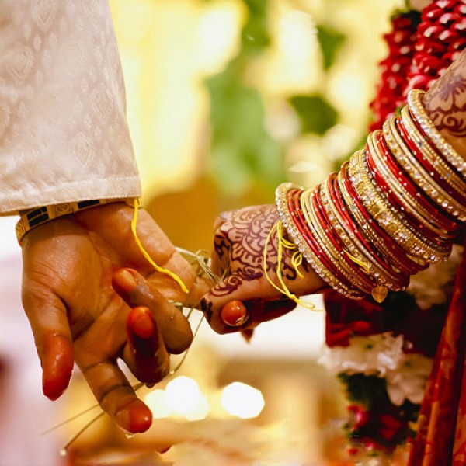
Home
Service
About Us
Contact
IMPERIAL WEDDINGS
AGGARWAL MARRIAGE BUREAU IN DELHI
Presented by Imperial Wedding
Website:
https://www.imperial.wedding/aggarwal-rishte-in-delhi-ncr-india

Slide 2

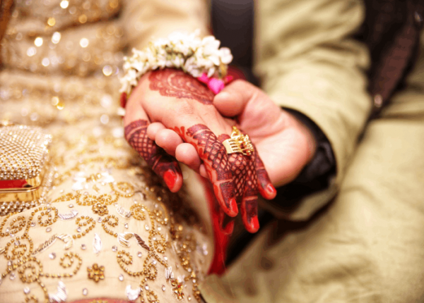

Home
Service
About Us
Contact
About us:-
Why Choose Imperial Weddings?
  Tailored matchmaking services for personalized connections.
  Expert team with years of experience in matrimonial services.
  Focused on finding compatible matches based on your preferences.
  Trusted by hundreds of happy couples in Gurgaon.
Website:
https://www.imperial.wedding/aggarwal-rishte-in-delhi-ncr-india

Slide 3
Home
Service
About Us
Contact
Aggarwal Matrimonial Services in Delhi
Imperial Weddings is a premier Aggarwal marriage bureau in Delhi, dedicated to facilitating meaningful matrimonial alliances within the Aggarwal community. Recognizing the importance of cultural alignment and shared values, Imperial Weddings offers specialized matchmaking services tailored to the unique preferences of Aggarwal families.
Website:
https://www.imperial.wedding/aggarwal-rishte-in-delhi-ncr-india

Slide 4


Home
Service
About Us
Contact
Thank you For Watching
contact us :
011-40505815 9773525525
117, 1st Floor, NDM-1
Netaji Subhash Place
Pitampura, Delhi-110034
info@imperial.wedding
Website: https://www.imperial.wedding/aggarwal-rishte-in-delhi-ncr-india

