Slide 1


Tanzania Honeymoon Safari Packages
www.professional-safari-africa.com

Slide 2

About Us
Search for Tanzania Honeymoon Safari Packages that offer a combination of luxury and fun on the Tanzania honeymoon safaris. Experience the Serengeti plains, Ngorongoro Crater, and Tarangire National Park with exclusive use of vehicles, excellent standard lodgings and guided tours. Customer packages of their choice are memorable moments that provide an experience range of activities such as Wildlife viewing, Sunset views, candle light dinners and many more.
www.professional-safari-africa.com

Slide 3

You will get professional tour guides and drivers, beautifully located lodges, and private activities to make your honeymoon in Tanzania unforgettable. Share your romance by the warm karibu and amid the wild wonders of one of Africa’s top wildlife destinations.
www.professional-safari-africa.com

Slide 4
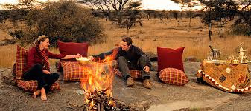



Contact Us
+255788249264
info@professional-safari-africa.com
www.professional-safari-africa.com

Slide 5
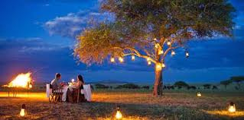
THANK YOU
www.professional-safari-africa.com

