Slide 1



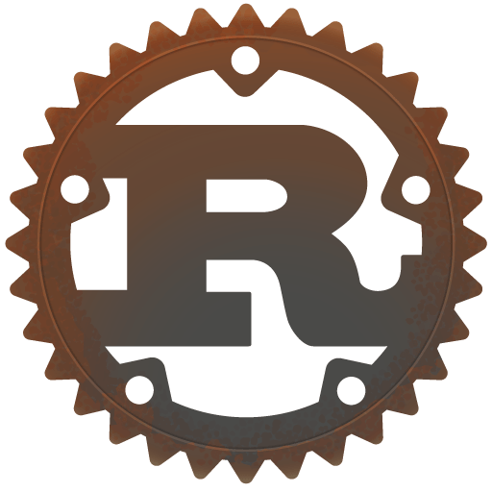

Why Hiring Rust Developers is a Smart Investment for Tech Companies
www.blockchainx.tech

Slide 2
In the contemporary fast-paced world of technology, choosing the right programming language and employing the right developers might turn out to be the most efficient hack into an organization for success. Rust is a systems programming language well-known for its advantages in memory safety, performance, and concurrency. In recent years, it has gained popularity, so hiring Rust developers is a reasonable strategy for tech companies interested in creating solid, effective, and scalable software solutions. Hire an Rust Developer to reap all the benefits of this great new language and develop really strong, secure, and future-proof applications. As the usage of Rust continues to grow and demand rises for software that is highly optimized, companies using their resources toward Rust talent can continue to stay competitive in this cutthroat technology landscape.

Slide 3
1. Rust Ensures High-Performance Applications
It's performance that definitely matters the most to tech firms, especially those with high-load systems like fintech platforms, gaming engines, and even cloud computing. Rust was meant to offer performance on the same level as C/C++ but ensuring safety. Development in Rust will allow for creating high-performance applications that utilize hardware efficiently, all without the concerns of leaks or segmentation faults, due to its zero-cost abstractions, low-level control, and efficient memory handling. This means that applications may easily perform computations at scale, process data, and respond in near-real time. Rust's optimized execution makes it possible to develop applications that are not only faster but also run on fewer system resources, thereby improving the user experience as well as operational expenditure.

Slide 4
2. Enhanced Memory Safety Without a Garbage Collector
Memory safety issues like buffer overflow and null pointer dereference have haunted software development for decades. Rust provides a remedy for these problems by enforcing strict memory safety rules at compile time. In contrast to those languages that rely on garbage collection mechanisms (e.g., Java, Go), Rust secures memory via an ownership, borrowing, and lifetime system, minimizing runtime overhead and increasing application stability. Given that Rust is free of most common memory errors, reliable and secure code can be written by developers to minimize vulnerabilities. As such, it is well-suited for those industries where security and stability are of utmost importance. The absence of garbage collection also means that programs in Rust have lower latency and greater throughput-perfect for real-time systems and mission-critical applications.

Slide 5
3. Strong Concurrency Model for Scalable Systems
The rising popularity of multi-threaded applications is highlighted by Rust in effectively blocking data races and other concurrency-induced bugs. Hence, businesses working on any form of distribution system, microservices, or real-time applications can highly benefit from Rust's proficient ability to cater to concurrent spectral execution. The language, with its built-in concurrency features of message-passing channels and essentially functioning in thread-safety mode, helps applications scale well and harden up considerably under constantly high-pressure processing. By hiring Rust developers, any business can now potentially create highly concurrent systems devoid of any speed-stability trade-offs, while using resources judiciously. The best thing about Rust concurrency is the fact that it minimizes overhead in synchronization, meaning less hassle while getting programs to fully realize parallelism without issues of unexpected outcomes, or choked up with synchronization issues.

Slide 6
4. Growing Ecosystem and Community Support
The ecosystem of Rust is really fast expanding through various frameworks and libraries set out for web development(Rocket, Actix), game development(Bevy), blockchain(Substrate), and even embedded systems. There are many active communities of Rust that provide corporate backing by some companies like Mozilla, Microsoft, and AWS, which will improve the language and make it viable for a longer time. These would allow developers relatively massive documentation, forums, and open-source libraries to further create and solve problems more easily. That's also another growing ecosystem that makes it much easier for businesses to integrate Rust into their tech stack. It has also allowed them to find and attract relative talent in creating projects. These are just some examples of using tools such as Cargo, America's Package manager, which has optimized development workflows and made dependency management and project maintenance considerably more efficient.

Slide 7
5. Security-First Approach
Cybersecurity today appears to be the top on the list of priority aspects that present-day tech companies would want to see in place as it pertains to using software whose code base is Rust, with Rust encompassing built-in security features that relieve the proverbial weight immediately upon such common vulnerabilities-buffers that overflow, conditions of race, and corrupted memory. The fact that both program compilation and strict checking occur at the time compile has ensured that engineers can never have any compromise and risk the introduction of security flaws common in C and C++. For enterprises in a number of sectors, among these finance, healthcare, or defence, Rust could stand to be a solution by virtue of its focus on safety and reliability. Hiring Rust developers would actually go a long way to ensure proactive protection of systems due to the strong and maintained fort at developing even more significant safeguards against causes that threaten cyber safety.

Slide 8
6. Cost Savings in Development and Maintenance
While the learning curve for Rust can cause delays in development, the expenses of hiring Rust programmers could pay off in the long run; fewer runtime errors, decreased debugging time, and diminished infrastructure costs (due to efficient memory handling) lead to savings. With less frequent security patches, decreased maintenance overhead, and reduced system failures, Rust earns a good credibility with lower operational expenses. Therefore, hiring skilled Rust developers guarantees that businesses will develop software solutions requiring very little subsequent support for them to spend their time and energy on actual innovation and growth. On the other hand, because of Rust's performance optimizations, server and cloud expenditures can drop tremendously, making it a cost-friendly approach for firms eager to maximize resource consumption.

Slide 9
7. Adoption by Leading Tech Companies
A number of large enterprises, such as Dropbox, Discord, Amazon, and Cloudflare, are utilizing Rust as a language for building the backbone of their critical systems. This trend mirrors Rust's employment in real-world scenarios with a chord struck for becoming the next mainstream programming language, which is handy for high-performance applications. Due to Rust being reliable and witnessing ever-growing acceptance, companies may safely invest in it, as it arrives with the endorsement of prominent industry players and a vibrant developer community. By adopting Rust, the companies can have an upper edge over their competitors to develop hyper-efficient and secure systems. Global leaders increasingly adopting Rust attest to how it solves software problems today, validating that it will evolve along with the technology of the future.

Slide 10
Conclusion
For tech companies that prioritize performance, security, and scalability, hiring Rust engineers represents an investment in the future. Armed with Rust's guaranteed memory safety, efficient memory management, and powerful concurrency model, businesses are free to develop future-proof applications without drowning in technical debt. As Rust keeps gaining acceptance, organizations that introduce it into their development stacks will be poised for further success in the future. Hire Rust developers to keep your competitive tech company at the forefront and develop secure and high-performing software into the next decade. With its modern abilities, Rust can create software that is faster, safer, and more efficient and bring that competitive edge to the game.

Slide 11




THANK
YOU
www.blockchainx.tech
contact@blockchainx.tech
+91 7708889555

