Slide 1


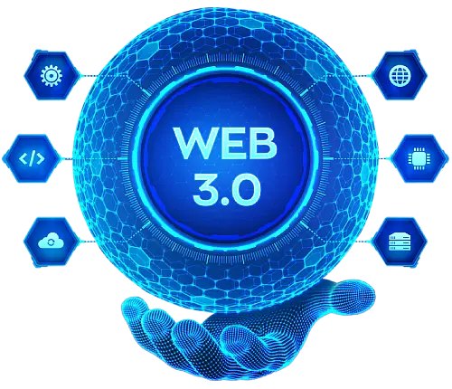
How to Get Started with Web3: Wallets, DApps, and Tokens Explained
www.blockchainx.tech

Slide 2
The concept of decentralized internet called Web3 is the next step for this technology along with capabilities driven by blockchain. Web3 differs from the conventional, centralized Web2 in that it enables users to own their data, digital identities, and assets, enhancing security and privacy. With the increase in demand for Web3 solutions, the businesses and developers can leverage Web3 development services to create applications that run on the technology of a decentralized network. This revolutionary shift is affording people greater independence and new ways of interacting with digital environments. Investor, developer, or enthusiast-Whoever you are, this technical guide will familiarize you with the basic elements of Web3, including wallets, decentralized applications (DApps), and tokens, and aid you in grasping how this new internet works

Slide 3
What is Web3?
Web3, or Web 3.0, is envisioned as a decentralized internet where users have sovereignty over their data, identity, and digital assets. Under the Web2 model, data is stored on centralized servers owned by corporations such as Google, Facebook, or Amazon. Web3 follows the ideals of a new decentralized ecosystem built on blockchains that provide a peer-to-peer network with distributed control. In this ecosystem, you are your own bank, and transactions will be done transparently, securely, and without intermediaries. Wherever privacy and ownership are maintained, Web3 development services, such as smart contracts and DeFi implementations, are changing industries by providing new avenues for the development of applications and platforms.

Slide 4
Setting Up a Web3 Wallet
To access the Web3 universe, you need a Web3 wallet that serves as the door to this decentralized world. Web3 wallets are charged not only with cryptocurrencies but also with directives for interaction with decentralized apps and token management. Some of the well-known Web3 wallets such as MetaMask, Trust Wallet, and Coinbase Wallet give you a place to safely store your private keys, manage your assets, and sign transactions. Each wallet generates a unique address where your tokens are stored. When you're setting up the wallet, you will receive a private key or a seed phrase, which is basically a sequence of words that work as the password for your wallet. Store this information in a secure location since whoever has access to this information would be able to control your assets. Moreover, the majority of wallets provide easy ways to link to Web3 apps so that you can easily interact with DeFi, NFT, and other types of blockchain activities.

Slide 5
Exploring DApps (Decentralized Applications)
The Decentralized application, DApps are the main features of Web3, and they live on top of blockchains instead of centralized servers. These apps can be considered open-source, transparent and governed by smart contracts, conditions under which executing specific transactions automatically takes place. DApps range from decentralized platforms like DeFi (decentralized finance) where one can lend, borrow and trade cryptocurrencies, to games and social networks to promote ownership. Perhaps the most popular examples of DApps come from blockchains like Ethereum, Binance Smart Chain, and Solana, as they well harness the benefits of decentralization. Hence, we might talk about controlling data and assets by users in DApps. It acknowledges the possible censorship or interference of a third party as far as data, assets, or users are concerned. Whenever you continue exploring DApps, you will discover some incredible features, such as decentralized exchanges, marketplaces, and NFT trading platforms.

Slide 6
Understanding Web3 Tokens
Tokens are the cornerstones of the entire web3 ecosystem. They represent value and assets or give access and entities to different resources within decentralized networks. Tokens come in many forms in web3; among them are cryptocurrency tokens, security tokens, utility tokens, and non-fungible tokens (NFTs). The most well-known of these all is Ether (ETH), which is the native currency of the Ethereum blockchain designed to perform transactions and provide the fuel for smart contracts. However, there are many parallel examples: each blockchain has its native token, such as Binance Coin (BNB) on Binance Smart Chain or Solana (SOL) on Solana. And apart from these, they have also been considered as one of the new phenomenon in the Web3 world: non-fungible tokens which energized the interest of the industry in the representation of property rights over creative virtual goods, such as paintings, pieces of music, and even fictional items used in the context of digital games. Containing location tokens has always been seen as an important part of engaging the Web3 ecosystem.

Slide 7
The Future of Web3: How to Stay Informed
As Web3 keeps moving in, it is important to keep following the latest trends, technologies, and innovations in this impetuous arena. Web3 development services are changing fast, and many new development tools and platform solutions are already extending. Follow blogs, listen to podcasts, and go through industry news to stay in line with innovations in blockchain, smart contracts, DApps, and token economies. Perhaps, get into different Web3 communities like Discord channels, Telegram groups, or Twitter chitter-chatter to catch up on what is emerging in terms of trends and opportunities in this new decentralized Internet. If you're a developer, investor, or user-the point is, you're in the wave that will help harness the totality of what Web3 promises. Provide entry to an industry like finance or gaming, art, where it is set to revolutionize, and develop new opportunities to innovate and disrupt markets.

Slide 8
Conclusion
Supporters of Web3 envisage an alternative internet based on decentralization and flipping the business model of existing giants on its head. The Web3 development platform presents a bouquet of tools and infrastructure to the developers for the domain of decentralized applications, smart contracts, and blockchain-based systems that come as building blocks of this new arena, the decentralized internet. With people and organizations alike taking more interest in the Web3 sphere, it is still growing, thus becoming a center of both opportunities and challenges. While Web3 allows developers to build secure, transparent, and user-driven experiences, which are also very close to the heart of decentralization, it equally provides entrepreneurs and startups an opportunity to invest in the creation of DApps for upcoming, far-reaching forward solutions. And regardless of whether one is an entrepreneur developing DApps, an investor exploring token markets, or just anyone wanting to understand this new internet, immersing himself in Web3 will put him in the present day and in the days to come. Web3 is poised to bring disruption to sectors like finance, gaming, and digital art, therefore, this is no trend but a change at a different level of how we essentially engage with the digital world. The short-time acceptance of new norms and technologies under existence will create an opportunity by adopting the existing evolution and utilizing the kits of the Web3 development platform to rekindle new avenues into the excitement of a decentralized future.

Slide 9




Thank You
CONTACT US
www.blockchainx.tech
contact@blockchainx.tech
+91 7708889555

