Slide 1


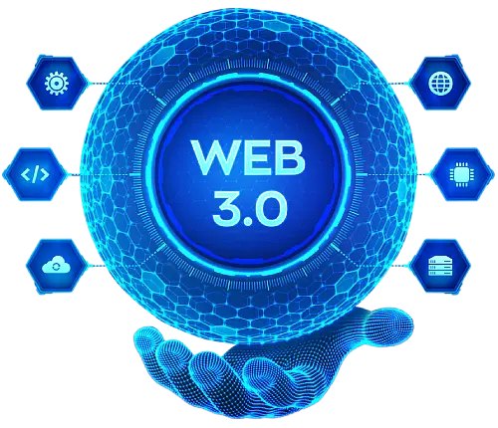
Creating
Cross-Chain Applications: A Guide to Web3 Interoperability
www.blockchainx.tech

Slide 2
The Web3 ecosystem is still in its nascent stage, where interoperability among the blockchain networks is vital for realizing the full capacity of decentralized applications (dApps). Cross-chain applications enable users to seamlessly access several blockchain networks, bridging over the chasms between them. This extends the very scope of DeFi, token exchange, NFT markets, and more. Web3 development services serve a central position in the realization of such solutions, arming developers with tools and frameworks for creating high-level interoperable blockchain applications. Web3 development services enable cross-chain communication, thus helping businesses deal with the complexities of blockchain technology, thus affording the opportunity for more representative and scalable solutions.

Slide 3
Understanding Cross-Chain Technology
Cross-chain technology pertains to the mechanisms that allow different blockchain networks to inter-operate or communicate to share data between them, thus forming an interconnected rather than isolated silos. This is achieved through the various protocols, among them bridges, wrapped tokens, and interoperability platforms. It can allow cross-associated blockchains through a common network, like in the case of Polkadot, or present a certain module approach where blockchains can communicate with the help of the Inter-Blockchain Communication (IBC) protocol, like what Cosmos does. All these solutions will allow users to transfer assets: execute cross-chain smart contracts and even exchange tokens between incompatible networks. There is immense flexibility in this kind of technology, allowing interaction with various decentralized applications spread across multiple blockchains without having to have trust on a single intermediary or platform.

Slide 4
The Importance of Interoperability in Web3
One of the fundamental features that make a website truly competitive is interoperability. In terms of DeFi and NFT, interactivity between different blockchains can greatly improve liquidity, functionality, and usability of apps. Without interoperability, users will be forced to use just one blockchain's advantages and miss out on all others. Interoperability would, therefore, create a condition where different ecosystems can talk and develop more diverse and innovative solutions, thus leveraging the strengths of the different networks. For example, a DeFi_application built on an Ethereum blockchain might easily communicate with a decentralized oracle network on Chainlink and would not have to restrict its sources of information to those available on Ethereum itself. All this, therefore, opens up for richer user experience and, thus, more dynamic application development that ultimately continues driving the growth of Web3.

Slide 5
Tools and Protocols for Building Cross-Chain Applications
There are countless cross-chain development tools and protocols suited for different needs of interoperability and blockchain applications. Polkadot and Cosmos have some of the first projects to develop decentralized platforms that allow multiple blockchains to interoperate. Polkadot’s relay chain acts as a security and scalability layer that enables communication between blockchain networks, while Cosmos utilizes the Inter-Blockchain Communication (IBC) protocol to bind chains into its family. Also, cross-chain integration is now being welcomed in some DeFi platforms, such as Uniswap and Sushiswap, which enable users to exchange assets across different blockchains using bridges and wrapped tokens. Using these tools gives developers the agency to ensure their dApps work seamlessly on numerous networks, creating a hassle-free experience for users in accessing an extensive range of decentralized services.

Slide 6
Challenges in Cross-Chain Development
To develop cross-chain applications, developers are confronted with quite an array of uniqueness. Among the greatest hindrances to their entering into cross-chain solutions would be security; vulnerabilities are already evident when transferring assets and data from one blockchain to another. Cross-chain bridges need to be designed with considerable thought to security because they allow for the transfer of tokens among blockchains and are susceptible to malicious attacks and exploitation. Other factors that may also complicate integration among blockchains include: one protocol may be changing transaction validation in different ways depending on its consensus algorithm, transaction throughput, or token standards. So, a strictly Proof of Work (PoW) blockchain will validate transactions differently from one that runs on Proof of Stake (PoS) consensus. Thus, ensuring this interoperability does not come at the loss of speed and efficiency, or security for that matter, is a very big challenge. Developers will also need to put into their consideration that liquidity could be fragmented over other chains, which might limit the efficiency of cross-chain transactions and thus, the scalability of applications.

Slide 7
The Future of Cross-Chain Web3 Applications
The future of cross-chain applications looks bright in Web3. Interoperability solutions will be created to allow different networks to talk to one another through unified infrastructure within an evolving blockchain technology. Optimistic Rollups and zk-Rollups are layer-2 solutions that are increasingly preferred for their transaction acceleration and fee reduction effects, which further optimize their cross-chain logic. Future-proof also exists within an increasing diversity of networks that will result in more cross-chain applications because there will be room for more innovations. There will also be more DAOs growing, and with that, more NFTs and decentralized finance (DeFi) protocols. This is expected to increase the focus on different apps across blockchains. All this goes a long way toward creating simpler, much more efficient, and adaptive Web3 applications, generating very fruitful possibilities for developers and users alike.

Slide 8
Conclusion
Cross-chain applications are important in creating a truly decentralized Web3 ecosystem. Interoperability between different blockchain networks allows developers to design dApps that are versatile, scalable, and secure. The interaction between different blockchain platforms enhances user experience and provides new ways for businesses and developers to enter larger markets. Supported by Web3 development solutions, these companies can go through the intricacies of cross-chain application development while ensuring that their projects would exist within an increasingly interlinked blockchain setting. With ever-developing technology, cross-chain applications will contribute largely toward shaping the future of decentralized applications in the Web3 ecosystem.

Slide 9
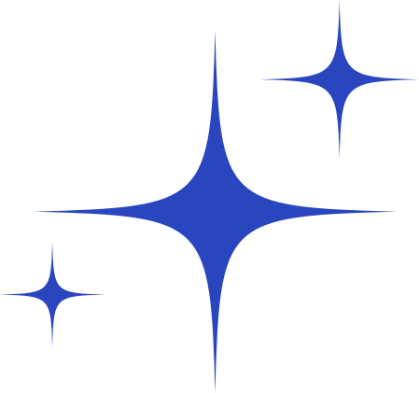




Thank You
CONTACT US
www.blockchainx.tech
contact@blockchainx.tech
+91 7708889555

