Slide 1

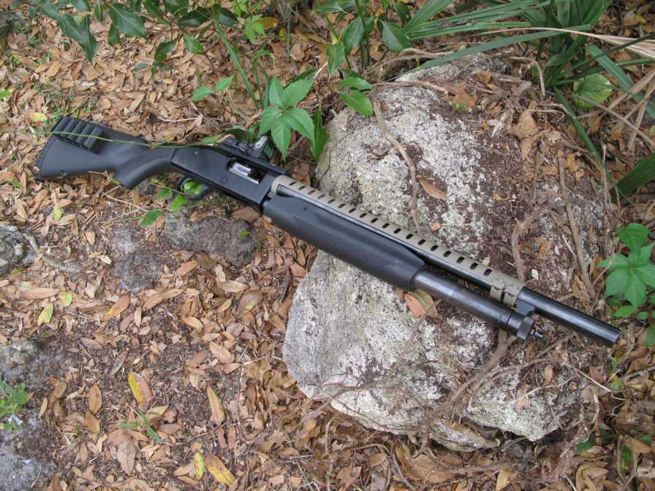

TAC-14 HEAT SHIELD
shockwaveheatshield.com

Slide 2
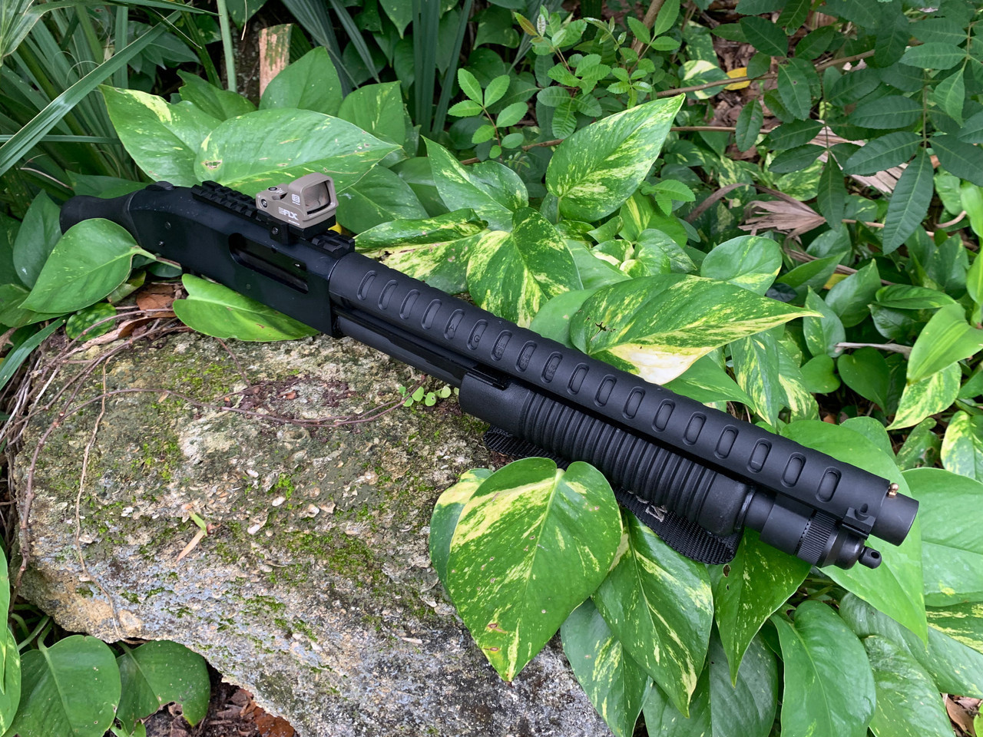

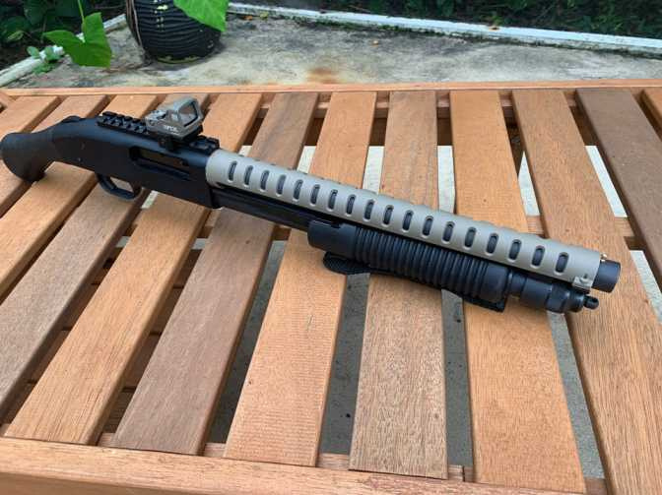

About Us
The Tac-14 heat shield functions as an accessory built specifically for use with Remington 870 Tac-14 and comparable firearms systems. This protective device outwardly situates on the firearm to dissipate heat during long firing events while retaining user control and guarding against burns.
Call to Action
shockwaveheatshield.com

Slide 3
The heat shield available in aluminum or polymer formats attaches to the barrel before extending to cover the handguard region of various firearms. Better handling and safety emerge from this heat dissipation system that uses the shield efficiently. Heat shields deliver both tactical style and functional benefits by improving look with rugged aesthetics while improving how the firearm operates.
Risk Mitigation
shockwaveheatshield.com

Slide 4




CONTACT US
Email
magazinemasters@gmail.com
Website
shockwaveheatshield.com
Location
London, South East, United Kingdom

Slide 5

THANK YOU
shockwaveheatshield.com

