Slide 1

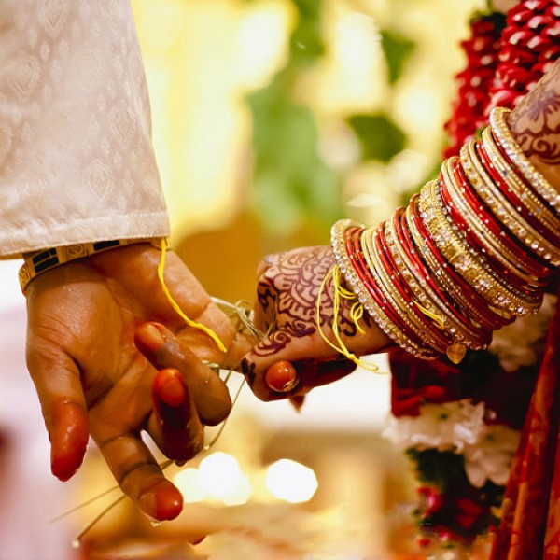
Home
Service
About Us
Contact
IMPERIAL WEDDINGS
TRUSTED MATRIMONIAL SERVICES IN GURGAON
Presented by Imperial Wedding
Website:
https://www.imperial.wedding/matrimonial-services-in-gurgaon

Slide 2

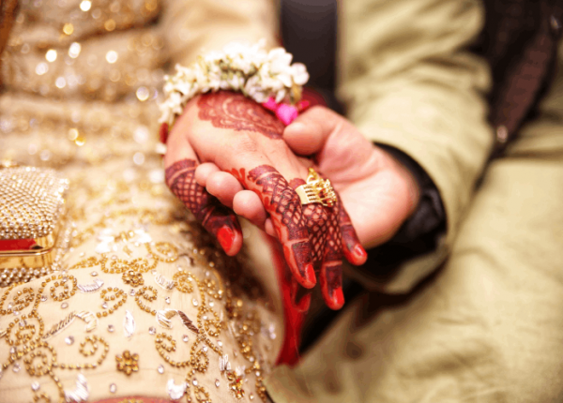

Home
Service
About Us
Contact
About us:-
Why Choose Imperial Weddings?
  Tailored matchmaking services for personalized connections.
  Expert team with years of experience in matrimonial services.
  Focused on finding compatible matches based on your preferences.
  Trusted by hundreds of happy couples in Gurgaon.
Website:
https://www.imperial.wedding/matrimonial-services-in-gurgaon

Slide 3
Home
Service
About Us
Contact
Matrimonial Services in Gurgaon
Imperial Weddings provides the best matrimonial services in Gurgaon, guaranteeing a smooth search for your soulmate. As a reputable name in the industry, Imperial Weddings stands out for its professional expertise, individualized matchmaking, and profound understanding of individual preferences. Our committed team puts a lot of effort into bringing like-minded people together and creating enduring relationships.
Website:
https://www.imperial.wedding/matrimonial-services-in-gurgaon

Slide 4


Home
Service
About Us
Contact
Website: https://www.imperial.wedding/matrimonial-services-in-gurgaon
Thank you For Watching
contact us :
011-40505815 9773525525
117, 1st Floor, NDM-1
Netaji Subhash Place
Pitampura, Delhi-110034
info@imperial.wedding

