Slide 1
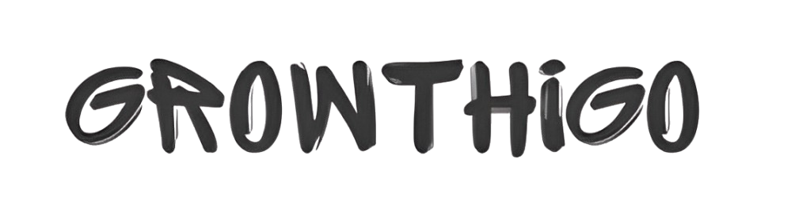
Corporate Gift Ideas for Clients: Building Loyalty and Trust
https://growthigo.com/

Slide 2
Corporation gifts have become an important part of doing business in the current world where competition among companies is increasing. It is not only about making a gift to a client, colleague or a partner; it is also about carving a strategy to make sure that your business is hard to forget. When you want to make a good impression with a new client or indeed when you want to ensure client satisfaction with an already existing customer, then an appropriate gift goes a long way. Here are some suggestion to assist in organizing the categorization process to get you going.
Personalized Gifts
Among promotional tools, gifts can be called one of the most effective that help to leave a lasting impression. Such may include engraved pens or writing set, notebooks with special engravings, or personalized leather writing accessories. Whereas by using the personal approach, you convey to your clients that you appreciate having them on board and you have thought about them.

Slide 3
Eco-Friendly Products
As the aspect of sustainability is gaining crucial importance, gifts which are environmentally friendly are perfect. Some examples include re-usable water bottle, bamboo desk organizer or an eco-friendly hamper. All serve a purpose of making the world a better place to live in and are in tandem with the ideals of many a contemporary organization.
High-Quality Tech Gadgets
Technology related items are liked at all times, more so if its value is felt in our day-to-day lives. Some of them include wireless chargers, portable speakers or even noise cancelling headphones can make an impression. This is where they come in handy; they serve as a way of proving to the clients that you are progressive and interested in improving their realities.

Slide 4
Gourmet Hampers
It is always a good idea to gift food items; you do not need to be told this. Luxury corporate gifts with high quality , wines or other savoury delicacies can always be a plus for any client. The recommendation should be accompanied by a handwritten personal message.
Engage with the corporate gifting companies operating Pune area
If one is a Pune-based company or planning to associate with local talent, it is best to reach out to corporate gifting companies in Pune. These specialists are usually involved in the development of distinctive gift solutions appropriate to your clientele and your company’s image. When you outsource this process, it takes less of your time yet you get the best of what you wanted.
For Employees Too
However, let’s not confuse corporate gift with gifts that are only given to clients as they are for all business associates. No less important is the strengthening of internal relations. The best corporate gifts employees can receive may in include wellness baskets, promotional products and experience gifts such as gift certificates for a spa or for a bungee jumping activity. Corporate gifting for employees create improvement in their morale, loyalty and have a positive impact on their productivity.

Slide 5
Contact us
Curated Selection: Explore a wide variety of corporate gifts designed for clients and employees, offering thoughtful and meaningful selections for every occasion.
Customization Options: Personalize your gifts with branding and messaging options, creating memorable experiences that strengthen client and employee relationships.
https://growthigo.com/
Office No – 703, ANP Landmark, Sr. no. 89, Bhumkar Chowk,Hinjawadi – Wakad Rd, Pune, Maharashtra 411057
Phone : 77092 80369
Email: Bhavesh@growthwayadvertising.com

