Slide 1


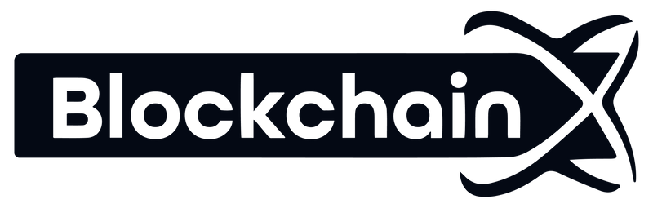
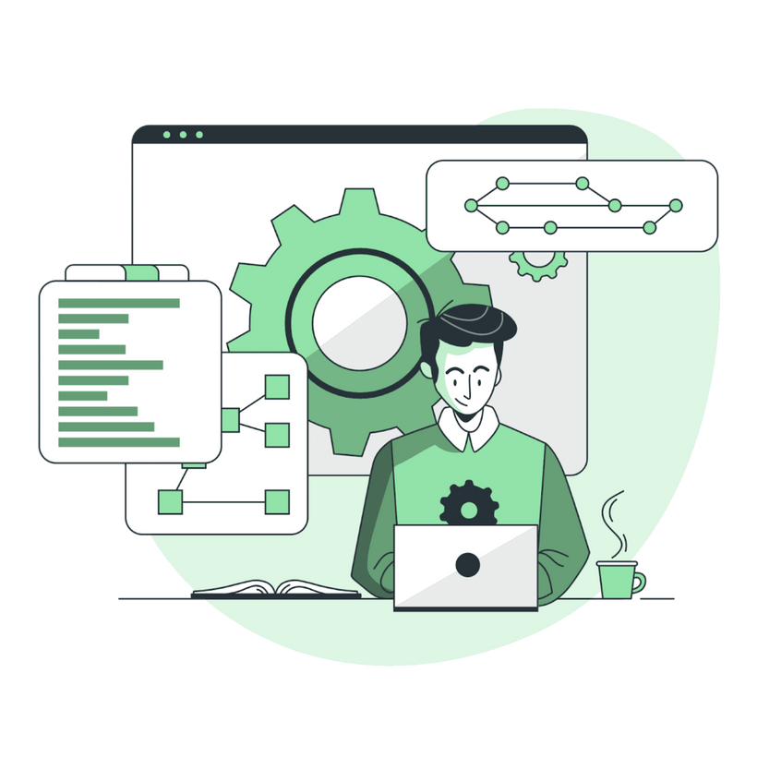


How to Build a Solidity Developer Dream Team for Your Blockchain Startup
www.blockchainx.tech

Slide 2
Founding a blockchain startup is no small task, and a failed success relies heavily on having the right Solidity developers on your team. Its importance is critical in decentralized applications ( dApps, NFT, and DeFi platforms ), since it serves as the backbone for smart contract development and prevents competition. You should Hire Solidity developers who are not just very technically competent, yet also have the capacity to think outside the box." It is through a balanced team like this that you can handle all the twists and turns that blockchain development presents as well as deliver secure, scalable, and efficient solutions. This article shows the breakdown of assembling an effective Solidity developer dream team for your blockchain startup.

Slide 3
Define Your Blockchain Startup's Needs
It is important to have a clear understanding of your project requirements and long-term goals before you start hiring. What sort of blockchain applications are you building? A DeFi platform, NFT marketplace, or something entirely different? Identifying the nature and scope of your project helps you determine the talent that you need. For example, some startups may require a junior or mid level developer to assist with some foundational tasks, while others may need a senior developer to architect and lead complex smart contract development and security audits. This understanding will guide your hiring strategy and ensure that you create a team in line with your vision.

Slide 4
Look for Key Skills in Solidity Developers
When hiring Solidity developers, it is important to find the right balance between technical and soft skills requirements. A good candidate not only learns to write smart contracts efficiently, securely, and optimally but also requires a thorough understanding of deep concepts related to the Ethereum Virtual Machine (EVM), knowledge of the fundamentals of the blockchain, expected token standards for creating tokens such as ERC-20 and ERC-721. Knowledge on frameworks and tools that come along with Solidity like Hard Hat, Truffle, and Ganache is a must, as these tools streamline development and testing processes. Knowledge of DeFi protocols and gas optimization practices together with some security best practices makes sure your project is competitive and resilient. Beyond that, look for problem-solving abilities, adaptability, and strong communication skills in your selected developers to ensure a smooth workflow within the team.

Slide 5
Leverage the Right Hiring Channels
Not all is that awesome as it seems, and to build that dream team you have to use the right channels for hiring, which will get you not only any Solidity talent but the best out there. Not only Toptal, Upwork, or LinkedIn, but also other places where skilled developers with verified profiles and portfolios can be found. Go further than the average recruiting sites to blockchain-specific forums and communities such as GitHub, forums under Ethereum, and Reddit groups where developers can showcase their work and discuss what is going on in the industry. Hackathons, blockchain meetups, and conferences are great places to find enthusiasts who keep up-to-date with the happenings in the industry. This unique space of networking increases the chances of encountering a developer who possesses all the requisite skills and a passion for the blockchain industry.

Slide 6
Create an Effective Hiring Process
When it comes to hiring Solidity developers, detailed and structured procedures should be followed to attract the suitable talent for your projects. Start by writing a detailed job description that states the project goals, technical stack, and expectations clearly. Then be clear about the skills and experience you want, like expertise in Solidity programming, from a DeFi background, or skills in blockchain security audits. Perform technical assessments to evaluate coding skills as well as the use of Solidity strings. Have a problem-solving challenge similar to the real-world scenarios so that you can measure how they would deal with such issues. Following up with interviews will help you assess culture, teamwork capability, and long-term commitment toward the vision of your startup. A streamlined yet rigorous process will make sure that you have the right candidates possible in your project.

Slide 7
Build a Collaborative Work Environment
An awesome team is not only hiring, but it also means creating viability for them to thrive. To keep your Solidity development teams energised and aligned, ensure there is a culture of teamwork and creativity. Employ an agile methodology, be it Scrum or Kanban, to streamline workflow, measure progress, and improve transparency. Make it a point of providing continuous training and resources to ensure that the teams are up-to-date with recent developments in blockchain technology and Solidity development. Promote an open environment within your team so that members feel free to voice their ideas, talk about the issues they face, and learn from one another's experiences. Through collaboration and professional development, you unlock the full capability of your dream Solidity developer team.

Slide 8
Scale Your Team Strategically
Your blockchain startup must grow with your team. The expansion of your Solidity developer team should be equally strategic to ensure efficiency while maintaining quality. First assess existing team strengths, then examine which gaps exist in expertise: If you are flexible enough to use a hybrid method, consider in-house with some freelance or remote experts. For duty specialization, expect senior developers to define and command essential elements, and assign minor repetitive or less complex assignments to junior developers. This way, you will have both the junior staff under the mentorship of senior professionals and optimization of output. Planning how your team is to grow will make it easier for you to create necessary adaptations to demands brought about by the ongoing momentum of projects.

Slide 9
Conclusion
Building a dream team of Solidity developers is essential to the success of your blockchain startup. By clearly defining your project’s needs, leveraging the right hiring channels, and fostering a collaborative culture, you can attract top-tier talent who will bring your vision to life. Whether you’re developing a DeFi platform, NFT marketplace, or dApp, taking a strategic approach to Hire a Solidity development team ensures your project remains innovative, secure, and scalable. With the right team in place, your blockchain startup can thrive in the fast-paced and ever-evolving world of Web3.

Slide 10





Thank You
CONTACT US
www.blockchainx.tech
contact@blockchainx.tech
+91 7708889555

