Slide 1


What is an ICO on blockchain and how can it change the world?

Slide 2
Introduction
Transaction and storage ways have really been reorganized since blockchain technology came into existence. It's set up as a decentralized as well as transparent technology that enables people to trade safely and without intermediaries. It is this pivotal aspect that has led to the rise of the Initial Coin Offerings (ICOs) as a new innovative form of fundraising for projects based on the blockchain.

Slide 3
Introduction
Transaction and storage ways have really been reorganized since blockchain technology came into existence. It's set up as a decentralized as well as transparent technology that enables people to trade safely and without intermediaries. It is this pivotal aspect that has led to the rise of the Initial Coin Offerings (ICOs) as a new innovative form of fundraising for projects based on the blockchain.

Slide 4
ICO (Initial Coin Offering) Overview
An ICO is a fundraising method where a project or company offers its own cryptocurrency or tokens to investors in exchange for funds, typically in the form of established cryptocurrencies like Bitcoin or Ethereum.
  Purpose: Raise capital for a new blockchain project or business.
  Process: Investors purchase tokens during the ICO, often at a discounted price before the project launches.

Slide 5
Importance of ICOs for Blockchain Technology
  Funding Innovation: ICOs provide an alternative, decentralized way to raise capital for blockchain projects, bypassing traditional venture capital and financial institutions.
  Decentralization: Empower creators and users by enabling direct investment in blockchain projects, promoting decentralization of power and control.
  Community Engagement: ICOs allow early adopters to participate in the project’s growth, often giving them governance or utility tokens to influence the future direction.
  Accelerated Development: Immediate access to funds enables rapid development and scaling of blockchain solutions, advancing adoption and innovation in the space.
  Global Accessibility: ICOs provide a global platform for investors to fund projects, creating a more inclusive and international blockchain ecosystem.

Slide 6
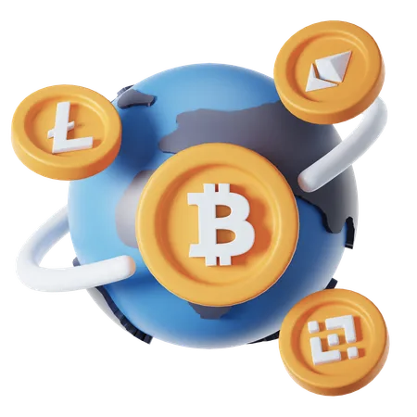
How ICOs Can Change the World
  Democratizing Investment
  Disrupting Traditional Finance
  Enabling Decentralized Innovation
  Empowering Global Communities
  Driving Economic Inclusion

Slide 7
Top 5 Successful ICO Examples in Blockchain
Ethereum (ETH)
  Launch: 2014
  Fund Raised: $18 million
  Impact: Created the first decentralized smart contract platform, revolutionizing blockchain development.
Tezos (XTZ)
  Launch: 2017
  Fund Raised: $232 million
  Impact: Introduced on-chain governance and self-amending blockchain, enabling more democratic decision-making.

Slide 8
Filecoin (FIL)
  Launch: 2017
  Fund Raised: $257 million
  Impact: Developed a decentralized storage network, transforming data storage and accessibility.
EOS (EOS)
  Launch: 2017
  Fund Raised: $4.2 billion
  Impact: Aimed to create a scalable, high-performance blockchain for decentralized applications (dApps).
Polkadot (DOT)
  Launch: 2017
  Fund Raised: $145 million
  Impact: Introduced a multi-chain framework for interoperability among different blockchains.

Slide 9
ICO Regulations & Legal Framework
  Lack of Universal Regulation: ICOs are subject to varying regulations across countries, with some jurisdictions offering clearer frameworks than others.
  Securities Laws: In many countries (e.g., U.S., EU), ICO tokens can be classified as securities, requiring compliance with securities laws, such as registration with regulatory bodies (e.g., SEC in the U.S.).
  AML & KYC: Increasingly, ICOs are required to follow Anti-Money Laundering (AML) and Know Your Customer (KYC) procedures to prevent fraud and money laundering.
  Consumer Protection: Many countries have introduced or are developing laws to protect investors from fraud, scams, or misleading information in ICO projects.
  Global Variance: Countries like China and India have banned or heavily regulated ICOs, while others (e.g., Switzerland, Singapore) have created more supportive environments with clearer guidelines.

Slide 10

Future of ICOs on Blockchain
  Increased Regulation
  Security & Compliance
  Focus on Utility & Value
  Integration with DeFi
  Fractionalization & Tokenization
  DAO-Based Funding

Slide 11
What can we expect from ICOs in the future?
In simple terms, blockchain ICOs form a new means to finance blockchain projects where entrepreneurs and developers can get direct funds rather than involving traditional investors or financiers to realize their ideas and projects.
In fact, ICOs are capable of becoming transformative by propagating the fragmented, new economic order and offering new destinations of investment and integrating funding voids. However, ICOs also pose inherent risks to both investors as well as projects.
Regulations on ICOs are expected to be developed in the future that would put more confidence in investors and less risks associated with investment in blockchain-based projects

Slide 12
conclusion
In conclusion, much is expected from ICOs in nurturing the development and utilization of blockchain technology to the comes-out of industries such that they would continue to become some innovative way for funding projects-switching altogether in the future.

Slide 13

Contact Us
7708889555
contact@blockchainx.tech
https://www.blockchainx.tech/

