Slide 1
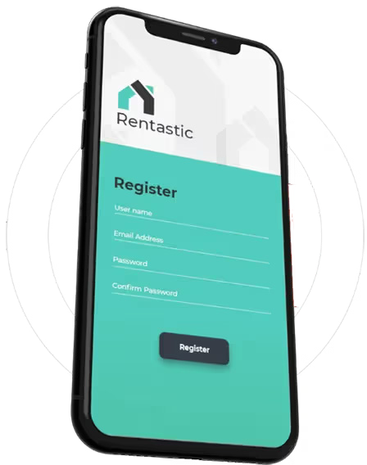


ACCOUNTING SOFTWARE
https://www.rentastic.io

Slide 2
ABOUT US
Rentastic started out as many other business ideas typically do -- usually attempting to solve or cure a problem, due to frustration. Rentastic is built for real estate investors, BY real estate investors. The creators of Rentastic own multiple rental properties. As most investors soon come to find, accounting for all the different income and expenses can be a nightmare -- especially come tax time. While there are lots of different types of accounting software out there, too many attempt to be the end-all, be-all for every type of business. Frustrated with the limited options, or the complexity and pricing of current options, the idea for Rentastic was born. Rentastic aims to be a super-simple, easy-to-use accounting software for all your rental properties -- and it's designed to do only that. No bells, no whistles, just straight to the point. Rentastic literally wouldn't be possible without you, and because of that, we constantly want to improve to make the product better. If there's anything you'd like to see, please be sure to submit a feature request. https://www.rentastic.io

Slide 3



Businesses need
to be precise, agile, and efficient in today’s
technologically advanced and fast-paced environment to remain competitive. Every successful business relies heavily on financial management, which can no longer be done by hand. This is where accounting software enters the picture, revolutionizing the way businesses manage their money. This blog explores the benefits of accounting software, why it is necessary for modern firms, and how adopting this technology is crucial for long-term viability and success.
Accounting Software’s Function in Contemporary
Companies
Accounting software is a comprehensive system made to guarantee compliance, expedite financial procedures, and offer insightful data. It is not just a tool for recording income and expenses. Making use of modern technology is essential for success, regardless of the size of
your company.
Essential Elements of Accounting Software
Automated Financial Tracking: Real-time tracking of income, expenses, invoices, and payments is possible with automated financial
tracking.
https://www.rentastic.io

Slide 4

Tax Compliance: Makes tax computations easier and guarantees that
rules are followed.
Financial Reporting: Detailed reports are produced by financial
reporting to aid in decision-making.
Payroll management: Automates employee payment procedures and
salary computations.
Inventory Management: Inventory management involves keeping track of stock levels and combining them with financial information.
Accounting by hand takes a lot of time and is prone to human mistakes. Accounting software allows companies
to:
Automate Routine Tasks: Tasks such as data entry, bank reconciliation, and invoicing are managed automatically.
Boost Precision: Minimize computation and data entry errors to
guarantee accurate financial records.
Save Time: Make time for important business-related tasks.
https://www.rentastic.io

Slide 5

FOLLOW US
https://www.facebook.com/rentasticsoftware https://twitter.com/rentastic_ai https://www.instagram.com/rentastic_ai https://www.youtube.com/@rentastic_ai

Slide 6
CONTACT US
https://www.rentastic.io

Slide 7
THANK YOU
https://www.rentastic.io

