Slide 1



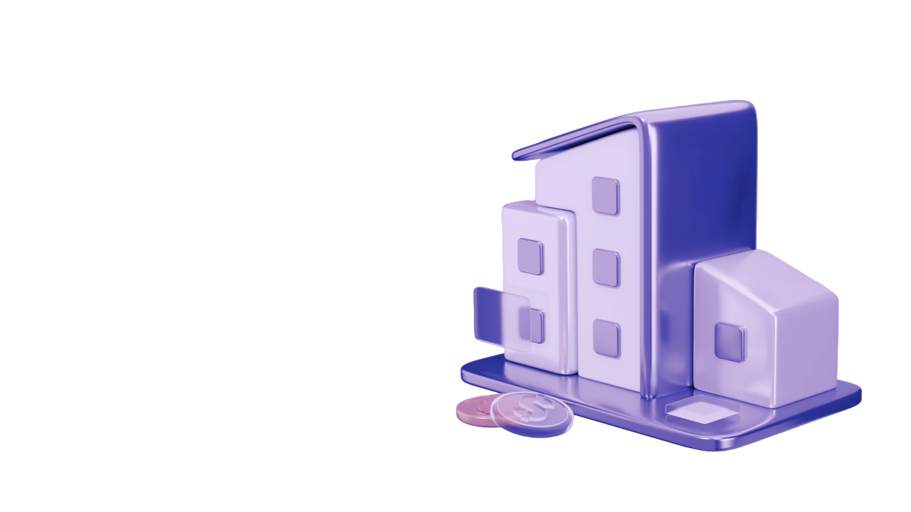
A GUIDE TO REAL-WORLD ASSET OPPORTUNITIES IN 2024
www.blockchainx.tech

Slide 2
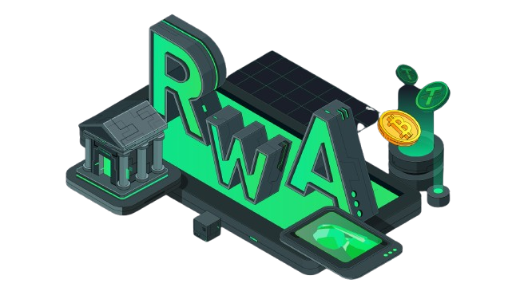
With the changing financial paradigms, tokenization as an idea has changed the perspective of ownership and investments. In the year 2024, there is a significant potential for the tokenization of real-world assets whereby many investors will be able to spread their investment avenues and tread into hitherto unavailable markets. This guide lays out the different types of real-world asset opportunities available in the tokenization sphere and how investors can also take advantage of such developments.

Slide 3
Understanding Real-World Asset Tokenization
The tokenization of a real-world asset is the process of issuing a blockchain-based cryptographic representation of a physical asset like real estate, commodity or even objects of art. Each token issued corresponds to a portion of the underlying asset which enables prospective buyers to purchase or trade parts of assets with ease. This broadens the scope for such investment opportunities by making it less costly in the first place, and also adding an element of speed to the entire process. Due to this reason, this investment strategy is appealing to a wide spectrum of investors. As such, this Real World Asset Tokenization Guide presents how this approach is revolutionizing investment endeavors.

Slide 4
1. Real Estate Investment Opportunities
For ages, real estate has been one of the most preferred asset classes, although in most cases, the traditional ways of making investments tend to take a lot of capital. The introduction of tokenization addresses this issue in several ways:
  The Possibilities of Fractional Ownership : For example, companies such as RealT and Fundrise allow people to buy portions in real estate properties and earn rent and property value increase without the whole property purchase.
  Access to Investments in Different Geographies: Tokenization also opens doors to commercial real estate, residential properties within different countries, and other asset classes, hence expanding the scope of investment.
  Liquidity Solutions: Real estate that has been tokenized may, unlike traditional real estate investment, be sold in the secondary market, enabling increased liquidity for investors.

Slide 5
2. Fine Art and Collectibles
Traditionally, the art market has proven to be complex and has high initial investment requirements coupled with illiquidity. Tokenization nexus brings something new to the existing shambles.
  Art Investment Platforms: Masterworks and similar companies give investors the opportunity to purchase fractional ownership of extremely valuable works of art, facilitating access to the previously purely white collar market.
  Tokenization of Collectibles: Even in the case of Currence, however, it seems that globalization plays a dominant role over technology as it is hard to collect vintage cars in every single country. It is also possible to invest via CurioInvest and buy fractions of expensive vintage cars or sports collectibles.
  Improved Markets: Ownership rights history is recorded in the blockchain thereby enhancing the context of art and collectibles markets by their trustworthiness.

Slide 6
3. Commodities and Natural Resources
The concept of tokenization is starting to penetrate the commodities market in a way that introduces exciting new investment prospects:
  Fractional Commodities: By tokenizing assets like gold, silver, and oil, it becomes easier for retail investors to trade in these commodities and therefore such assets can be doctored into smaller usable portions for ease of trade.
  Green Investments: Electrical vehicles tend to be costly but their components such as batteries can be leased out as an example of tokenized asset within that vehicle’s lifecycle that might be attractive to investors seeking returns in addition to help with the environment.
  Streamlined Exchanging: There is also the possibility of selling the same digital tokens on blockchain systems and it will shorten the time taken for commodity transactions and it will remove in a way the difficulties presented in the many commodity trading systems.

Slide 7
4. Intellectual Property and Digital Assets
With the growing advancements of the third space, there is increasing prospects of investing in intellectual property (IP) through tokenization of the intellectual property:
  Creation of IP Rights Token: in this phase creators can create a token of their IP rights so that investors can buy parts of patents, trademarks, and copyrights. This provides alternative sources of financing for the creators and gives investors an interest in profitable assets.
  Digital collectibles: With the development of non-fungible tokens (NFT), the popularity of digital collectibles has spread far and wide. Through it, producers and content creators can now offer one of a kind images in digital form, making it possible for all investors to invest in this new trend.

Slide 8
5. Private Equity and Startup Investments
Tokenization is changing the picture in private equity and startup investment by enhancing accessibility and liquidity for all:
  Fractional Shares in Startups: For instance, republic and seed-invest provides the opportunity for company shares to be complemented with tokens in young and emerging organizations making it possible to engage in investment conducting risk capital in cutting-edge companies which before was available to other accredited investors only.
  Enhanced Liquidity: Such investment vehicles as tokenized private equity funds, give an opportunity for investment liquidity via secondary markets, where investors can easily enter and exit their positions in such investment fund buyouts as unlike traditional private equity investment.

Slide 9
Conclusion
As 2024 arrives upon us, asset tokenization is the catalyst for providing ample investment opportunities in diverse industries. Investing in the partial ownership of valuable assets is transforming the way investments are made, in such sectors as real estate and arts, commodities, and intellectual property. Any investor today cannot miss out on such promising chances knowing that there is a technology, that of tokenization, that can aid in portfolio diversification and liquidity enhancement. On top of that, an exploration of the Top Real World Asset Tokenization Companies can bring profound knowledge as well as innovative investment platforms. However, as in any other investment, it is fundamental to conduct a proper analysis and comprehension of the dangers involved. For the time being, it is sufficient to say that it is possible to increase one’s chances of going through this market successfully by keeping abreast of current developments and maximally utilizing the trend of real world assets being tokenized.

Slide 10

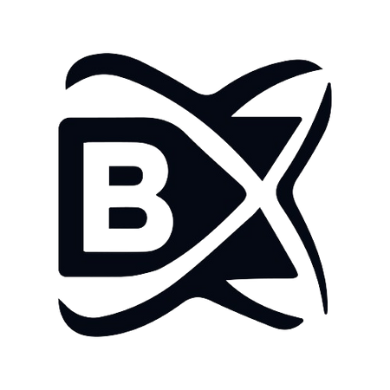


THANK YOU
CONTACT US
www.blockchainx.tech
+91 7708889555
contact@blockchainx.tech

