Slide 1
Exploring the Landscape of IB Schools in Pune: Opportunities and Challenges

Slide 2
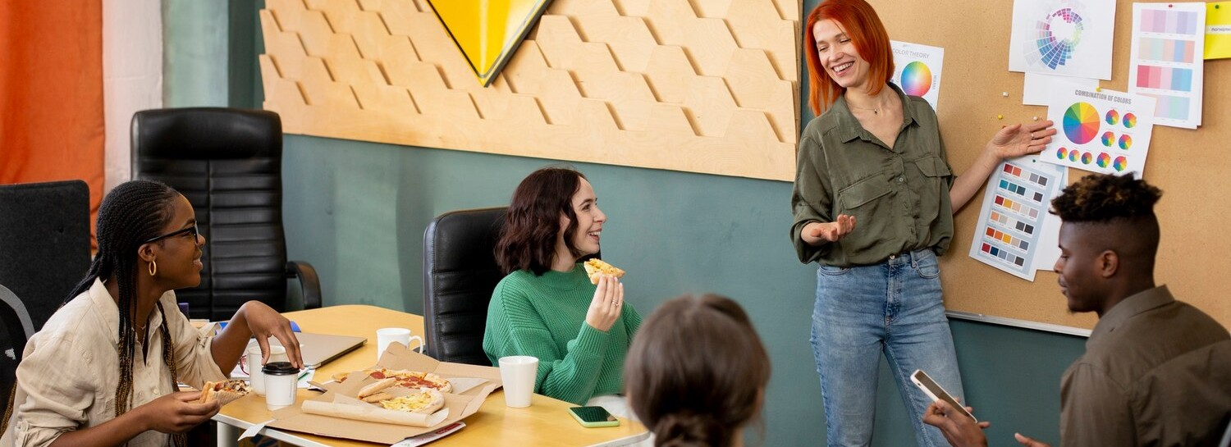
Introduction to IB Schools
The International Baccalaureate (IB) program offers a globally recognized education framework. In Pune, the rise of IB schools presents both opportunities and challenges for students and educators alike. This presentation will explore these dynamics, highlighting the unique aspects of the IB landscape in Pune.

Slide 3
Opportunities for Students
IB schools in Pune provide students with a holistic education that emphasizes critical thinking and global awareness.
The curriculum encourages students to
explore their interests and develop skills necessary for success in a rapidly changing world, preparing them for higher education and beyond.

Slide 4
Quality of Education
The IB curriculum is known for its rigorous standards and emphasis on international- mindedness. Schools in Pune are increasingly adopting these standards, aiming to provide a high-quality education that fosters academic excellence and prepares students to thrive in a global context.

Slide 5
Challenges Faced by Schools
Despite the advantages, IB schools in Pune face several challenges including high tuition fees, limited resources, and the need for well-trained educators.
These factors can impact accessibility and the overall effectiveness of the IB program, posing questions about its sustainability in the region.

Slide 6
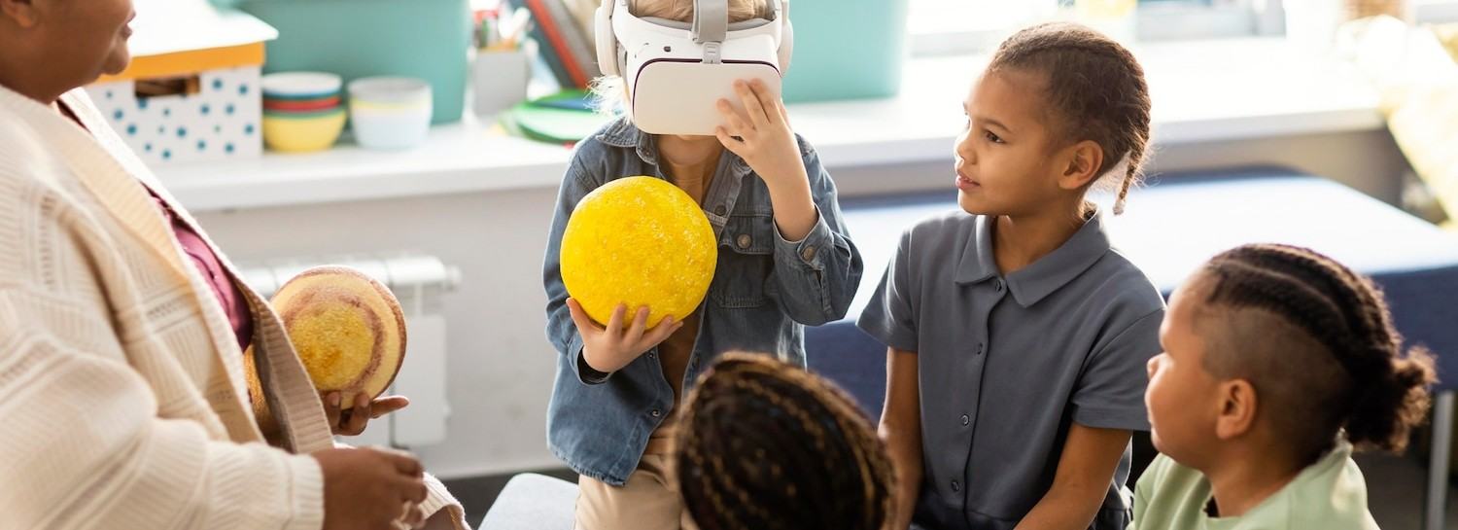
Community Engagement
Building a strong community around IB schools is essential for their success. Engaging parents, local organizations, and alumni can enhance the educational experience and provide vital support systems. Collaborative efforts can lead to a more robust IB ecosystem in Pune.

Slide 7
Conclusion and Future Outlook
The landscape of IB schools in Pune is evolving, presenting both opportunities and challenges. By addressing these challenges and fostering community engagement, IB schools can enhance their impact and continue to provide valuable educational experiences for future generations.

Slide 8
Thanks!

