Slide 1

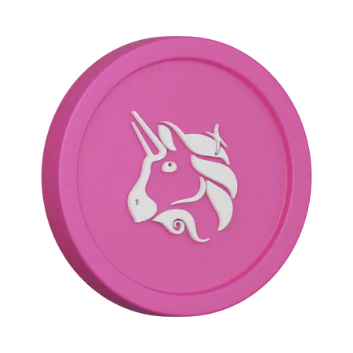


Uniswap clone script- Explain
www.blockchainx.tech

Slide 2

What is Uniswap script
  A Uniswap Clone Script is an instant, adjustable programming arrangement that recreates the center functionalities of Uniswap, the main decentralized trade (DEX) on the Ethereum blockchain.
  It permits organizations to rapidly send off their own DEX stage with highlights like liquidity pools, robotized token trades, and administration.
  Based on blockchain innovation, it upholds ERC20 tokens and can be custom-made with extra highlights like marking and yield cultivating. A Uniswap clone script lessens improvement time, making it simpler to enter the DeFi space.

Slide 3
What is Uniswap script
  A Uniswap Clone Script is an instant, adjustable programming arrangement that recreates the center functionalities of Uniswap, the main decentralized trade (DEX) on the Ethereum blockchain.
  It permits organizations to rapidly send off their own DEX stage with highlights like liquidity pools, robotized token trades, and administration.
  Based on blockchain innovation, it upholds ERC20 tokens and can be custom-made with extra highlights like marking and yield cultivating. A Uniswap clone script lessens improvement time, making it simpler to enter the DeFi space.

Slide 4

How to Develop a DeFi Exchange Like Uniswap?
Market Research
Choose a Blockchain
Smart Contract Development
User Interface Design
Liquidity Provision
Testing and Deployment

Slide 5
How Does Uniswap Clone Script Work?
  The Uniswap Clone Script functions by way of replicating the center mechanisms of the real Uniswap decentralized change. It makes use of automated clever contracts to facilitate seamless token swaps between customers without the need for intermediaries.
  When users exchange tokens, liquidity pools—funded through other users—offer the vital liquidity. The script employs an Automated Market Maker (AMM) model, figuring out token fees based totally on the ratio of tokens inside the swimming pools. Additionally, customers can earn rewards by way of providing liquidity, and the platform frequently consists of governance capabilities, permitting users to participate in decision-making.
  This structure promotes a decentralized buying and selling surroundings that complements client autonomy.

Slide 6

Features of our Uniswap Clone Script
Automated Market Maker (AMM)
Liquidity Pools
Governance Tokens
User-Friendly Interface
ERC-20/BEP-20 Support
Customizability
Back to Agenda

Slide 7





Pancake clone script
BlockchainX Provide Popular Defi Exchange Clone Scripts
Uniswap clone script
Bakeryswap clone script
Sushiswap clone script
Justswap clone script

Slide 8


Thank you
Contact@blockchainx.tech

